Slide 1



11 MORE LGBTQ+ Facts From AR History
Notes:
Did you know that the CALS EOA has many entries on LGBTQ+ issues, celebrities, laws, books, and more?

Slide 2
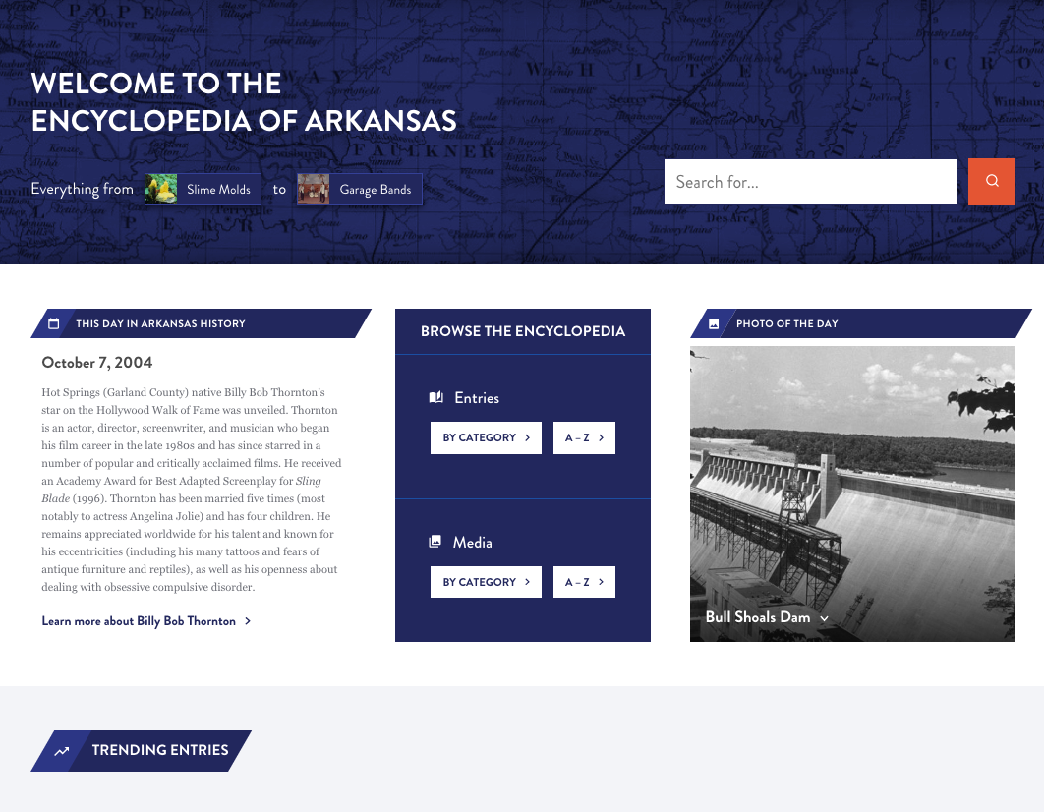
Notes:
The Encyclopedia of Arkansas launched in 2006 with 700 entries and 900 pieces of media.
In 2019 we switched platforms from the original proprietary site to a newly designed WordPress site.
And then in August 2022 we undertook a further redesign of the homepage, search function, and user experience features.
You can stop by the EOA for tidbits like THIS DAY IN ARKANSAS HISTORY and PHOTO OF THE DAY...
As well as trending entries and or to see what's been newly updated. (And here's a hint, we are updating all the time.)

Slide 3
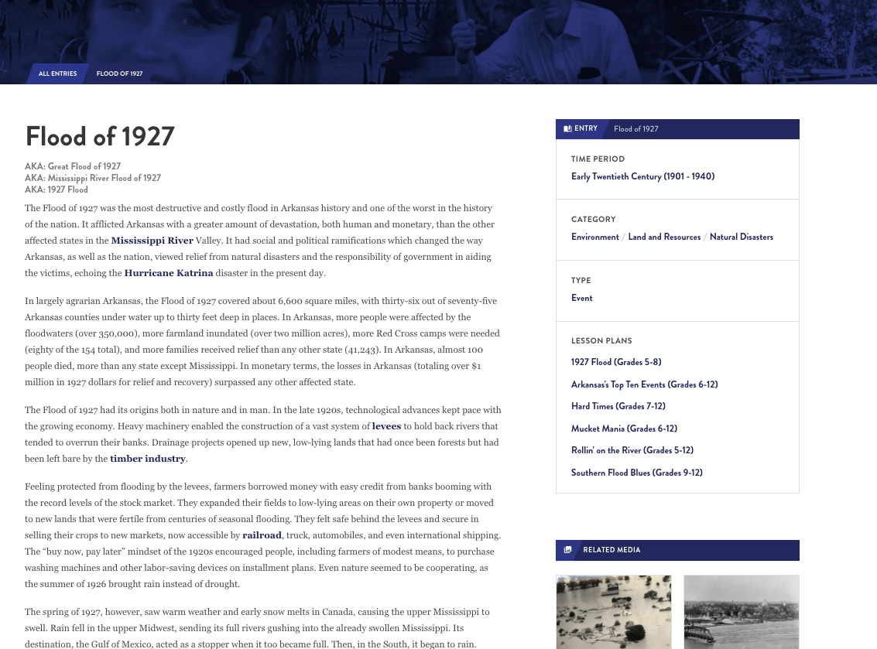
≈7,600
entries
Notes:
We currently have about 7,600 entries online.
We are often compared to Wikipedia but we are not crowd-edited.
All our content is peer-reviewed and staff edited. That means you can use the CALS EOA knowing it has the same accuracy and legitimacy as a published book or article.
Anyone can write for the EOA but all entries are reviewed by other scholars, fact checked, and edited for grammar and spelling.

Slide 4
  EVERY incorporated community
  Government officials
  Civil rights organizations from NAACP to CLOB
  EVERY military action including the smallest skirmishes
  Wildlife, flowers, plants
Notes:
WE HAVE ENTRIES ON ...
Every incorporated community and hundreds of unincorporated ones, and are always seeking more.
ENTRIES ON
Government officials, from those who served in Congress, to Arkansas constitutional officers, to individual state legislators, and even significant sheriffs, mayors, and county judges.
Civil rights organizations from the national level, such as the NAACP, to the local level, such as CLOB (Council for Liberation of Blacks).
Military events from the Civil War, ranging from major battles (Pea Ridge) down to small local skirmishes; if someone in blue and someone in gray met in the woods between 1861 and 1865 we probably have an entry documenting it.
AND THE NATURAL ENVIRONMENT - birds, fish, mammals, reptiles, and insects but also fungi, lichens, ferns, jellyfishes, slime molds YOU NAME IT!
AND WE ARE ALWAYS DEVELOPING MORE...
Developing entries on every film set or filmed in Arkansas, as well as every book, television show, and even individual episodes set in the state (Search: X-Files).

Slide 5
Produced by a public library
Users in 230 countries
EVERY continent
Notes:
We are unique in that we are produced by a public library.
Our site is used by government agencies and officials, students, media, genealogists, journalists, historians (local and national).
Users have come from every continent (including Antarctica) and more than 230 countries.
This year so far we've averaged approximately 194,000 users per month.

Slide 6
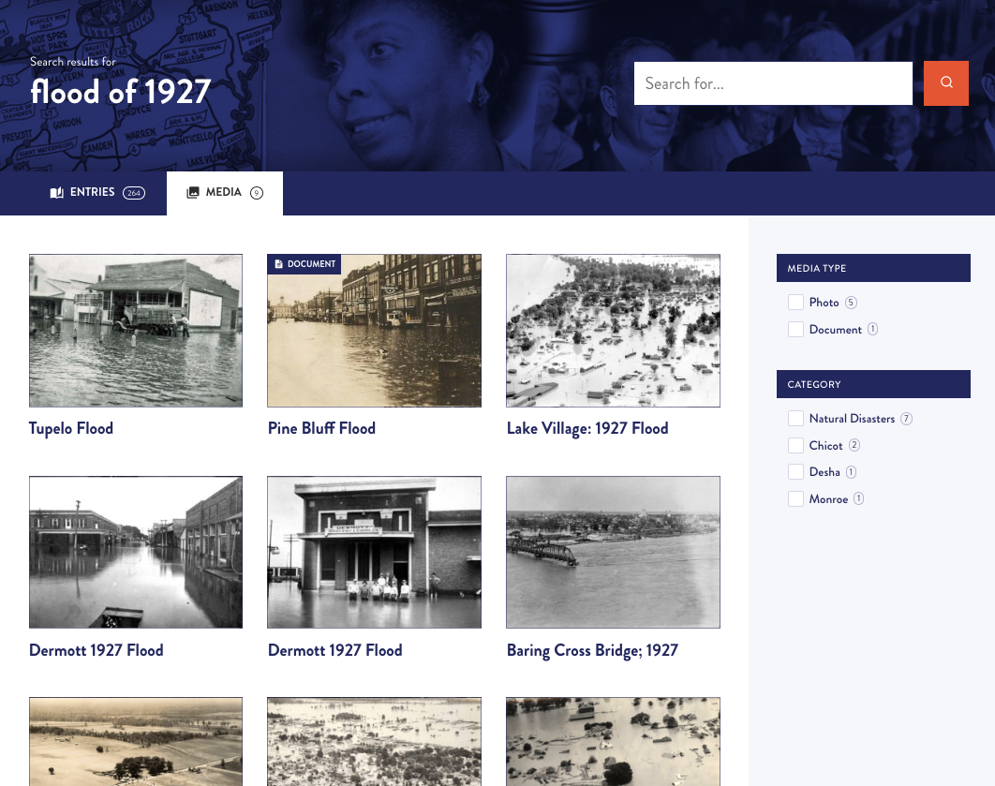
≈17,000
media
Notes:
AND DO WE HAVE MEDIA...
We currently have about 17,000 pieces of media published on the site.
We have worked with archives, libraries, museums, and universities around the state and the country to make sure that the EOA has visual images to illustrate our entries.
BUT THERE IS ALWAYS MORE TO FIND...
We accept submissions from everyday citizens of any photos you've taken we can pair with an entry. For example we love photos of water towers from small towns.

Slide 7
11 MORE LGBTQ+ Facts From AR History

Slide 8
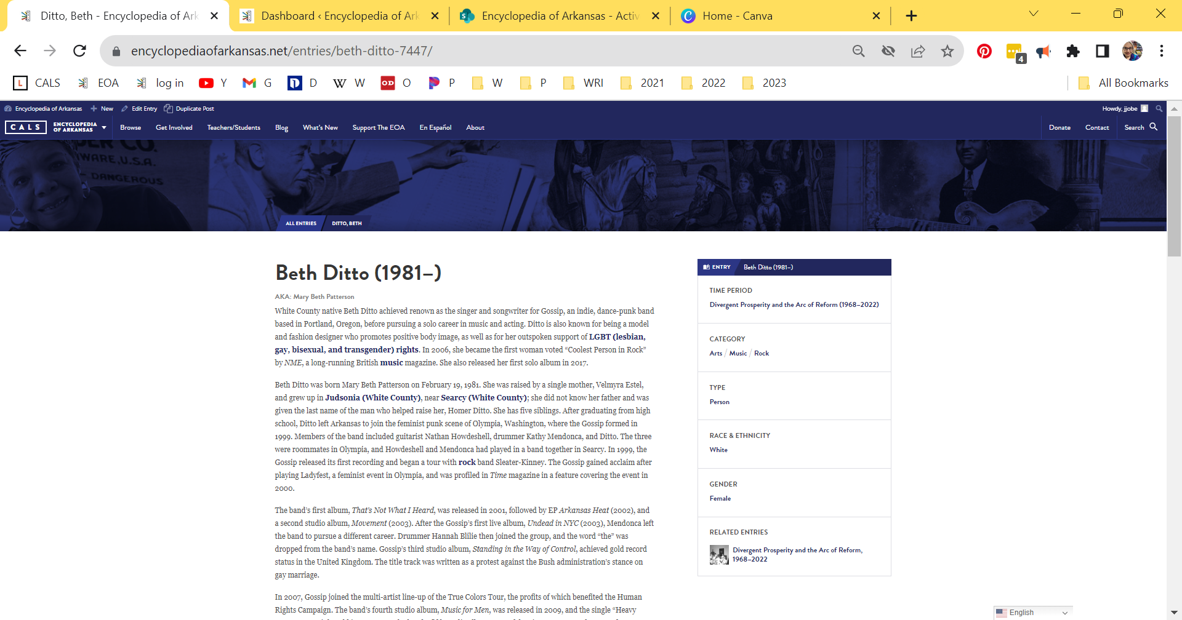
Notes:
Item 1
Beth Ditto (1981–)
Beth Ditto has referred to herself as a “fat, feminist lesbian from Arkansas.”

Slide 9

Notes:
White County native Beth Ditto, born Mary Beth Patterson in 1981, achieved renown as the singer and songwriter for Gossip, an indie, dance-punk band based in Portland, Oregon, before pursuing a solo career in music and acting. Ditto is also known for being a model and fashion designer who promotes positive body image, as well as for her outspoken support of LGBTQ+ rights.
Of her early music career, she stated, “We were radical feminist queers. No one’s goal was to become famous. Our goal was to pay our rent.” Even so, they did indeed become famous.
Gossip’s third studio album, Standing in the Way of Control, achieved gold record status in the United Kingdom. The title track was written as a protest against the Bush administration’s stance on gay marriage.
In 2006, Ditto became the first woman voted “Coolest Person in Rock” by NME, a long-running British music magazine.
In 2007, Gossip joined the multi-artist line-up of the True Colors Tour, the profits of which benefited the Human Rights Campaign.
From April 2007 to April 2008, Ditto contributed an advice column to The Guardian, titled, “What Would Beth Ditto Do?”

Slide 10

Notes:
The band’s fourth studio album, Music for Men, was released in 2009, and the single “Heavy Cross” went triple gold in Germany.
Ditto’s weight has garnered much media attention, and she promotes positive body image and has been featured nude on the cover of several magazines, including NME and Love. In October 2010, she modeled for designer Jean Paul Gaultier’s spring 2011 fashion show during Paris Fashion Week.
In 2011, Ditto released the EP Beth Ditto. The band released a fifth studio album in 2012, the same year Ditto’s memoir, Coal to Diamonds, was published. In this memoir, Ditto speaks out against racism, homophobia, and fatphobia, while also exposing the male privilege and sexism that permitted the rampant multigenerational sexual abuse in her family.
Ditto married longtime girlfriend Kristin Ogata in Maui, Hawaii, in July 2013; they divorced in 2018. Ditto split from Gossip to pursue her solo career in 2016 and released her first solo album in 2017.
Ditto resides in Portland, Oregon where she teaches at Rock ‘n’ Roll Camp for Girls, a program designed to empower young musicians.
She was featured in various acting roles in 2014, 2016, 2018, 2019, 2021, and 2022.
In an interview in the fall 2022 issue of Bust magazine, Ditto opened up about her current relationship with transgender musician Teddy Kwo and about how Gossip reunited in 2019 for a series of European shows before the COVID-19 pandemic. She mentioned a forthcoming Gossip album.

Slide 11
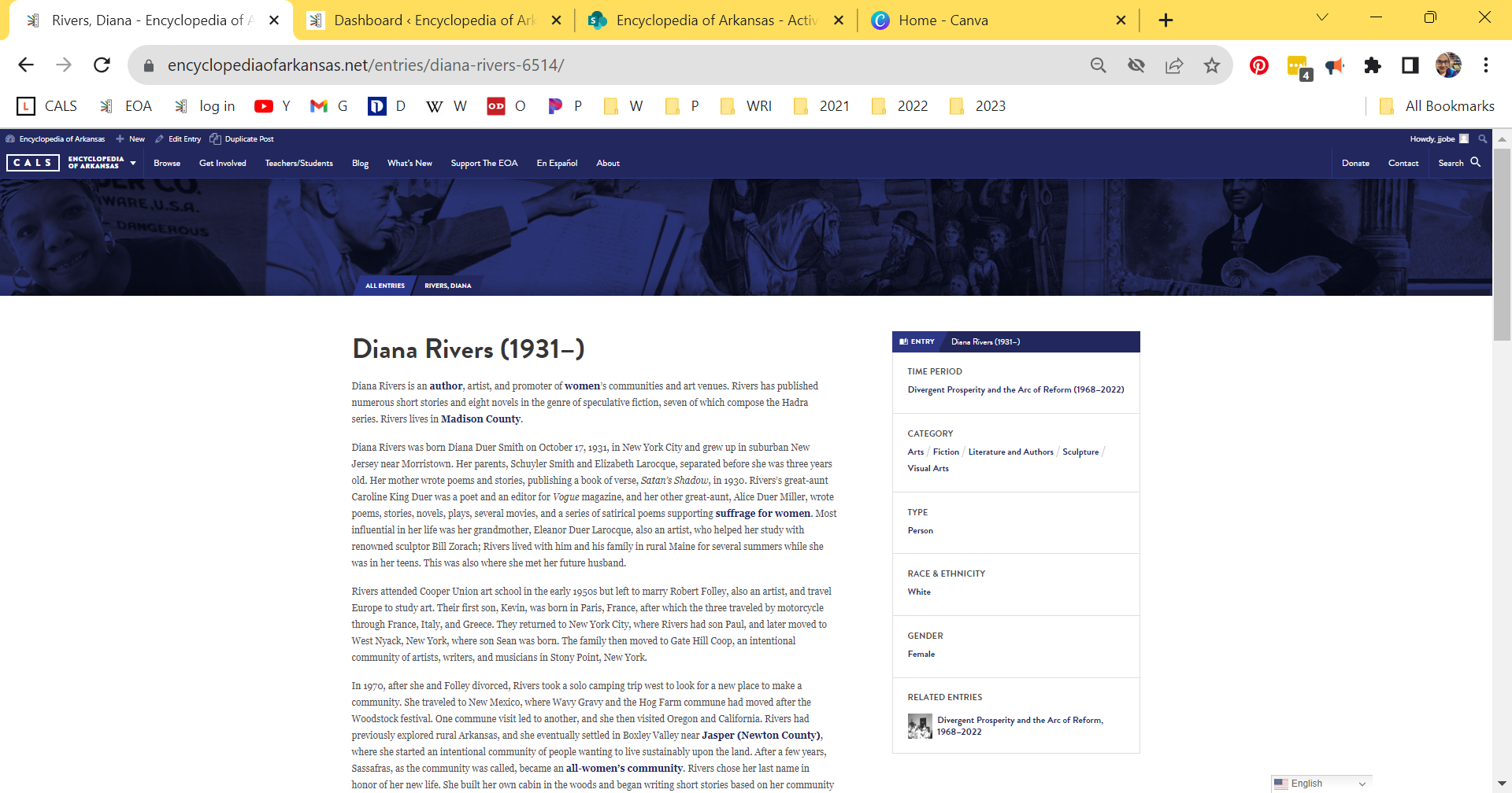
Notes:
Item 2
Diana Rivers (1931–)
Diana Rivers is an author, artist, and promoter of women’s communities and art venues. Rivers has published numerous short stories and eight novels in the genre of speculative fiction, seven of which compose the Hadra series. Rivers lives in Madison County.

Slide 12

Notes:
Diana Rivers was born Diana Duer Smith. Many of the women in her family were writers and artists.
After having a son and getting divorced, Rivers eventually settled in Boxley Valley near Jasper (Newton County), where she started an intentional community. After a few years, Sassafras, as the community was called, became an all-women’s community. Rivers chose her last name in honor of her new life. She built her own cabin in the woods and began writing short stories based on her community experiences. She published these stories in magazines such as Sinister Wisdom, Feminary, Conditions, and Common Lives/Lesbian Lives. This was also where she wrote her first novel.
Rivers left Sassafras in 1980, wanting to start an intentional women’s land community closer to Fayetteville (Washington County). With nineteen other women, the Ozark Land Holding Association was created on several hundred acres and remained an active community in the twenty-first century.
Rivers published her first novel in the Hadra book series, Journey to Zelindar (Lace Publication), in 1987. The main theme running through these novels is love and conflict between women as they struggle to create community and an alternative way of life in the face of patriarchal oppression.
Rivers is a Pagan and an ardent lesbian-feminist involved in supporting gay rights issues as well as advocating for peace, racial equality, social justice, and ecology. She was particularly active in opposing and demonstrating against the Vietnam War and the Iraq War. Fayetteville’s OMNI Center for Peace, Justice & Ecology acknowledged Rivers as one of the Arkansas Peace and Justice Heroes in 2005. Rivers is also an amateur naturalist.
Rivers designed her own house and helped the all-women crew to build it. Her life partner lives in her own house nearby.

Slide 13
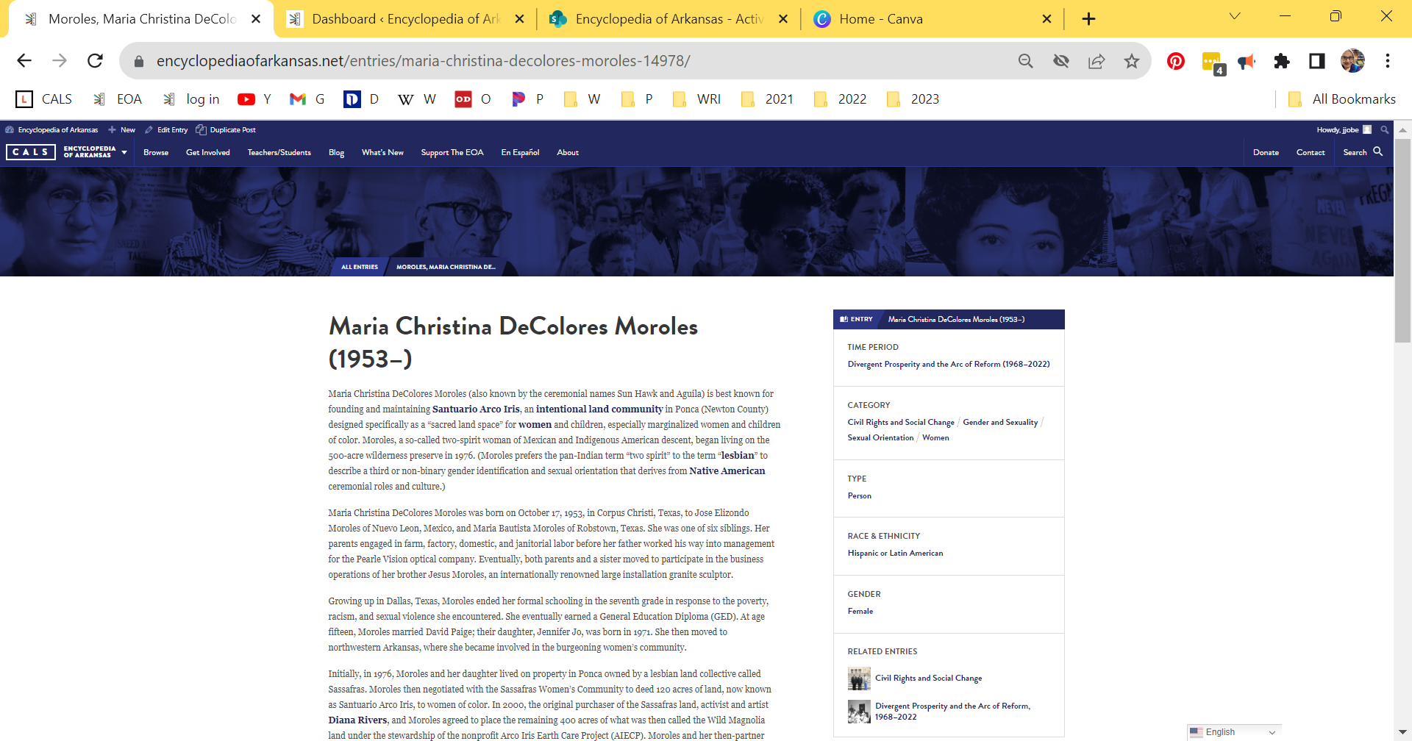
Notes:
Item 3
Maria Christina DeColores Moroles (1953–)
Maria Christina DeColores Moroles (also known by the ceremonial names Sun Hawk and Aguila) is best known for founding and maintaining Santuario Arco Iris, an intentional land community in Ponca (Newton County) designed specifically as a “sacred land space” for women and children, especially marginalized women and children of color. Moroles, a so-called two-spirit woman of Mexican and Indigenous American descent, began living on the 500-acre wilderness preserve in 1976. (Moroles prefers the pan-Indian term “two spirit” to the term “lesbian” to describe a third or non-binary gender identification and sexual orientation that derives from Native American ceremonial roles and culture.)

Slide 14
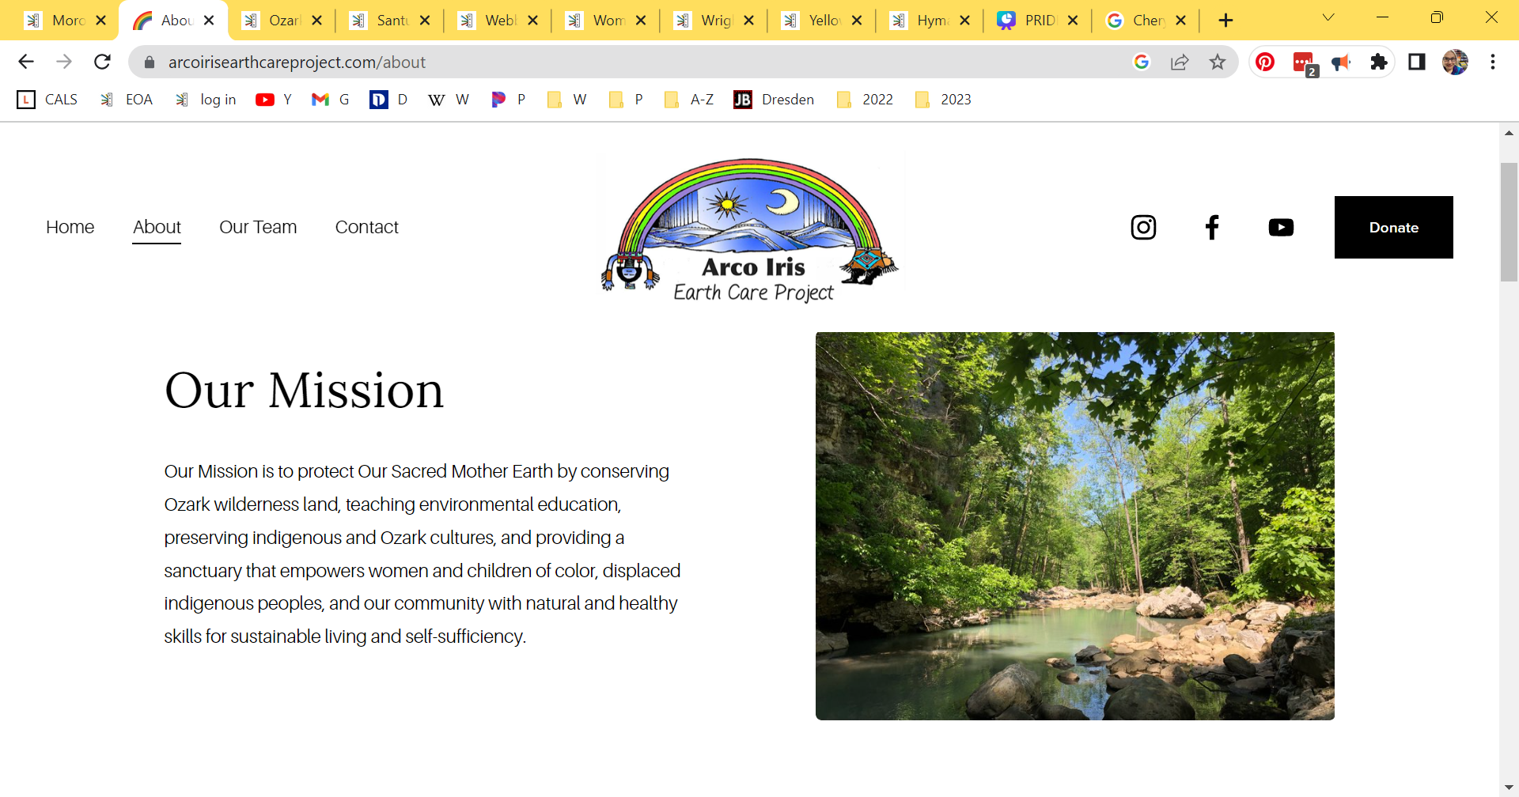
Notes:
At age fifteen, Moroles married David Paige; their daughter, Jennifer Jo, was born in 1971. She then moved to northwestern Arkansas, where she became involved in the burgeoning women’s community.
Initially, in 1976, Moroles and her daughter lived on property in Ponca owned by a lesbian land collective called Sassafras. Moroles then negotiated with the Sassafras Women’s Community to deed 120 acres of land, now known as Santuario Arco Iris, to women of color. In 2000, the original purchaser of the Sassafras land, activist and artist Diana Rivers, and Moroles agreed to place the remaining 400 acres of what was then called the Wild Magnolia land under the stewardship of the nonprofit Arco Iris Earth Care Project (AIECP). Moroles and her then-partner Miguela Borges reared a second child, Mario, born in 1988, on the land.
The signal contribution that Moroles has made to the people and history of Arkansas over four decades has been her commitment to living on and preserving the 500-acre wilderness preserve in the Ozarks, which includes both Santuario Arco Iris and the AIECP. Through this commitment, Moroles has provided a safe place of retreat for women and children of color from Arkansas and beyond, offered an array of natural healing treatments to all who requested them, and served as the “matriarchal steward” of an intentional community devoted to Indigenous American, ecofeminist, and anti-racist principles.

Slide 15
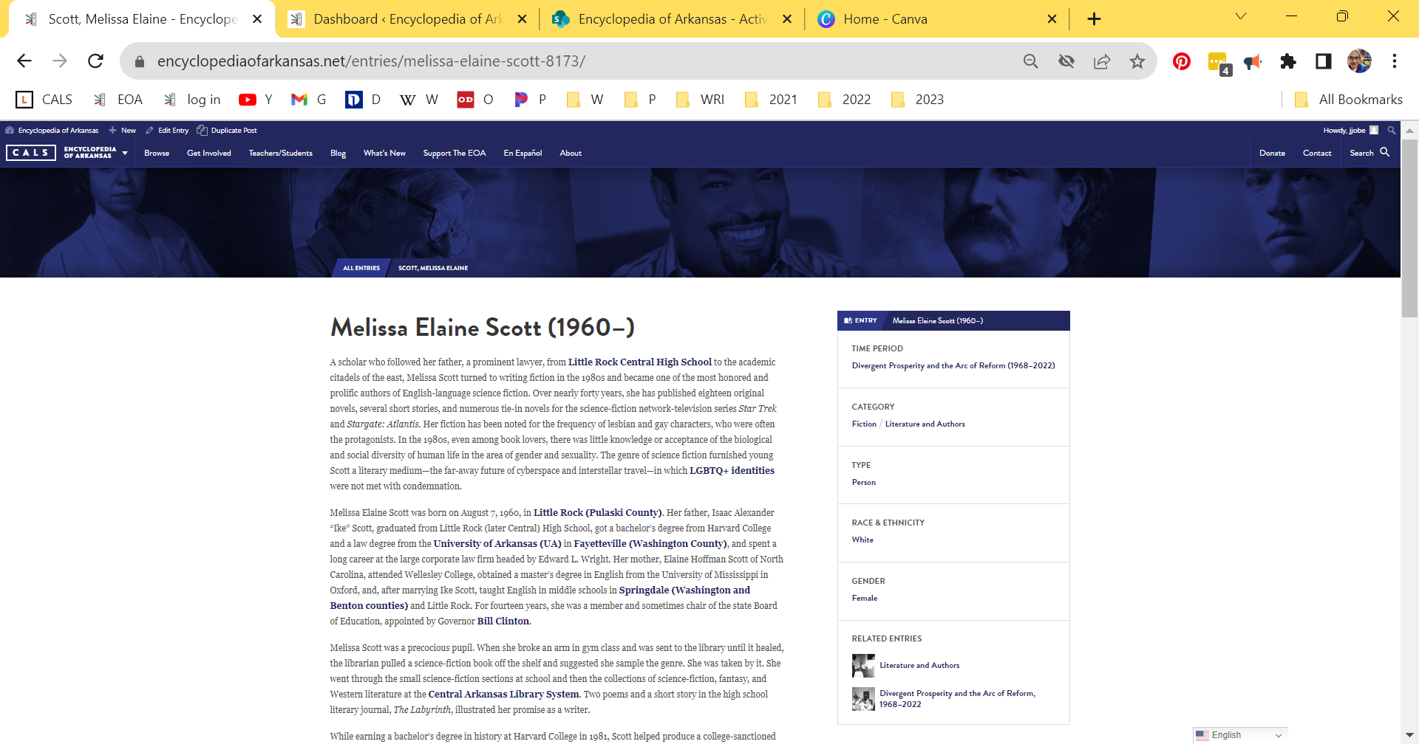
Notes:
Item 4
Melissa Elaine Scott (1960–)
Melissa Elaine Scott became one of the most honored and prolific authors of English-language science fiction. Over nearly forty years, she has published eighteen original novels, several short stories, and numerous tie-in novels for the science-fiction network-television series Star Trek and Stargate: Atlantis. Her fiction has been noted for the frequency of lesbian and gay characters, who were often the protagonists. In the 1980s, even among book lovers, there was little knowledge or acceptance of the biological and social diversity of human life in the area of gender and sexuality. The genre of science fiction furnished young Scott a literary medium—the far-away future of cyberspace and interstellar travel—in which LGBTQ+ identities were not met with condemnation.

Slide 16

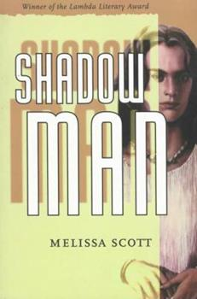
Notes:
Scott was born in Little Rock and grew up in the Little Rock area. She got her bachelor’s degree in history at Harvard College in 1981, where she helped produce a college-sanctioned science-fiction magazine. She enrolled in the graduate program of comparative history at Brandeis University in Boston; published her first novel; and earned a master’s degree and a doctorate.
In Boston, she met Lisa Anne Barnett, a writer and editor who attended the nearby University of Massachusetts, and with whom she would collaborate on three novels. The two settled in Portsmouth, New Hampshire. In February 2000, seven months after Vermont became the first state to recognize civil unions of gay couples, Scott and Barnett went to Burlington and had their union officially legalized. Barnett died of breast and brain cancer in 2006.
Scott only rarely made gender and sexuality the overt theme of a story; rather, the disparate sexualities of the characters were merely noted and occasionally explicitly described, as had long been the case for heterosexual characters in other genres of fiction. The lone book that deals predominantly with the theme of gender and sexual acceptance is Shadow Man (1995), in which, eons from the present, a drug taken to survive interstellar travel increased intersex births and led across the universe to the recognition of five body types—except in the planet of Hara, where only two body types were recognized: female and male.

Slide 17
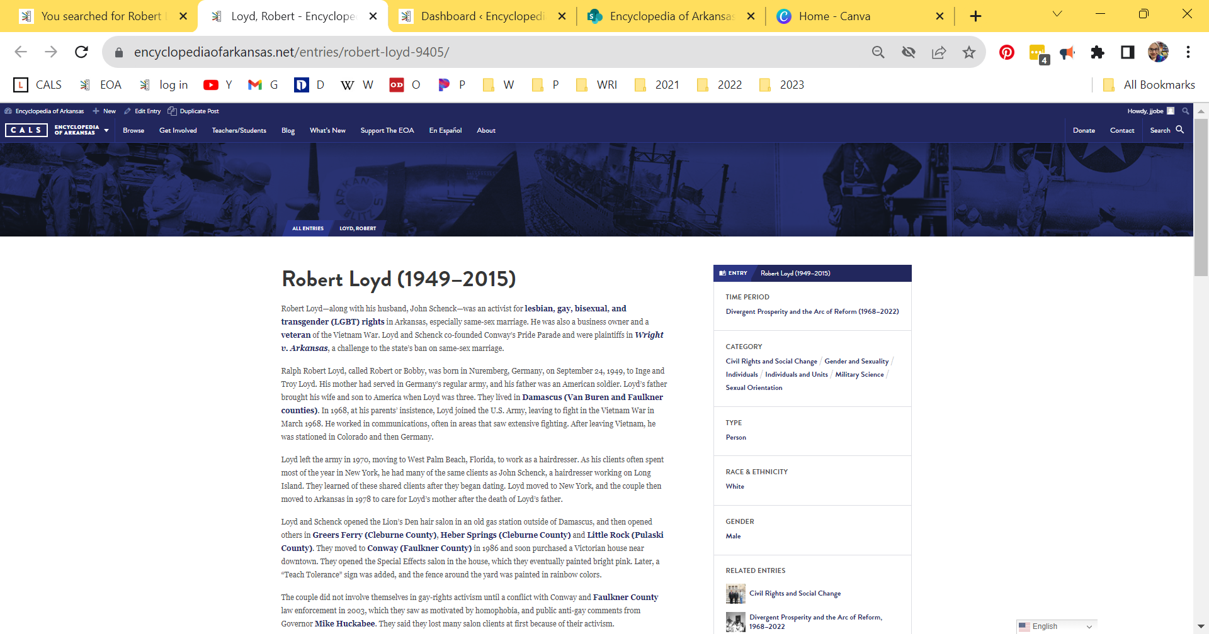
Notes:
Item 5
Robert Loyd (1949–2015)
Robert Loyd—along with his husband, John Schenck—was an activist for LGBTQ+ rights in Arkansas, especially same-sex marriage. He was also a business owner and a veteran of the Vietnam War. Loyd and Schenck co-founded Conway’s Pride Parade and were plaintiffs in Wright v. Arkansas, a challenge to the state’s ban on same-sex marriage.

Slide 18
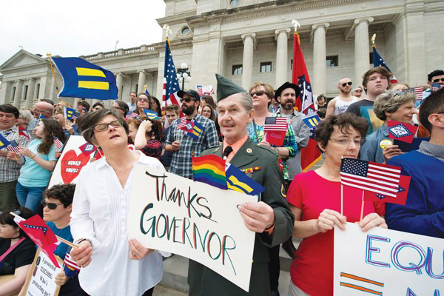
Notes:
In 1968, at his parents’ insistence, Loyd joined the U.S. Army, leaving to fight in the Vietnam War in March 1968. He worked in communications, often in areas that saw extensive fighting. After leaving Vietnam, he was stationed in Colorado and then Germany.
Loyd left the army in 1970, moving to West Palm Beach, Florida, to work as a hairdresser. As his clients often spent most of the year in New York, he had many of the same clients as John Schenck, a hairdresser working on Long Island. They learned of these shared clients after they began dating. Loyd moved to New York, and the couple then moved to Arkansas in 1978 to care for Loyd’s mother after the death of Loyd’s father.
Loyd and Schenck opened the Lion’s Den hair salon in an old gas station outside of Damascus, and then opened others in Greers Ferry (Cleburne County), Heber Springs (Cleburne County) and Little Rock (Pulaski County). They moved to Conway (Faulkner County) in 1986 and soon purchased a Victorian house near downtown. They opened the Special Effects salon in the house, which they eventually painted bright pink. Later, a “Teach Tolerance” sign was added, and the fence around the yard was painted in rainbow colors.
The couple did not involve themselves in gay-rights activism until a conflict with Conway and Faulkner County law enforcement in 2003, which they saw as motivated by homophobia, and public anti-gay comments from Governor Mike Huckabee. They said they lost many salon clients at first because of their activism.
In 2004, Loyd and Schenck organized the first annual Conway Pride Parade; about 100 people marched in the parade, while there were more than 1,000 protestors. One protestor, Wesley Bono, dumped several tons of cow manure along the parade route before dawn on the day of the parade; he was eventually found guilty of misdemeanor harassment and fined. Two other protestors—Cristina Brown and Little Rock talk radio personality Phillip Beard—tossed pornographic DVDs to attendees of the parade; they negotiated a plea for misdemeanor charges at their trial. The parade became an annual event, drawing more marchers and fewer protestors over the years.
The couple became legally married in Canada in 2004. In 2005, a documentary film about Loyd and Schenck’s activism, Pink Houses, was released.
Loyd and Schenck became plaintiffs in the 2013 case Wright v. Arkansas, which was seeking to end the state’s 2004 ban on same-sex marriage and non-recognition of out-of-state same-sex marriages. On May 9, 2014, Pulaski County circuit judge Chris Piazza struck down the ban on same-sex marriages. Couples began obtaining marriage licenses the next day in some counties. Loyd and Schenck were at the Pulaski County Courthouse to support the dozens of same-sex couples who were able to marry before the state halted same-sex marriages a week later, but they decided to wait to marry until they could get a marriage license in Faulkner County. The case was then appealed, and county clerks ceased giving out marriage licenses to same-sex couples.
On June 26, 2015, with a 5–4 ruling in the case of Obergefell v. Hodges, the U.S. Supreme Court announced that states cannot ban gay marriage, legalizing it nationwide (and thereby closing the Wright case). Loyd and Schenck received their marriage license at the Faulkner County clerk’s office that same day, the first same-sex couple in Faulkner County to do so. The couple married in Conway on August 22, 2015, with Conway mayor Tab Townsell performing the ceremony.
Loyd died suddenly of a heart attack on December 30, 2015. The 2016 Conway Pride parade was dedicated to his memory.
According to Loyd’s obituary, he and Schenck were officially foster parents for eleven years and unofficially for many more (including being “fairy godfathers” to Justin Rawls). They particularly helped young people who had been abandoned due to their sexual orientation; they served as legal guardians for four children over the years. Schenck died in 2016.

Slide 19
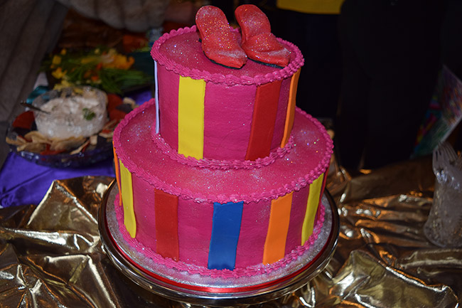
Notes:
Loyd died suddenly of a heart attack on December 30, 2015. The 2016 Conway Pride parade was dedicated to his memory.
This is a photo from the memorial service.
According to Loyd’s obituary, he and Schenck were officially foster parents for eleven years and unofficially for many more (including being “fairy godfathers” to Justin Rawls). They particularly helped young people who had been abandoned due to their sexual orientation; they served as legal guardians for four children over the years. Schenck died in 2016.

Slide 20
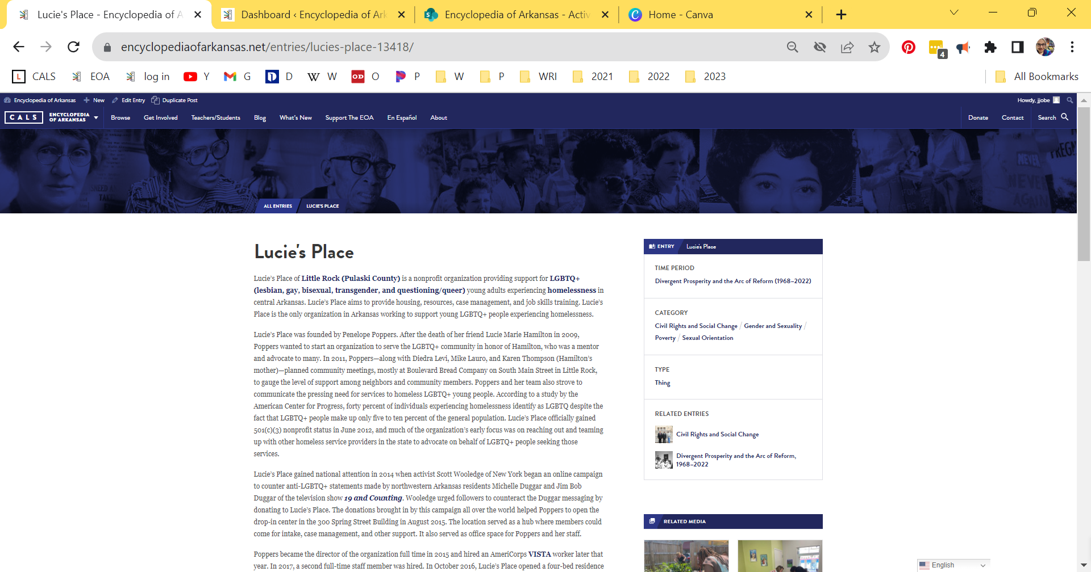
Notes:
Item 6
Lucie's Place
Lucie’s Place of Little Rock (Pulaski County) is a nonprofit organization providing support for LGBTQ+ (lesbian, gay, bisexual, transgender, and questioning/queer) young adults experiencing homelessness in central Arkansas. Lucie’s Place aims to provide housing, resources, case management, and job skills training. Lucie’s Place is the only organization in Arkansas working to support young LGBTQ+ people experiencing homelessness.

Slide 21

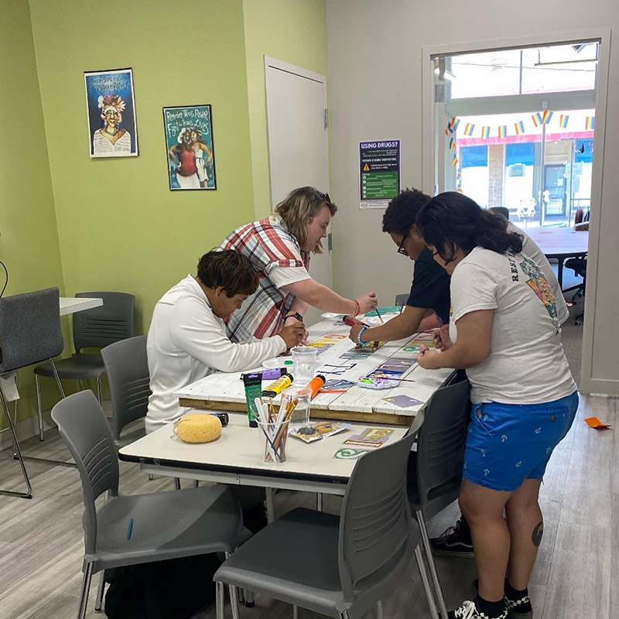
Notes:
Lucie’s Place was founded by Penelope Poppers. After the death of her friend Lucie Marie Hamilton in 2009, Poppers wanted to start an organization to serve the LGBTQ+ community in honor of Hamilton, who was a mentor and advocate to many. In 2011, Poppers—along with Diedra Levi, Mike Lauro, and Karen Thompson (Hamilton’s mother)—planned community meetings, mostly at Boulevard Bread Company on South Main Street in Little Rock, to gauge the level of support among neighbors and community members. Poppers and her team also strove to communicate the pressing need for services to homeless LGBTQ+ young people. According to a study by the American Center for Progress, forty percent of individuals experiencing homelessness identify as LGBTQ despite the fact that LGBTQ+ people make up only five to ten percent of the general population. Lucie’s Place officially gained 501(c)(3) nonprofit status in June 2012, and much of the organization’s early focus was on reaching out and teaming up with other homeless service providers in the state to advocate on behalf of LGBTQ+ people seeking those services.
Lucie’s Place gained national attention in 2014 when activist Scott Wooledge of New York began an online campaign to counter anti-LGBTQ+ statements made by northwestern Arkansas residents Michelle Duggar and Jim Bob Duggar of the television show 19 and Counting. Wooledge urged followers to counteract the Duggar messaging by donating to Lucie’s Place. The donations brought in by this campaign all over the world helped Poppers to open the drop-in center in the 300 Spring Street Building in August 2015. The location served as a hub where members could come for intake, case management, and other support. It also served as office space for Poppers and her staff.

Slide 22
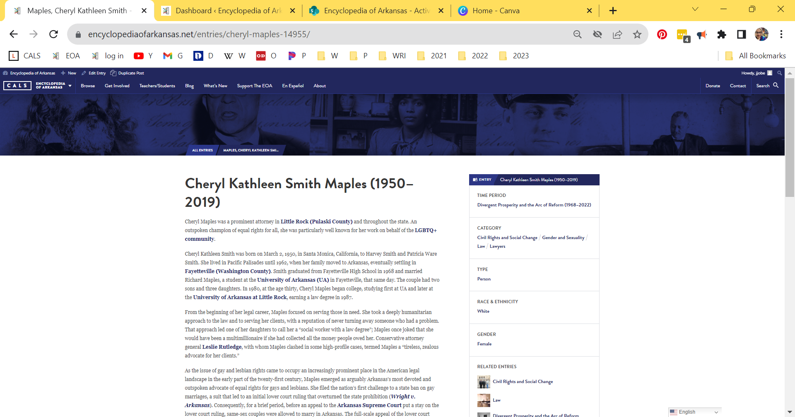
Notes:
Item 7
Cheryl Kathleen Smith Maples (1950–2019)
Cheryl Kathleen Smith Maples was a prominent attorney in Little Rock (Pulaski County) and throughout the state. An outspoken champion of equal rights for all, she was particularly well known for her work on behalf of the LGBTQ+ community.

Slide 23
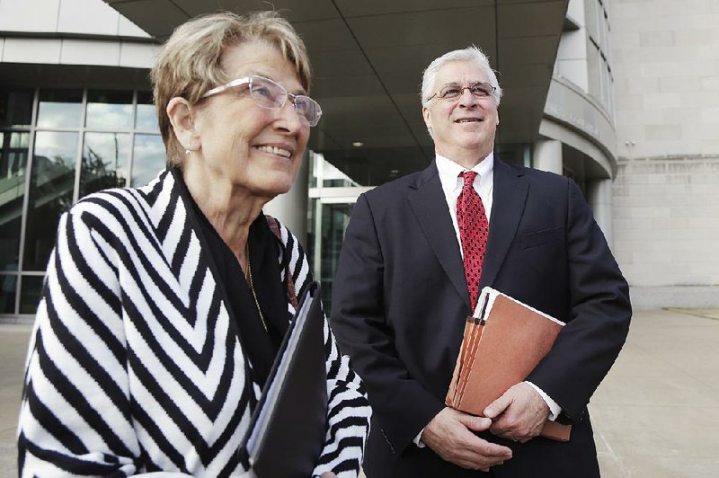
Notes:
As the issue of gay and lesbian rights came to occupy an increasingly prominent place in the American legal landscape in the early part of the twenty-first century, Maples emerged as arguably Arkansas’s most devoted and outspoken advocate of equal rights for gays and lesbians. She filed the nation’s first challenge to a state ban on gay marriages, a suit that led to an initial lower court ruling that overturned the state prohibition (Wright v. Arkansas). Consequently, for a brief period, before an appeal to the Arkansas Supreme Court put a stay on the lower court ruling, same-sex couples were allowed to marry in Arkansas. The full-scale appeal of the lower court ruling was pending when the U.S. Supreme Court’s Obergefell v. Hodges decision in 2015 rendered the state-based suit moot by making same-sex marriage legal nationally.
Maples once commented that her efforts on behalf of gay rights were in honor of her daughter, who was a lesbian. Two years after the Obergefell decision, in 2017, she led the effort in Pavan v. Smith, in which the U.S. Supreme Court struck down the Arkansas statute that prohibited putting the name of the second parent of a same-sex marriage on the birth certificate of their child, a decision that built upon the fundamental rights recognized in Obergefell, while expanding the full meaning of marriage and family for same-sex couples all over the United States.

Slide 24
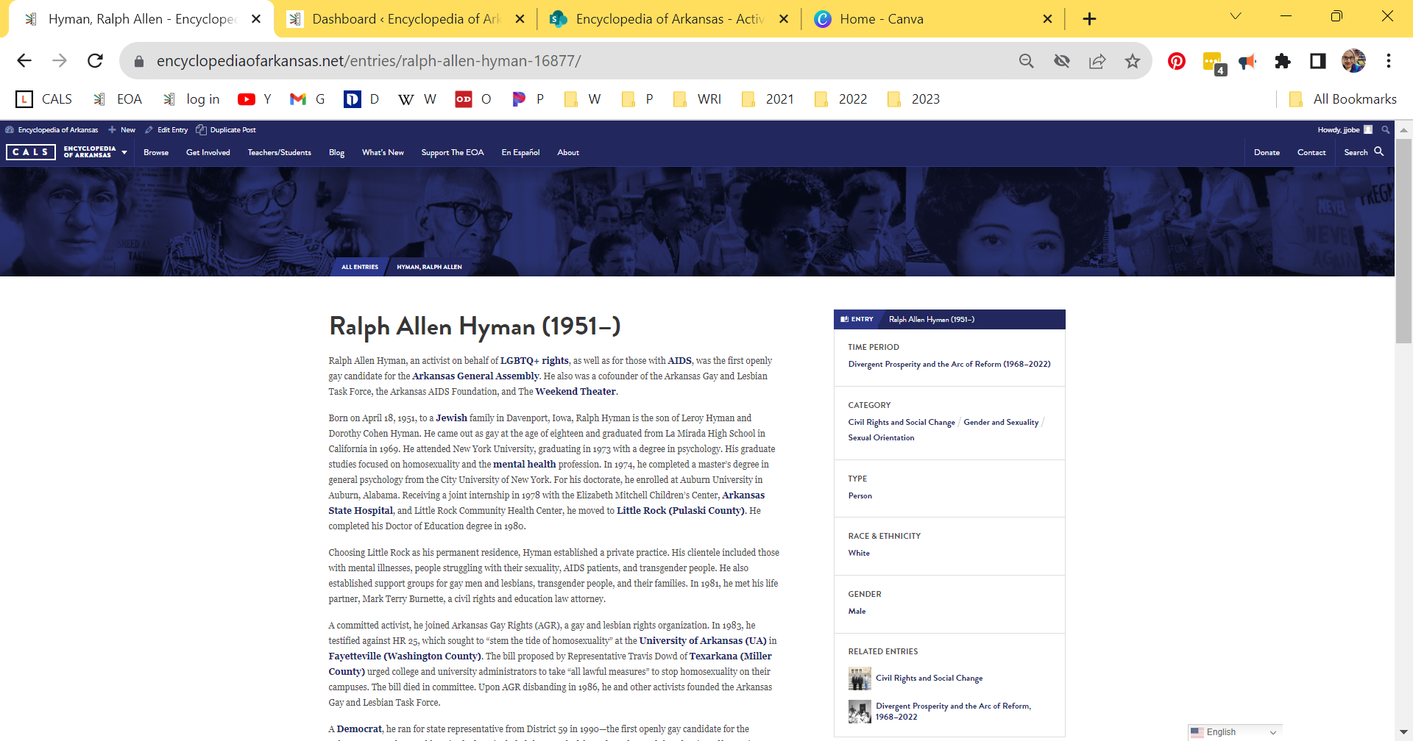
Notes:
Item 8
Ralph Allen Hyman (1951–)
Ralph Allen Hyman, an activist on behalf of LGBTQ+ rights, as well as for those with AIDS, was the first openly gay candidate for the Arkansas General Assembly. He also was a cofounder of the Arkansas Gay and Lesbian Task Force, the Arkansas AIDS Foundation, and The Weekend Theater.

Slide 25
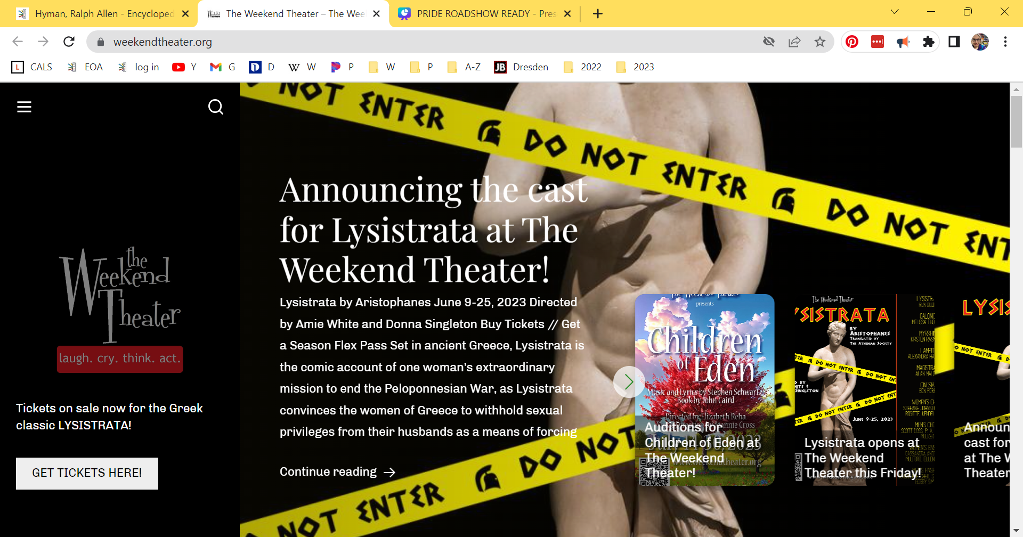
Notes:
He came out as gay at the age of eighteen. His graduate studies focused on homosexuality and the mental health profession. Choosing Little Rock as his permanent residence, Hyman established a private practice. His clientele included those with mental illnesses, people struggling with their sexuality, AIDS patients, and transgender people. He also established support groups for gay men and lesbians, transgender people, and their families. In 1981, he met his life partner, Mark Terry Burnette, a civil rights and education law attorney.
A committed activist, he joined Arkansas Gay Rights (AGR), a gay and lesbian rights organization. Upon AGR disbanding in 1986, he and other activists founded the Arkansas Gay and Lesbian Task Force.
A Democrat, he ran for state representative from District 59 in 1990—the first openly gay candidate for the Arkansas General Assembly. His platform included the repeal of the sodomy law and the adoption of hate crimes legislation, as well as measures supporting AIDS education, reproductive rights, tax reform, and the prevention of domestic violence. He did not win the seat.
In response to the AIDS epidemic, Hyman educated the public in safer-sex measures, including the use of condoms. He spoke to the public at press conferences, as well as speaking before community and professional groups, university classes, and Arkansas Governor’s School. Asserting that AIDS was not a “gay disease,” he warned that the malady also affected the heterosexual community. With no AIDS hotline in place at the time, he gave out his phone number. He established a “buddy system,” with volunteers helping AIDS patients with various tasks. He founded AIDS House, providing a living space for disowned HIV+ men. He cofounded the Arkansas AIDS Foundation (AAF) in 1985, which assumed management of AIDS House. In June 1988, his AIDS work was recognized with an Arkansas Community Service Award. During his acceptance speech, Hyman proclaimed, “I am a homosexual.” He asserted that the award recognized not just his contributions, but also those of the state’s gay and lesbian community. He also requested donations to support AIDS House.
In 1989, upon learning that most funds donated to the AAF went to salaries and office expenses, he withdrew from the organization. Without his consent, AIDS House was closed in 1991.
He redirected his energies to a lifelong passion: the theater. In 1994, he and friends founded The Weekend Theater. Both acting in and directing plays, he served as the theater’s artistic director through 2014. During his tenure, the theater produced more than 200 plays and musicals. He retired in 2015.

Slide 26
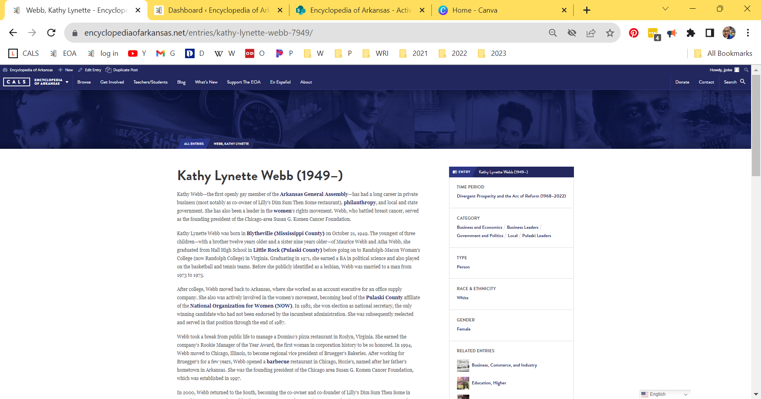
Notes:
Item 9
Kathy Lynette Webb (1949–)
Kathy Webb—the first openly gay member of the Arkansas General Assembly—has had a long career in private business (most notably as co-owner of Lilly’s Dim Sum Then Some restaurant), philanthropy, and local and state government. She has also been a leader in the women’s rights movement. Webb, who battled breast cancer, served as the founding president of the Chicago-area Susan G. Komen Cancer Foundation.

Slide 27
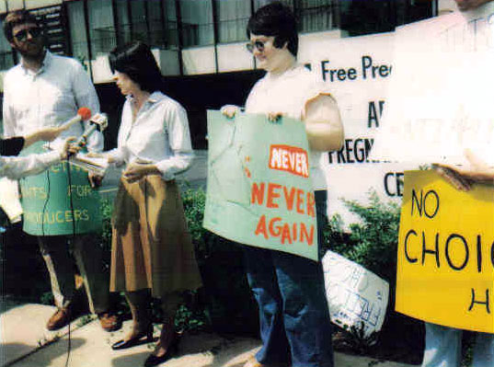
Notes:
This is a picture of Little Rock NOW members demonstrating for abortion rights circa 1983.
Webb was actively involved in the women’s movement, becoming head of the Pulaski County affiliate of the National Organization for Women (NOW). In 1982, she won election as national secretary, the only winning candidate who had not been endorsed by the incumbent administration. She was subsequently reelected and served in that position through the end of 1987.

Slide 28
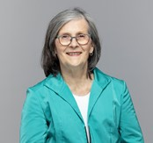
Notes:
In 2000, Webb returned to the South, becoming the co-owner and co-founder of Lilly’s Dim Sum Then Some in Memphis, Tennessee. She and her business partner (and romantic partner at the time), Nancy Tesmer, started a second Lilly’s Dim Sum Then Some in Little Rock in 2002. Webb left the business in 2011.
Webb sought elective office for the first time in 2006. Running as a Democrat, she won election to the Arkansas House of Representatives. She became the first woman to chair the Joint Budget Committee. She also served as chair of the Arkansas Assembly Economic and Tax Policy Committee and was a member of the House Rules Committee; the Arkansas House Education Committee; the City, County and Local Affairs Committee; and the Arkansas Legislative Council. Webb twice won reelection, running unopposed in both 2008 and 2010.
In 2014, Webb sponsored and shepherded through to passage a city ordinance prohibiting the City of Little Rock (and companies with which it contracted) from discriminating based on sexual orientation or gender identity; this was in conflict with a recently enacted state law that prohibited local government from expanding anti-discrimination protections.

Slide 29
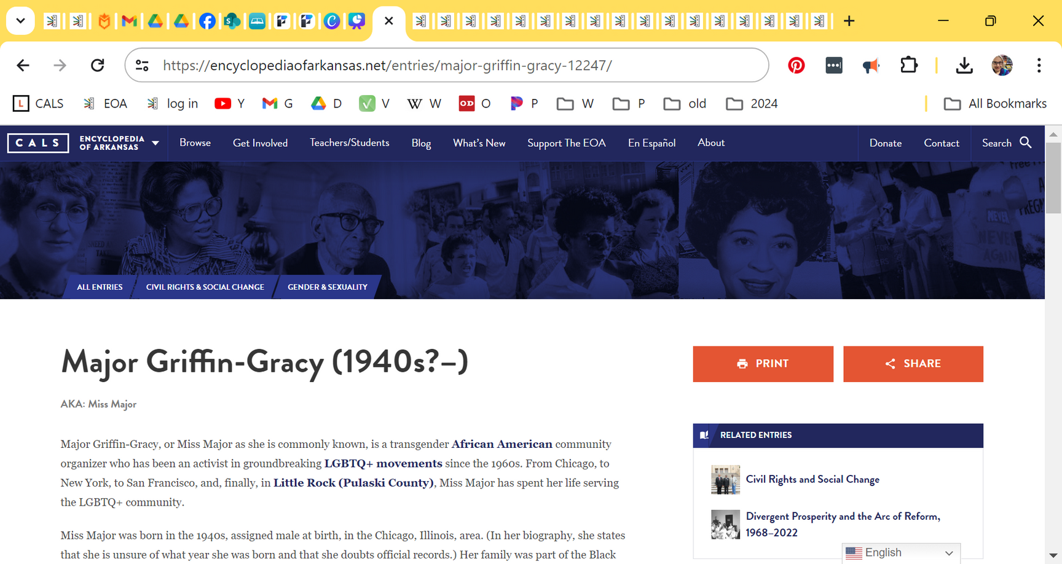
Notes:
Item 10
Major Griffin-Gracy (1940s?–)
Major Griffin-Gracy, or Miss Major as she is commonly known, is a transgender African American community organizer who has been an activist in groundbreaking LGBTQ+ movements since the 1960s. From Chicago, to New York, to San Francisco, and, finally, in Little Rock (Pulaski County), Miss Major has spent her life serving the LGBTQ+ community.
Miss Major was born in the 1940s, assigned male at birth, in the Chicago, Illinois, area. (In her biography, she states that she is unsure of what year she was born and that she doubts official records.) Her family was part of the Black middle class in Chicago’s South Side; her mother managed a beauty shop, and her father was a postal worker. After graduating early, she entered college in Milwaukee, Wisconsin, at the age of sixteen. She was quickly dismissed after a roommate discovered a suitcase of femme clothing among her belongings. After returning to Chicago around 1960, she stole a vehicle with a friend and attempted to flee. They were discovered speeding out of town, and she was arrested for the first time, spending six months incarcerated in a psychiatric facility, a common sentence for gender non-conforming people during the period.
After her release, she moved to New York City, where she became part of the underground Black and Latino drag and queer club scene known as Ballroom. During this period, she also engaged in sex work. She was arrested and jailed several times throughout the 1960s in New York. Because of the frequency of her arrests, she views the infamous raid at the Stonewall Inn in 1969, of which she is one of the few remaining survivors, as just another night during the period.
During a longer stint (circa 1970–1974) imprisoned in Dannemora, New York, Miss Major met and was influenced by Frank “Big Black” Smith, who shared his experiences organizing around Black liberation politics, community care, and abolition of the prison industrial complex; this relationship informed the rest of her life as a community organizer.
After her release, she returned to New York City, met Deborah Brown, and had a son, Christopher, in 1978. When their romantic relationship ended, Brown returned to New York City but continued to co-parent their son.
Miss Major’s release from prison coincided with the beginning of the HIV/AIDS epidemic. In New York and after moving to San Diego, California, around 1978, she worked to provide direct services to those affected by the disease. In the 1990s, she moved to the San Francisco Bay Area and worked with multiple HIV/AIDS organizations, including the City of Refuge in San Francisco and the Tenderloin AIDS Resource Center (TARC). During this time, she also operated the first needle-swap in the Bay Area to help prevent the spread of the disease.

Slide 30
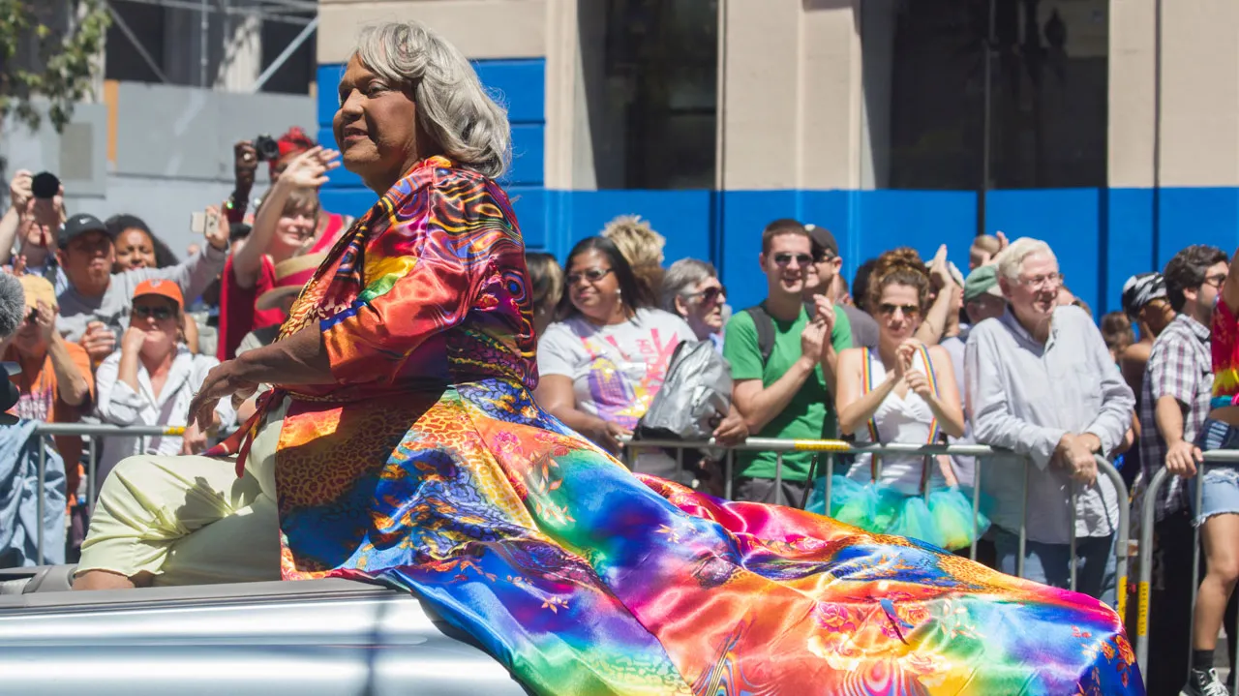
Notes:
In 2003, Miss Major joined the Transgender Gender-Variant & Intersex Justice Project (TGIJP), the only organization in the United States dedicated to assisting transgender people in prisons. She served as executive director from 2009 to 2015.
In 2015, after viewing a screening of MAJOR!, the 2015 documentary about her life, in Little Rock, she decided to move to the city, saying that she enjoyed the openness of the city and wanted to support trans Black women in Arkansas. She lives in Little Rock with her longtime partner Beck Witt Major, who identifies as a transgender man. Beck gave birth to their child Asiah in 2021. Miss Major maintains the operations of House of GG, also known as the Griffin-Gracy Educational and Historical Center. The center seeks to create safe, transformative spaces where transgender women of color can heal—physically, mentally, emotionally, and spiritually. The center also focuses on supporting the well-being and development of transgender community leaders in the South.
In May 2023, Verso Books published Miss Major Speaks: Conversations with a Black Trans Revolutionary, a memoir composed of interviews with Miss Major by journalist Toshio Meronek, her friend and former assistant.

Slide 31
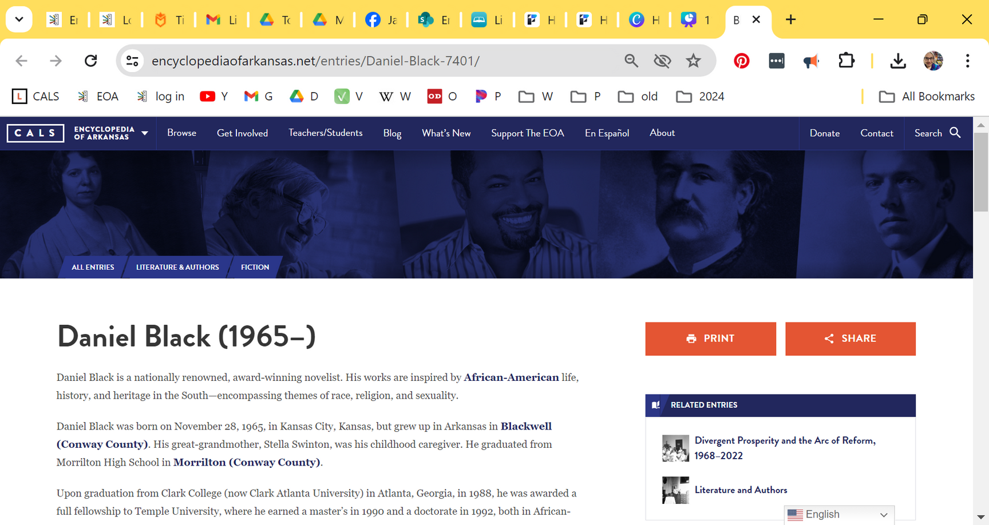
Notes:
Item 11
Daniel Black is a nationally renowned, award-winning novelist. His works are inspired by African American life, history, and heritage in the South—encompassing themes of race, religion, and sexuality. In addition to his writing, he has spoken widely about being both Black and gay in the United States.
Daniel Black was born on November 28, 1965, in Kansas City, Kansas, but grew up in Arkansas in Blackwell (Conway County). His great-grandmother, Stella Swinton, was his childhood caregiver. He graduated from Morrilton High School in Morrilton (Conway County).
Upon graduation from Clark College (now Clark Atlanta University) in Atlanta, Georgia, in 1988, he was awarded a full fellowship to Temple University, where he earned a master’s in 1990 and a doctorate in 1992, both in African-American studies. Black also earned the prestigious Oxford Modern British Studies fellowship, leading him to study at Oxford University in 1987. He studied under Sonia Sanchez, who many consider to be the poet laureate of the Black Arts Movement.
Black, who lives in Atlanta, is a professor of African-American studies and English at his alma mater Clark Atlanta University and at Morehouse College, where he has mentored burgeoning writers and scholars since 1993. Black is also the founder of the Ndugu and Nzinga Rites of Passage Nation, a mentoring society that teaches character and the principles to African-American youth. Within that society, Black is known as Omotosho Jojomani.

Slide 32
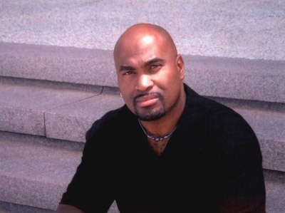
Notes:
Black credits his great-grandmother for inspiring him to write stories that work to transform and uplift humanity. Among his literary works are They Tell Me of a Home (2005), The Sacred Place (2007), Perfect Peace (2010), Twelve Gates to the City (2011), The Coming (2015), and Listen to the Lambs (2016)—all published by St. Martin’s Press. Black has been nominated for the Townsend Literary Prize, the Ernest J. Gaines Award, the Ferro-Grumley Literary Prize, the Lambda Literary Award, and the Georgia Author of the Year Prize; in addition, he was awarded the Writer’s Award from the Middle-Atlantic Writers Association.
One of Black’s most noted works is Perfect Peace. For this novel, the Go on Girl! Book Club named him its Author of the Year in 2011. It was also chosen as the 2014 selection for “If All Arkansas Read the Same Book” by the Arkansas Center for the Book at the Arkansas State Library. Pulitzer Prize–winning author Alice Walker described the book, about a young boy being raised as a girl until turning eight years old, as “a spellbinding novel that kept me reading late into several nights….It is a gift to have so much passion, so much love, so much beautiful writing so flawlessly faithful to the language of ancestors who grappled as best they could with more than they could ever understand. This novel will one day be a film of much benefit to us, if done well. The visuals of it will help us see what we are so often blind to: the great fluidity inherent in all things, including ‘race’ and sexuality.”
Black’s The Coming, which was released in 2015, is a first-person account of the trauma and triumph of Africans on a slave ship in the sixteenth century. Reviewers have described it as “brilliant,” “poetic,” and a “literary homage to the lives of those Africans tossed into the sea.” His novel Listen to the Lambs, released in 2016, explores the lives of homeless people who find each other on the street.

Slide 33

Notes:
In 2022, he published Don’t Cry for Me, a novel inspired by his own father’s struggles with Alzheimers, in which the narrator relates stories about his own ancestral ties to Arkansas. The following year, he published the collection of essays Black on Black: On Our Resilience and Brilliance in America.

Slide 34

QUESTIONS
Notes:
This is just the tip of the iceberg. The Encyclopedia of Arkansas is a rabbit hole I encourage you to jump down. No matter what you are interested in, Arkansas has it--and the EOA is where you can start looking.

