Slide 1

Benchmarking Language Model Creativity: A Case Study on Code Generation
Yining Lu^{1,2}, Dixuan Wang², Tianjian Li², Dongwei Jiang²,
Sanjeev Khudanpur², Meng Jiang¹, Daniel Khashabi²
¹University of Notre Dame, ²Johns Hopkins University

Slide 2
Human Creativity
Divergent thinking: adaptability to explore new environments or constraints (since the 1950s)
  P(sychological) creativity: a valuable idea is P-creative if the person in whose mind it arises could not have come up with it before.
  H(istorical) creativity: a valuable idea is H-creative if it is P-creative, and no one else in human history has ever had it before.
Convergent thinking: purposefulness to achieve a given goal (since the 1990s)
  Accuracy / correctness for problem-solving tasks (close-ended)
  Coherence / logic for story generation (open-ended)
Notes:
Divergent thinking is a cognitive process that involves exploring a multitude of potential applications for a given set of tools

Slide 3
Creativity Evaluation Protocols
“Human creativity is viewed as taking place in the interaction with a person, environment, or another model “ (Amabile, 1996; Csikszentmihalyi, 1996, 1998; Feldman, 1998; Feldman et al., 1994; Holyoak and Morrison, 2005).
State-Aware: adaptive to different contexts
Human Grounded: comparing solutions to historical human solutions.
Notes:
Similarly, the essence of LLM creativity should also be captured from its interaction with the current state (state-aware) and past human knowledge background (human-grounded). This understanding reveals that creativity evaluation should be dynamic, with an individual’s creativity varying under different contexts.

Slide 4
Machine Creativity
We define and evaluate LLM creativity for constrained problem-solving settings!
We argue that an effective creativity evaluation method should be based on the spectrum of maximal creative solutions attained from LLMs.
Limitations:
Eliciting creative solutions is difficult
A unified metric that quantifies both convergent and divergent thinking is missing

Slide 5
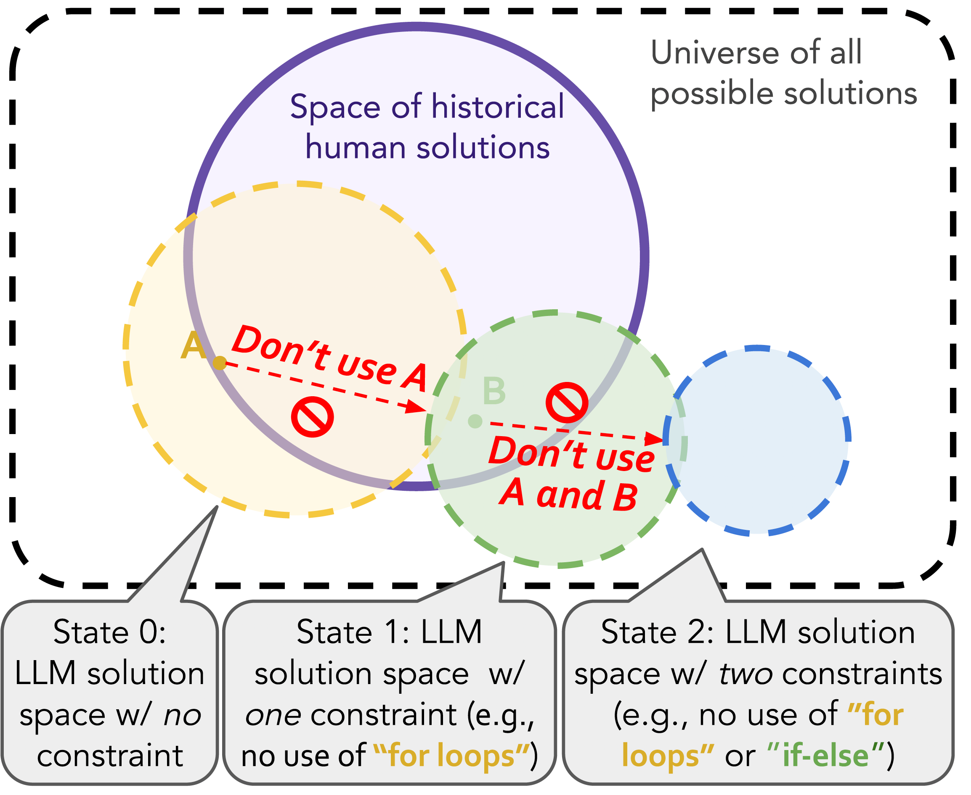
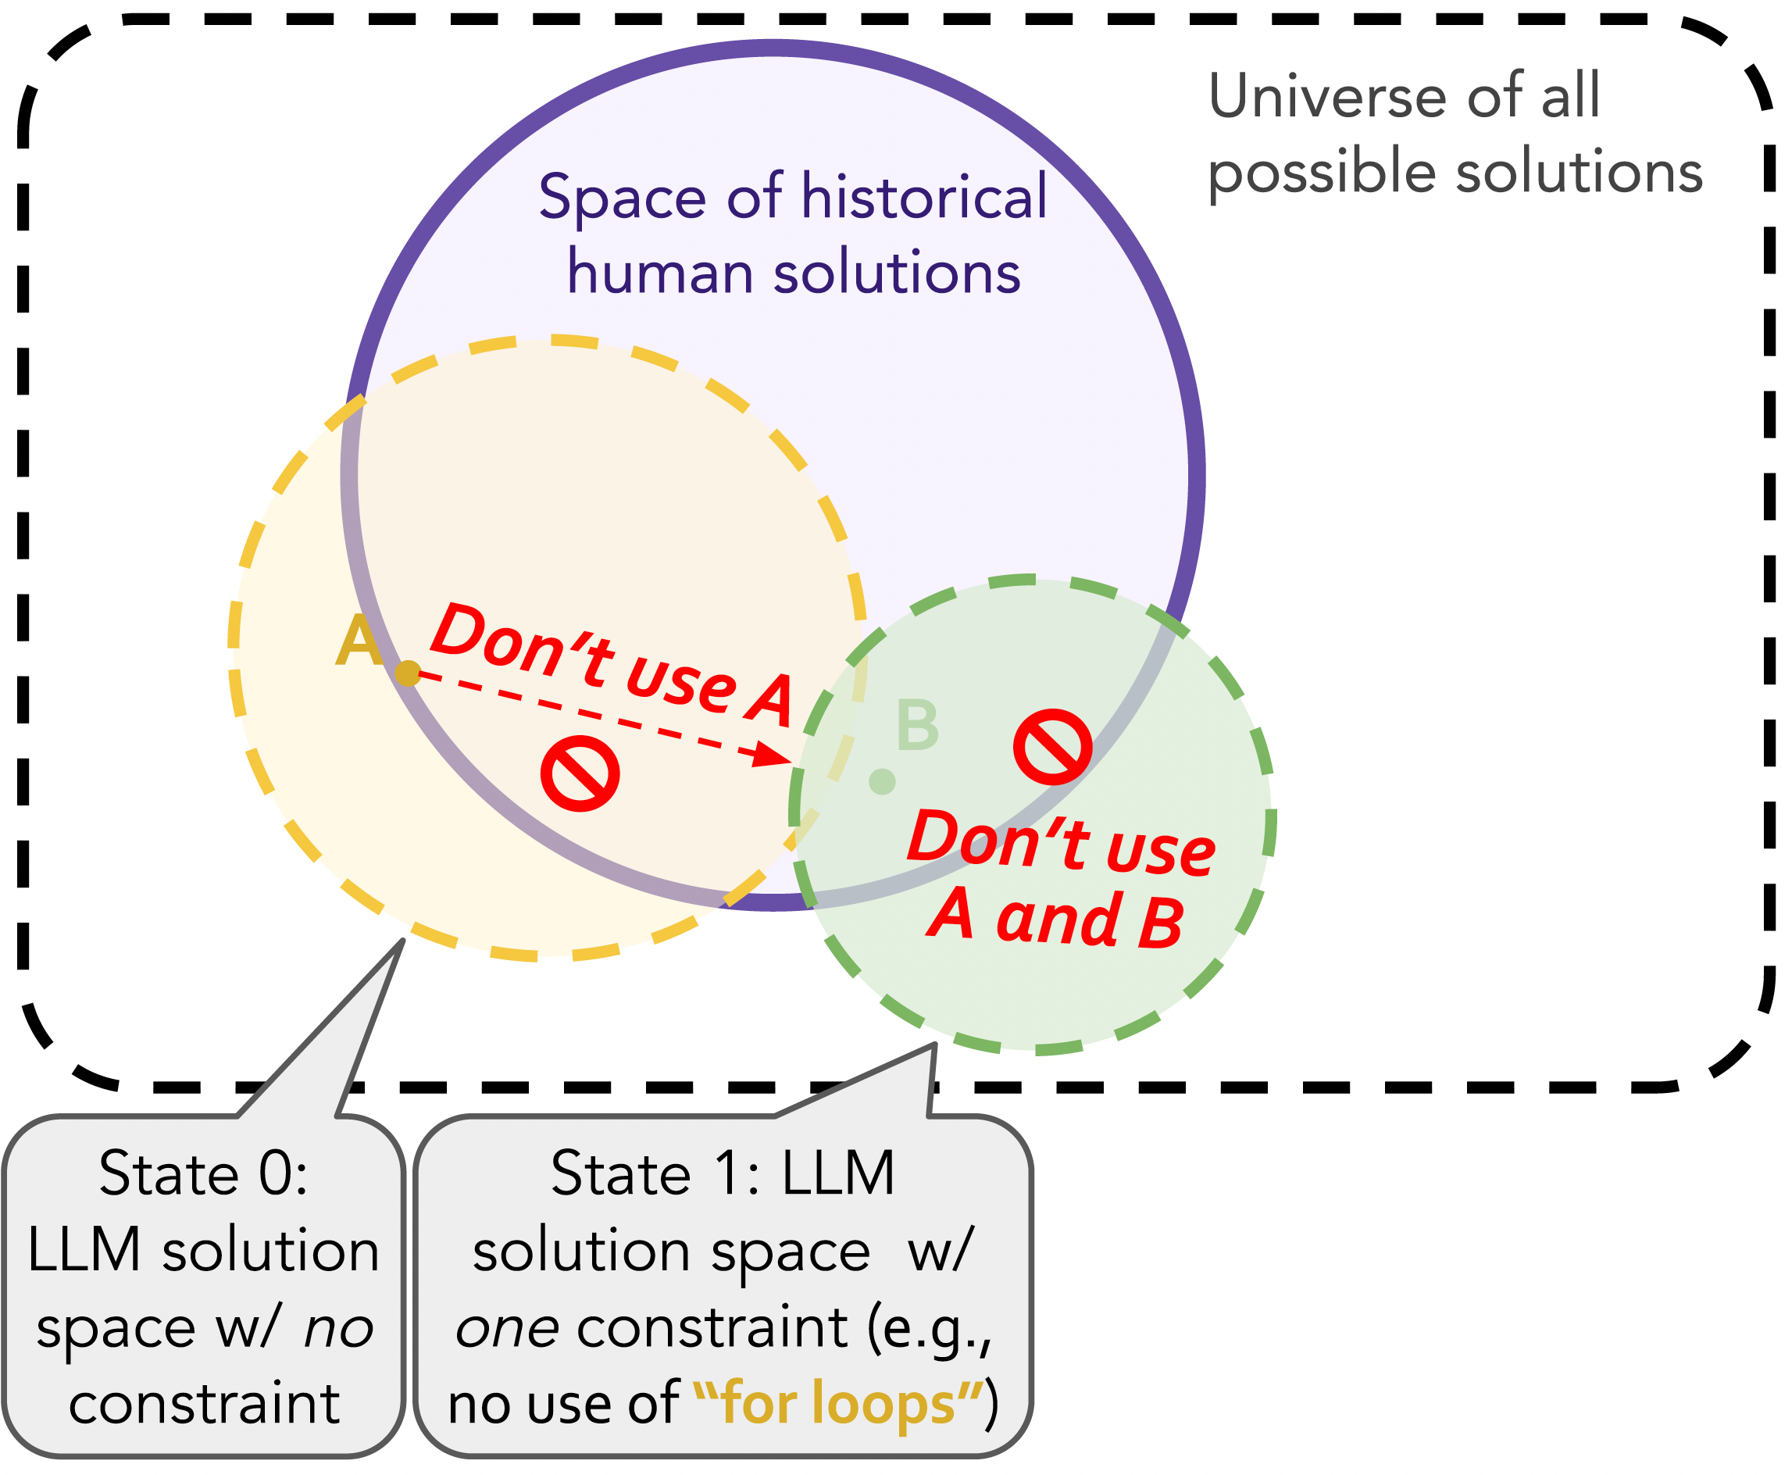
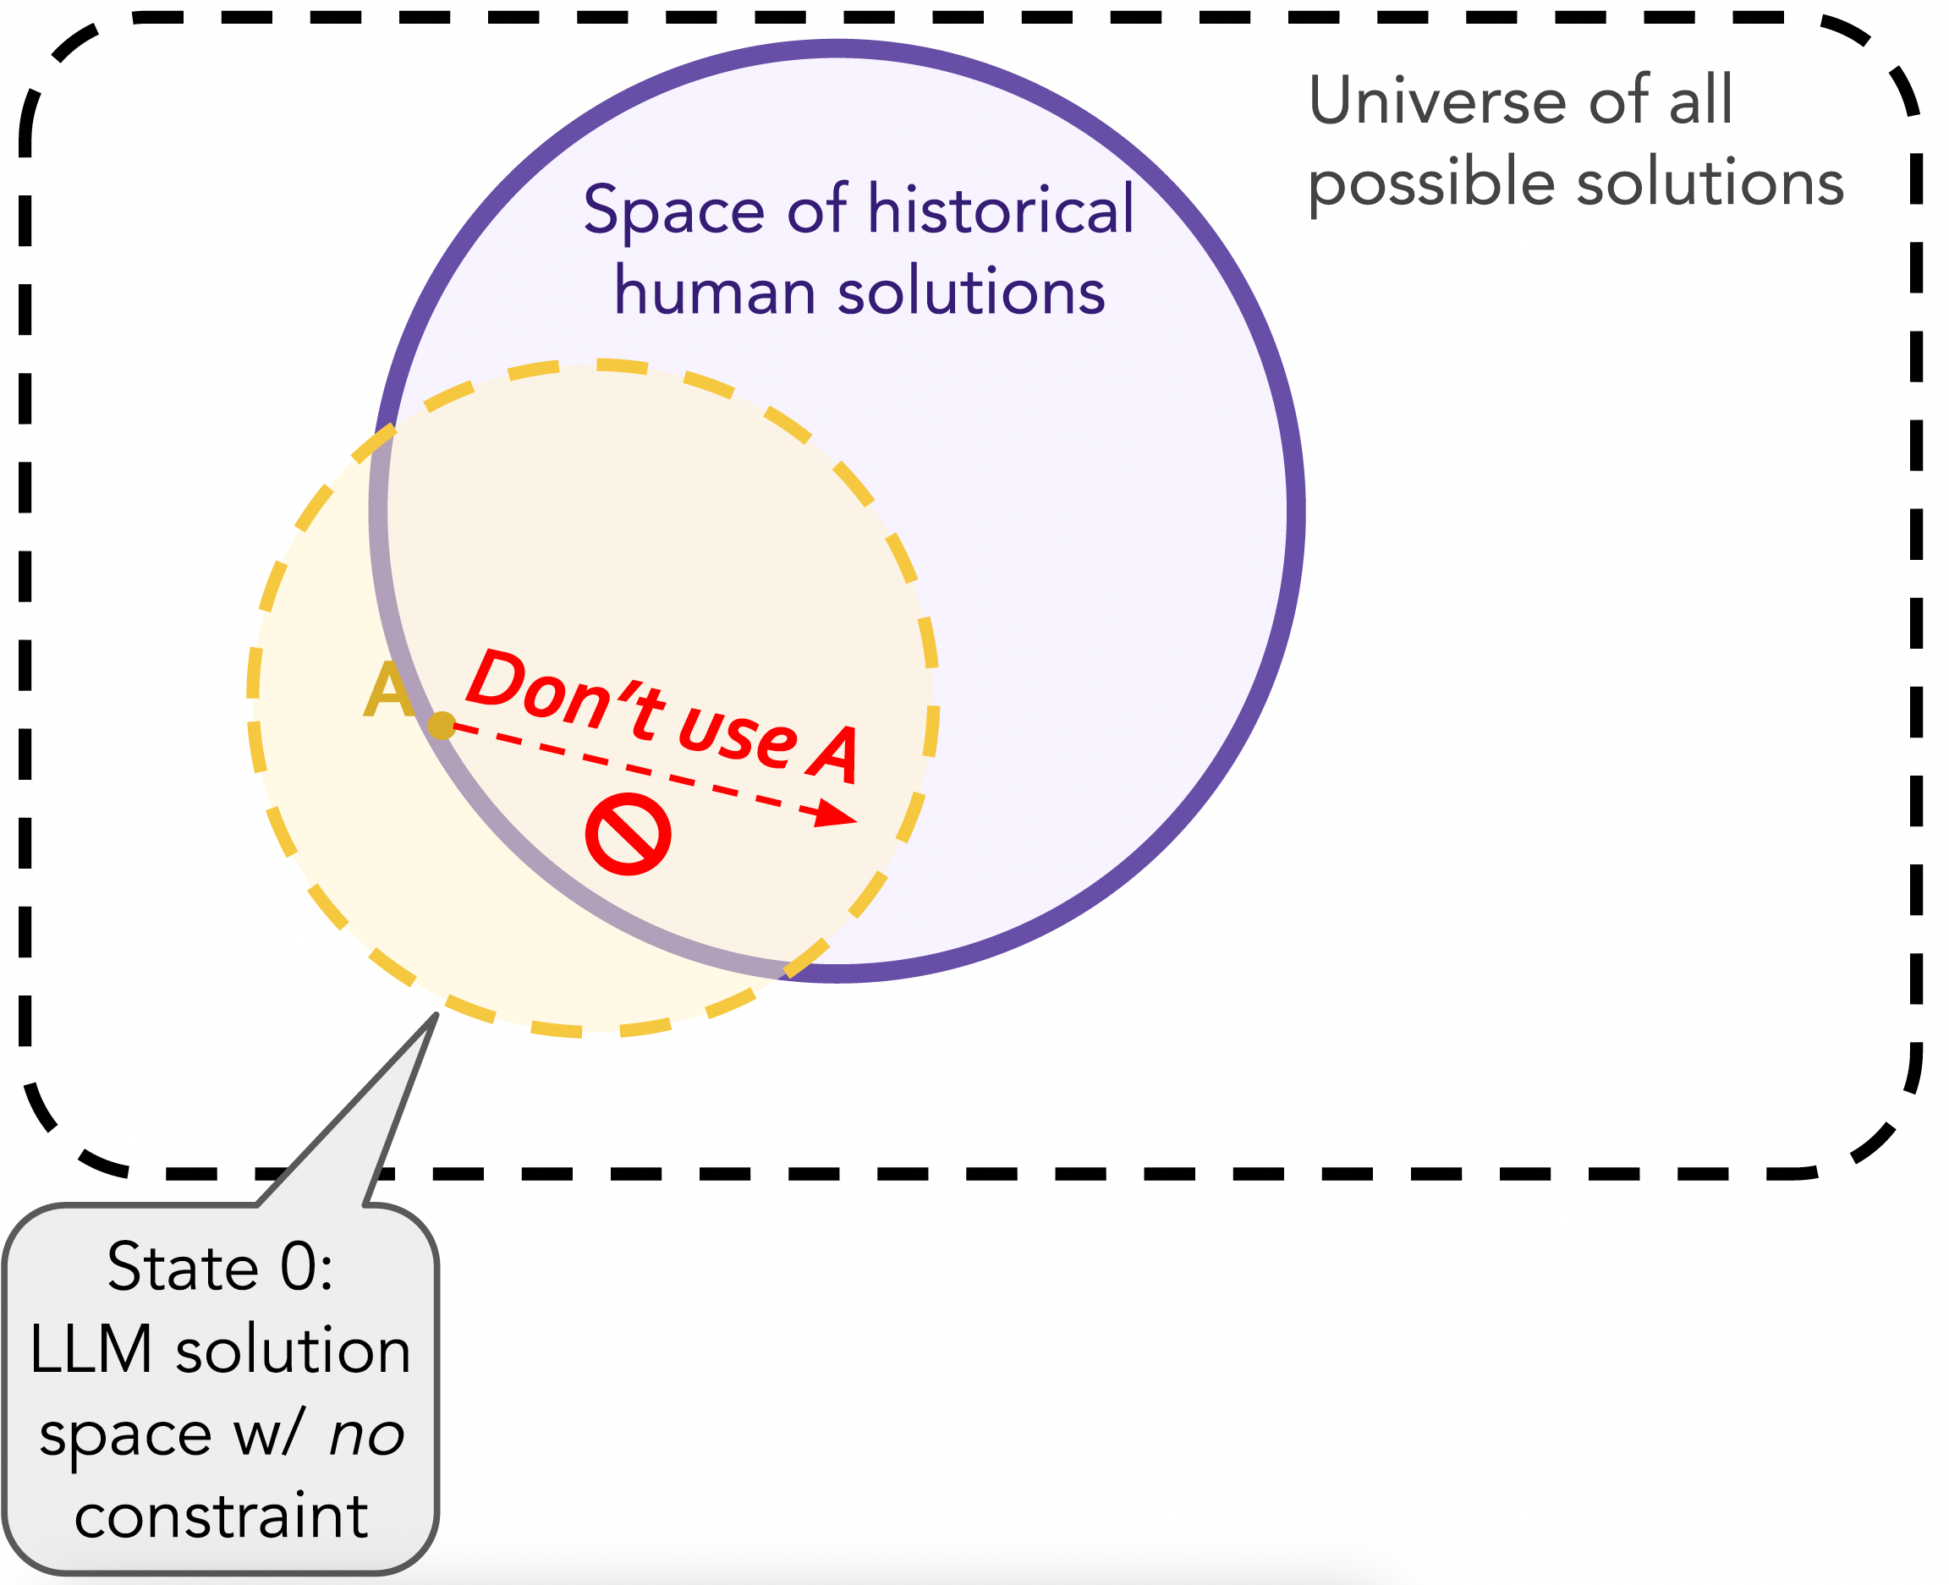
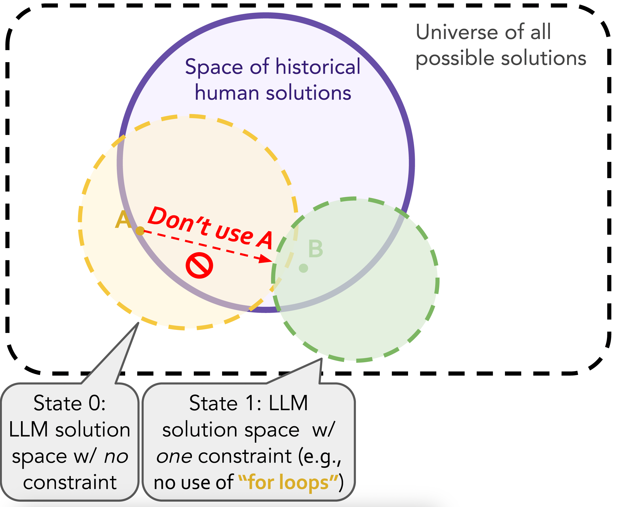
Denial Prompting
A prompting method that iteratively “denies” one of the basic tools, techniques, or strategies used in the previous solution, thereby pushing LLM to think out-of-the-box and to elicit creative generations to its fullest extent

Slide 6
NeoCoder Dataset
We compile 199 latest Codeforces problems
We extract 30 correct human solutions per problem
We retrieve all test examples (4.5 test examples per problem on average)
We feed the retrieved problems to Denial Prompting with 5 maximum iterations to obtain our dataset NeoCoder.
Notes:
DENIAL PROMPTING potentially reaching a point where it can no longer generate new constraints after a certain number of iterations

Slide 7
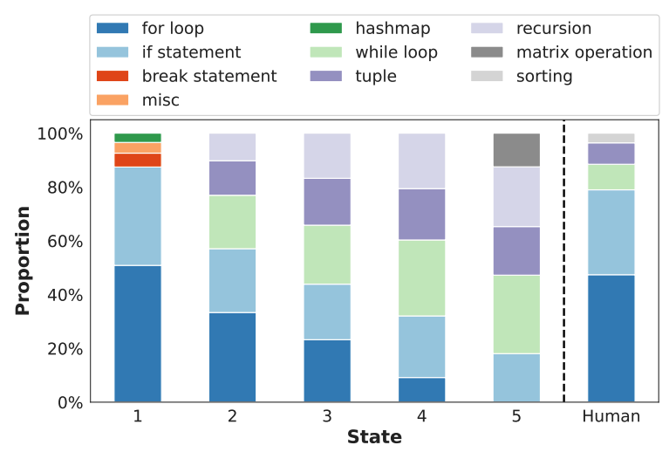
Techniques Distributions
In the absence of any constraints (the first column), the model defaults to common and accessible techniques, like humans!
This echoes our early claim that eliciting creative solutions is crucial for creativity evaluation.
Proportion of the top 5 most common atomic techniques used by GPT-4 per state

Slide 8
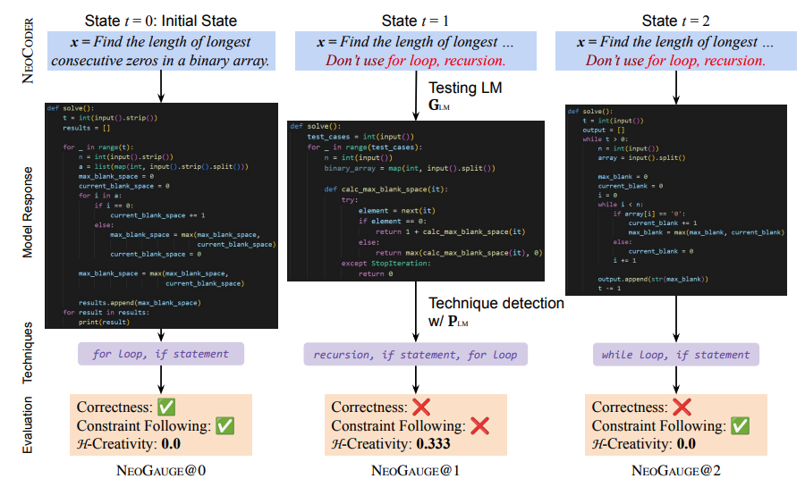
NeoGauge Metric
NeoGauge@T is a joint probability of being both convergent and divergent creative at state T
Notes:
We compute neogauge as the probability of LM generating correct solutions that meet the given constraints (convergent creativity) and also exhibit H-creativity (divergent creativity).
However, none of the above three solutions are considered to be “creative” since convergent solutions may lack divergent creativity (e.g., state t = 0). Alternatively, LLMs’ hallucinated responses resulting in high H-creativity, but often lack correctness and constraint following (e.g., state t = 1)

Slide 9
NeoGauge Metric
NeoGauge@T is a joint probability of being both convergent and divergent creative at state T
Notes:
We compute neogauge as the probability of LM generating correct solutions that meet the given constraints (convergent creativity) and also exhibit H-creativity (divergent creativity).
However, none of the above three solutions are considered to be “creative” since convergent solutions may lack divergent creativity (e.g., state t = 0). Alternatively, LLMs’ hallucinated responses resulting in high H-creativity, but often lack correctness and constraint following (e.g., state t = 1)

Slide 10
NeoGauge Metric
NeoGauge@T is a joint probability of being both convergent and divergent creative at state T
Notes:
We compute neogauge as the probability of LM generating correct solutions that meet the given constraints (convergent creativity) and also exhibit H-creativity (divergent creativity).
However, none of the above three solutions are considered to be “creative” since convergent solutions may lack divergent creativity (e.g., state t = 0). Alternatively, LLMs’ hallucinated responses resulting in high H-creativity, but often lack correctness and constraint following (e.g., state t = 1)

Slide 11
NeoGauge Metric
NeoGauge@T is a joint probability of being both convergent and divergent creative at state T
Convergent Creativity
Human-Grounded;
Divergent Creativity
State-Aware
Notes:
We compute neogauge as the probability of LM generating correct solutions that meet the given constraints (convergent creativity) and also exhibit H-creativity (divergent creativity).
However, none of the above three solutions are considered to be “creative” since convergent solutions may lack divergent creativity (e.g., state t = 0). Alternatively, LLMs’ hallucinated responses resulting in high H-creativity, but often lack correctness and constraint following (e.g., state t = 1)

Slide 12
Experiment
Cognitive scientists are agreeing on two key points:
Creative individuals tend to have higher intelligence (Renzulli, 2005)
People with extremely high intelligence not necessarily to be extremely creative (Faris et al., 1962)
We re-examine the two findings on LLMs and answer:
Are larger LLMs more creative?
Do extremely large models of equal size exhibit comparable creativity?

Slide 13
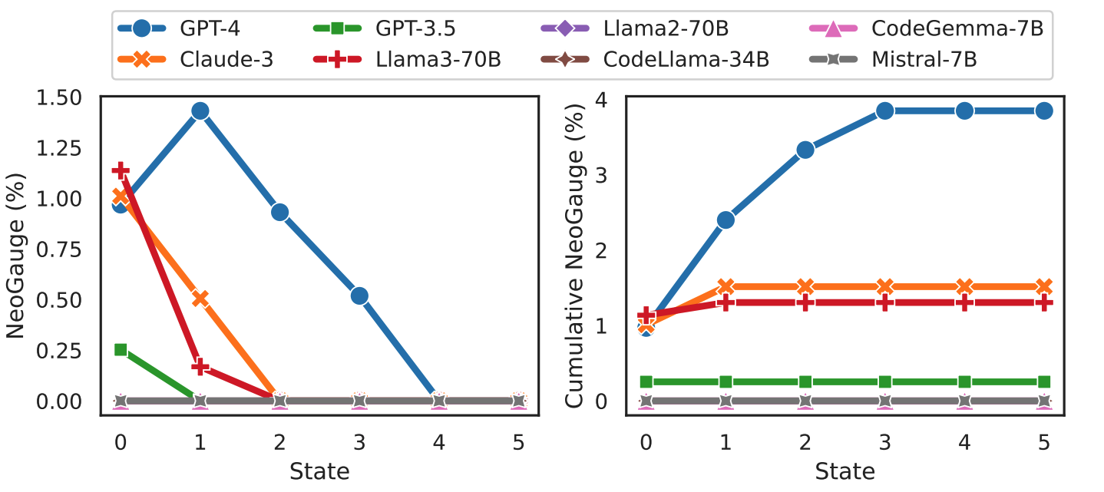
GPT-4 is the Most Creative LLM Thus Far
Notes:
GPT-4 consistently has the highest NEOGAUGE almost at every state t. While others (e.g., Claude-3 and Llama3-70B) have a close NEOGAUGE@0 score to GPT-4, their NEOGAUGE quickly decreases to 0 within the next two states.
larger LLMs are generally more creaitive, but extremely large LLM is not necessarily exhibiting extremely creative performance

Slide 14
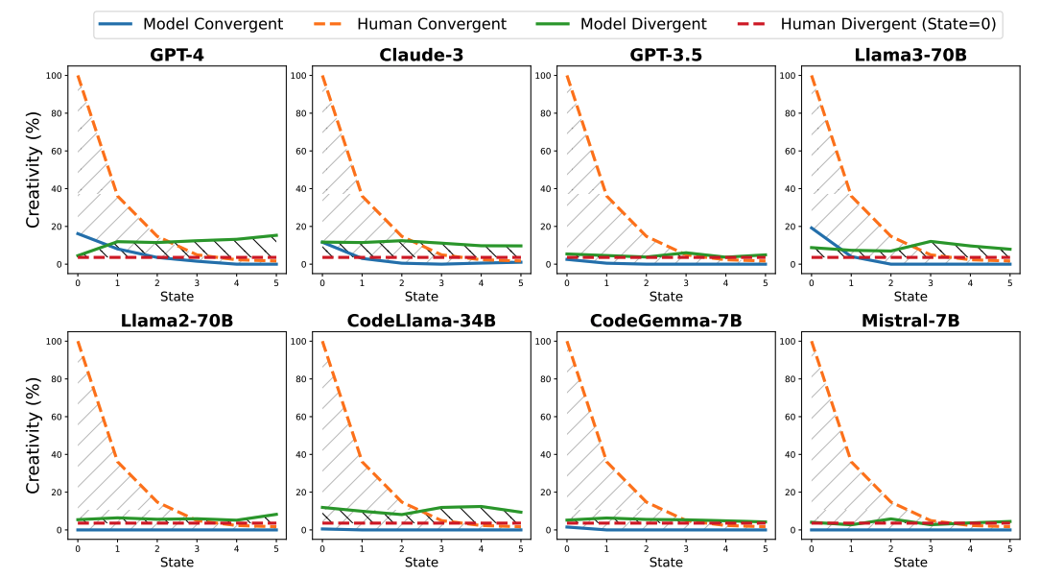
Who is More Creative: Machine or Human?
In problem-solving settings, LLMs in the above figure barely exhibit human-like creativity
Notes:
LLM demonstrates minimally better performance in divergent creativity compared to humans at their lowest level
However, humans have significantly greater convergent creativity than LLMs in early states

Slide 15
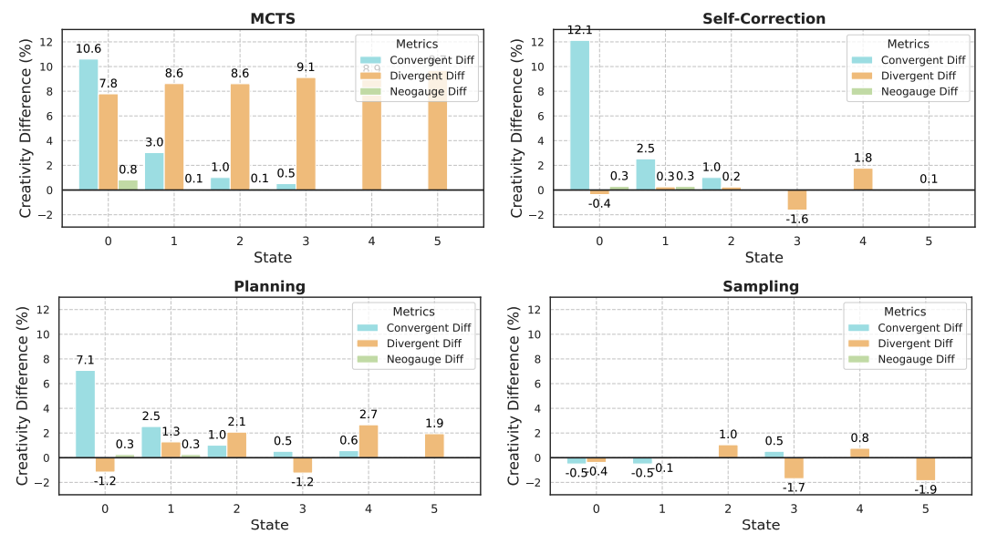
Inference-Scaling Slightly Boosts Divergent Thinking, with rapidly Diminishing Returns
Convergent thinking is improved except sampling.
Only MCTS successfully enhances divergent creativity
Notes:
Only MCTS improves divergent creativity, due to it rolling out numerous paths during the expansion. Strategies like self-correction, planning, and sampling, which operate on a single trial or path, fail to explore divergent solutions.

Slide 16
Conclusion
We propose protocols for evaluating language model creativity in problem-solving
We introduce the Denial Prompting framework and NeoGauge metric to provide a comprehensive creativity evaluation that unifies convergent and divergent thinking
We release our NEOCODER dataset for future work.

Slide 17


Meta Info
ylu33@nd.edu
ArXiv
GitHub

