Slide 1
Analyst primer
What every Leader & User should know

Slide 2


Agenda
Copilot Analyst Overview
Purpose and Use Cases
Comparison with other Agents
Technology Stack
Notes:
In this session, we will cover the following topics: an overview of Copilot Analyst, the technology stack behind it, a comparison with other agents, and its purpose and use cases.

Slide 3
Overview
Notes:
Copilot is becoming the primary user interface for AI, allowing users to interact with agents through natural language. The agentic ecosystem enables users to call on specialized agents for different needs, which makes workflows more efficient.

Slide 4
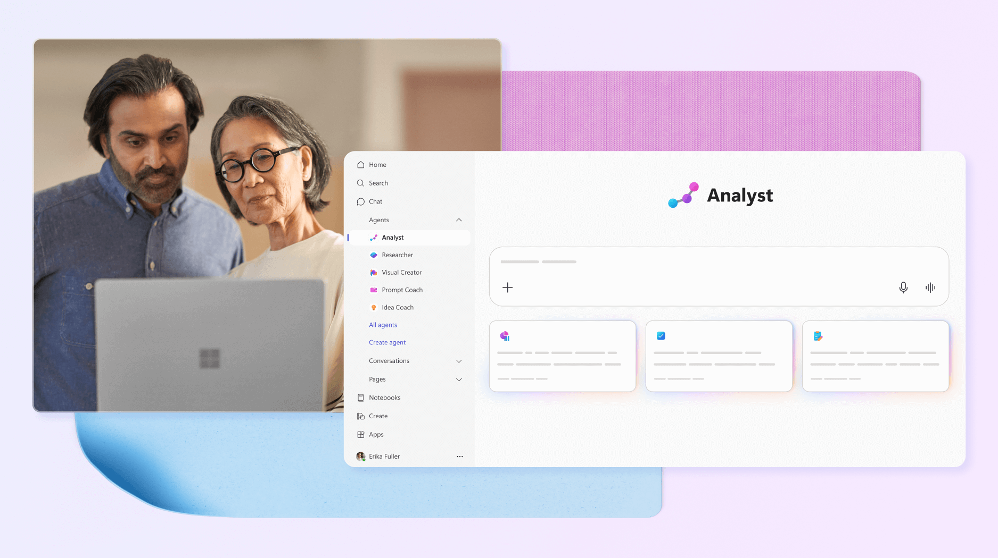
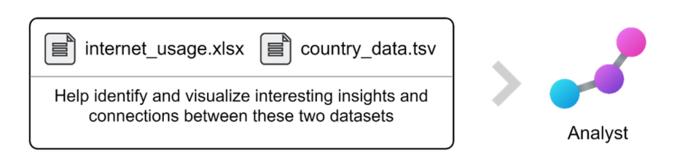
What is Copilot Analyst Agent?
Copilot Analyst is an AI-powered virtual data scientist built into Microsoft 365 Copilot. It is one of Microsoft’s first reasoning agents designed for advanced data analysis in everyday workflows. Analyst’s core intent is to help users transform raw, messy data into actionable insights within minutes – automating complex analysis tasks that would usually require expert skills in Excel, coding, or data science
Notes:
Copilot Analyst is an AI-powered virtual data scientist built into Microsoft 365 Copilot. It is designed to transform raw, messy data into actionable insights, automating tasks that typically require expert skills in Excel, coding, or data science. Users can upload their data and prompt the Analyst agent with their questions or analysis needs. The agent uses advanced AI reasoning and a Python engine to iteratively analyze data, generate charts, and refine results.

Slide 5
Copilot Analyst
Analyst at a Glance
Key Capability
Business Impact
Enterprise-Ready
Acts as a “virtual data scientist”
Embedded in Microsoft 365 Copilot
Enable deep analysis from enterprise data.
Leverages LLM + Python Engine
Iteratively analyzes data and generate charts.
Refine results via auto-generated code.
Turns raw spreadsheets and databases into visualized trends.
Detects patterns, correlations, summarizes data in minutes.
Democratize data analysis for non-experts.
Integrated with M365 security/compliance.
Works directly on your files.
No data leaves the secure boundary.
Notes:
Copilot Analyst acts as a virtual data scientist embedded in Microsoft 365 Copilot. It leverages large language models and a Python engine for deep analysis. The agent iteratively analyzes data, generates charts, and refines results using auto-generated code. It turns raw spreadsheets into visualized trends and insights, and is integrated with Microsoft 365 security and compliance, working directly on your files.

Slide 6
Purpose and Use Cases
Notes:
Copilot Analyst accelerates and elevates data-driven work. It handles complex spreadsheet analysis, cross-file data integration, statistical summaries, anomaly detection, visualization, reporting, and error identification.

Slide 7
Copilot Analyst’s mission is to accelerate and elevate data-driven work
Complex Spreadsheet Analysis:
Digesting large Excel workbooks with multiple sheets or poorly formatted data. Summarizing key insights.
1
Cross-File data Integration:
Combining data from different sources for a holistic analysis. Analyst can pull together and correlate information from multiple files or formats.
2
Statistical Summaries & Anomaly Detection:
Computing metrics, identifying outliers, and explaining significance.
3
Visualization and Reporting:
Turning analysis results into charts, graphs, or tables for easier consumption.
4
Error Identification and Code Refinement:
Uniquely, Analyst is built to recover from errors and adjust its approach on the fly.
5
Notes:
The mission of Copilot Analyst is to help users with data-related questions and tasks that go beyond simple Q&A. It automates report compilation, data cleaning, business insights, and data-driven narratives. By doing so, it saves hours of manual work and empowers employees to be more self-sufficient with data.

Slide 8


In short, Analyst targets scenarios where a user has data-related questions or tasks that go beyond simple Q&A: compiling reports from raw data, performing data cleaning and analysis, generating business insights, or preparing data-driven narratives. By automating these, it saves hours of manual work (for example, writing Excel formulas, running Python scripts, or consulting BI experts) and empowers employees to be more self-sufficient with data.
Notes:
Analyst is ideal for compiling reports from raw data, performing data cleaning and analysis, generating business insights, or preparing data-driven narratives. By automating these tasks, Analyst saves hours of manual work and enables employees to be more self-sufficient with data.

Slide 9



Business Scenarios
Financial Analysis
Marketing Analytics
Operations and Sales
Parsing a detailed budget Excel file and answering, “Where are the biggest variances this quarter and why?” (Analyst might compute variances and note overspending, etc.).
Integrating web analytics and lead conversion data to find correlations.
Analyzing support ticket logs in CSV to find patterns and resolution times. Aggregating scattered sales records to identify top products or regions and generating charts
Notes:
Copilot Analyst can be used for financial analysis by identifying variances in budgets and explaining their causes. It can also be used for marketing analytics to find correlations in web analytics and lead conversion data. In operations and sales, Analyst can analyze support ticket logs, aggregate sales records, and generate charts to identify top products or regions.

Slide 10
How Analyst Differs from Other Agents
Notes:
Analyst is a reasoning work agent that is capable of dynamic solution planning. Unlike task agents, Analyst can handle open-ended analytical questions by planning solution steps on the fly.

Slide 11
Copilot vs Analyst
Copilot
Analyst
Typically gives an answer in one step without deep reasoning.
Might only look at the last 10 related items in OneDrive for a quick answer.
Does not write or execute programming code
Responses are usually plain text (with maybe some format or tables)
Spend several minutes if needed, iterating to solve a problem.
It’s not bound by recent items, may check up to hundred items.
Use and integrated Python Engine, and several math libraries.
Produces a structured report: From tables, charts or narrative explanation.
Notes:
Copilot typically provides an answer in a single step, without engaging in deep reasoning. It may only review the most recent items in OneDrive to deliver a quick response, and it does not write or execute programming code. Most of Copilot’s responses are in plain text, sometimes with formatting or tables, but generally without advanced analysis.
In contrast, Analyst spends several minutes, if necessary, iterating through multiple steps to solve a problem. Analyst is not limited to recent items and can examine up to hundreds of files if needed. It uses an integrated Python engine and several mathematical libraries to perform computations. The output from Analyst is a structured report, which may include tables, charts, or narrative explanations.
In summary, Copilot is designed for fast, one-step answers, usually in plain text, while Analyst is built to solve complex problems through iterative reasoning, code execution, and the generation of structured, data-driven reports.

Slide 12
Technology Stack
Notes:
Copilot Analyst leverages the current Microsoft 365 Copilot Orchestrator, an advanced large language model, and a Python code execution engine. It uses a chain-of-thought reasoning model to solve complex analytical tasks.

Slide 13
How is Analyst Built?
Analyst leverages the current M365 Copilot Orchestrator, with an Advance LLM and a Python code execution engine.
Prompt
Result
Orchestrator
LLM
Python
Uses a Chain-of-Thought reasoning model
Notes:
Analyst uses the Microsoft 365 Copilot Orchestrator, an advanced LLM, and a Python engine. It employs chain-of-thought reasoning, orchestrates solution steps, and iteratively generates and executes Python code to analyze data and produce results.

Slide 14
Simplified Analyst Agent Architecture
1
2
3
User Prompt
User asks a complex data question via Copilot (e.g., in Teams chat or Copilot app).
Data Grounding
Copilot finds relevant files/data from Microsoft Graph (OneDrive, SharePoint, etc.) based on the query. These are provided to the Analyst agent.
LLM Reasoning Begins
The OpenAI o3-mini model, with Analyst’s reasoning prompt, interprets the question and plans solution steps (“chain-of-thought”).
4
5
6
Tool Use (Python)
For each step where computation is needed, the agent generates Python code and executes it in a sandbox. The output (data, chart, error) is returned to the LLM. The LLM updates its plan accordingly (iterating as needed).
Response Generation
When analysis is complete, the LLM produces a final answer: narrative insights, any charts/tables, and possibly the code used for transparency.
Delivery and Actions
The result is sent to the user in Copilot chat. The user can ask follow-ups or click “Open in Pages” to save/edit the full report. All steps are logged for compliance.
Notes:
The Analyst agent workflow begins with a user prompt, followed by data grounding, tool use (Python), and response generation. The agent plans, executes, and refines steps, delivering narrative insights and visualizations. All steps are logged for compliance, and users can save or edit the full report in Copilot Pages.

Slide 15
Demo
Notes:
In this demo, we will show how Analyst processes data, generates insights, and visualizes results. You will see a practical example of how the agent works in real scenarios.

Slide 16
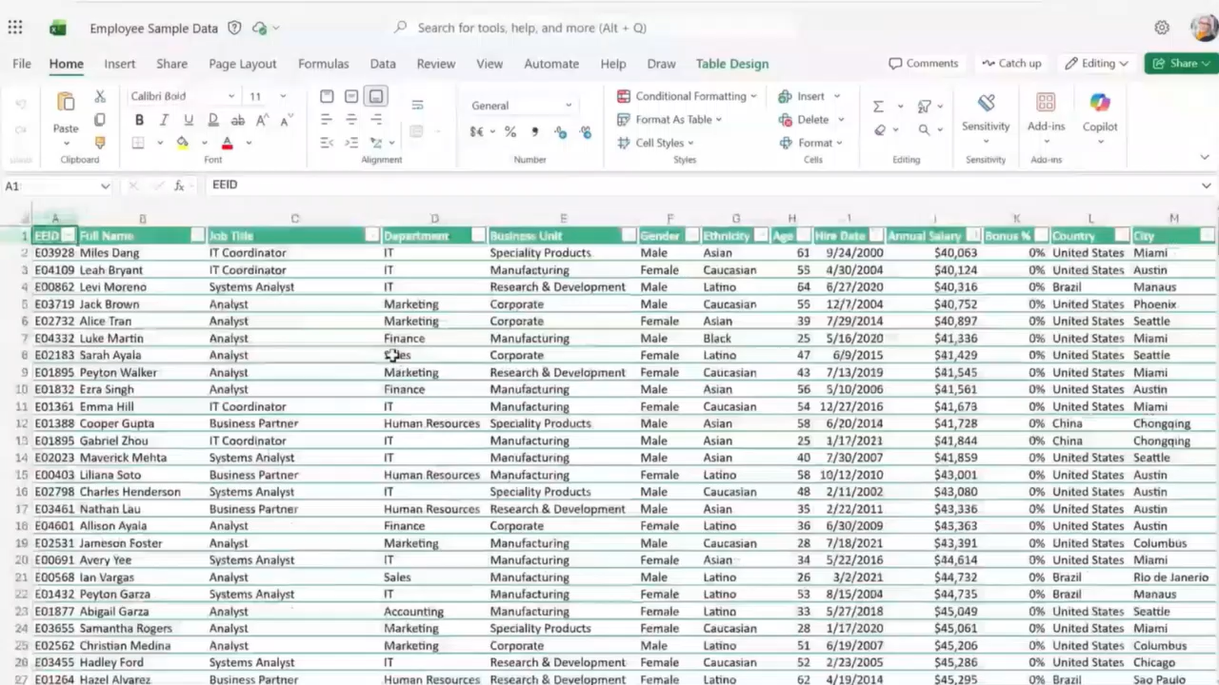
Analyst demo

Slide 17





Try it!
 | Customer Service | Sales | Finance | Marketing | HR
Pain point | Lack of visibility into customer service trends and feedback | Lack understanding of pipeline health and probability of meeting quarterly or year-end close targets | Strategic decisions require complex modeling across multiple business drivers | Limited understanding of campaign insights | Managers need to generate and modify team strategies while quickly assessing project performance for clarity and continuous improvement
Scenario | Gain visibility into larger trends and patterns of customer feedback | Gain real-time visibility into pipeline trends and sales performance | Analyze P&L, market growth, and cost structure data to evaluate the financial impact of launching a new product line | Gain insights into efficacy and outcomes of marketing levers and investments | Co-create and draft team strategy based on team goals and expected outcomes and use lessons learned to feed a continuous improvement loop
How Analyst can help | Use Analyst to understand sentiment across customer reviews and comments | Use Analyst to analyze data to determine sales targeting opportunities | Use Analyst to simulate financial outcomes, compare scenarios, and generate decision-ready insights for leadership. | Use Analyst to understand marketing results data (e.g. SEO, web traffic, conversion rates, etc.) to determine investments | Use Analyst to assess project outcomes for effectiveness, timeliness, and other metrics
Notes:
Analyst’s Versatility Across Functions
You just saw an example of how HR teams may use Analyst to understand company demographics. And often times it’s easy to think oh data analysis sits with the data teams and with roles in Finance, but the reality is data analysis is happening across a company, across so many different teams and roles, and so we’ve helped identify where there are opportunities to help across various scenarios and the business value that Analyst can deliver.
Analyst is designed to help with any scenario that requires data analysis, even in areas you might not expect, like HR, sales, or operations.
For example, HR teams can use Analyst to review effectiveness metrics, improvement loops, and other data to share insights with their teams.
Sales professionals can quickly analyze sales data, identify the best opportunities, and determine which customers to target for maximum impact.
Analyst’s ability to work across different file types and connect information from multiple sources means it can help uncover missed insights and support better decision-making in any department.
As organizations become more data-driven, Analyst empowers everyone—not just technical experts—to make sense of complex information and act on it quickly.

Slide 18
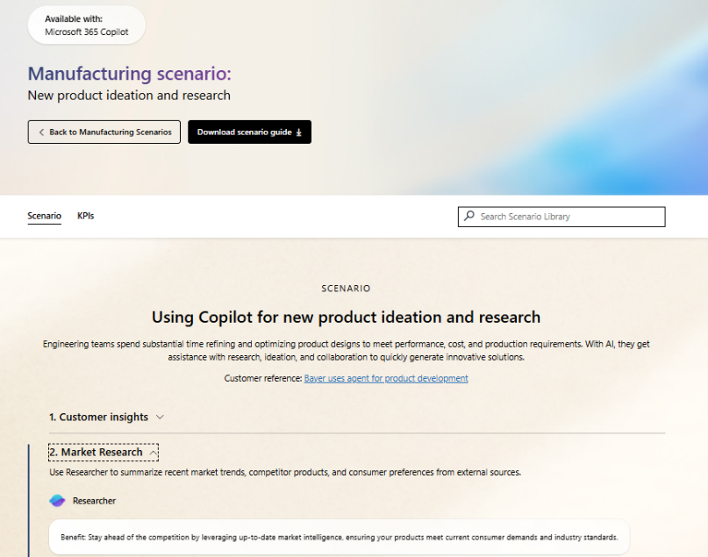
Scenario Library
Get ideas on how to integrate Analyst into your business processes.
Improve merchandising decisions – Use Analyst to help define sales targets based on historical data, market trends, and business goals.
Implement adaptive pricing – Use Analyst to identify sales trends and compare pricing options.
Data strategy and insights – Use Analyst to gain insights into data streams.
Intelligent sales forecasting – Use Analyst to analyze sales and market data to create forecasts.
Financial insights – Use Analyst to gain deeper insights into sources of revenues and costs.
Deliver insights to managers – Use Analyst to produce reports on manager strengths and development opportunities.
Notes:
Analyst in the Scenario Library
As we wrap up, I want to highlight some valuable resources to help you get the most out of the Analyst agent and other Copilot features.
Microsoft provides a scenario library at adoption.microsoft.com, which walks through specific use cases for different functions and industries. You’ll find examples tailored to finance, HR, sales, operations, and more.
These resources include KPIs you might be tracking and show where Analyst and Copilot can help you solve real business problems and drive adoption in your organization.

Slide 19

Resources
Read the announcement blog and view the demos: Blog: Researcher and Analyst are now generally available
Video: Explore Researcher and Analyst agents and the Agent Store
Check out the Agents in Microsoft 365 adoption page
Learn more from our engineering team:
Researcher agent in Microsoft 365 Copilot | Microsoft Community Hub
Analyst agent in Microsoft 365 Copilot | Microsoft Community Hub
Notes:
Finally, we have some great resources available to help you learn more, get started and start to realize how Analyst can play a meaningful role in data analysis across your business. We encourage you to check these resources out and know that we’re continuing to innovate, as you try out these agents, we welcome your feedback and look forward to hearing how you’re leveraging them across your organization.

Slide 20

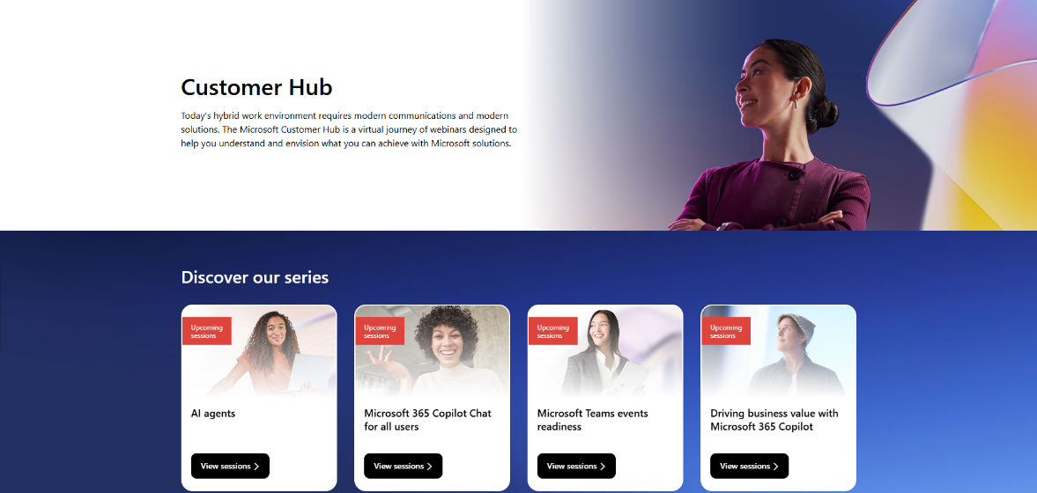
Customer Hub
Visit Customer Hub website for upcoming sessions, updates, and on demand contents!
https://aka.ms/CustomerHubSessions​
Notes:
Customer Hub
Introduction
“As we wrap up, I want to highlight some resources that can help you and your organization get even more value from Copilot Chat.”
Key Points to Cover
Customer Hub
“Get the latest information from Microsoft experts with extensive demos.”
“If you want to deliver the full version of the course you can access is on Customer Hub”
“Next, we’ll look at where to get the content you need for adoption.”

Slide 21
Thank you slide
Notes:
Thank you for attending and participating in today’s session. We appreciate your engagement and feedback.

Slide 22
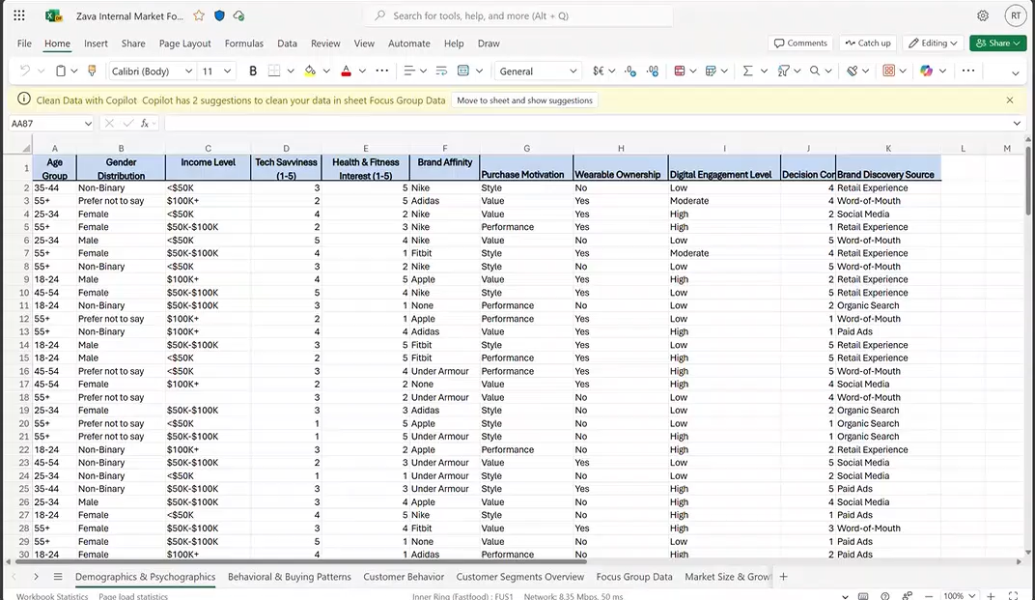
Analyst demo video
Notes:
Demo – use the audio in the video or turn it off and use this description
We used a scenario for working at a fitness company and we’re looking to launch a smart sneaker. We have this messy data set and we’re not sure what segment to target – what demographic, their buying patterns, we have so much of this data available in multiple tabs. You can see focus group data and even market size assumptions. Often times this would take me quite a bit of time to analyze and determine the best segment to target.
Start at 0:38
You can also see we have a second Word document here with more information on the intelligent footware market. There’s information on market size assumptions, growth assumptions, breakdown of regions, some market drivers, and where the best opportunities may sit. It’s likely that between these two data sets it will help me determine the answer to what customer segment we should start with. Typically it may take a few hours and I may need help from the team, so let’s see how Analyst can help me here.
Start at 1:12
So we’re going to head over to the Copilot app, access the Analyst agent and insert the prompt that is to help me decide the right customer segment and demographic to target with a new smart sneaker to maximize our market opportunity including a graph to visualize why. We’re going to point it to the two documents we showed previously, the Excel spreadsheet and the Word document – then we’ll let Analyst go off and do it’s job.
You can see Analyst is starting to think through the process, it starts to understand the data and what’s in the file and then starts to answer the question. You can see it’s sharing it’s chain-of-thought and reasoning along the way. It’s breaking down the steps, analyzing customer segments and you can follow along the entire process.
Start at 2:25
As it takes a few minutes and given time, we previously ran this prompt, so let’s show you the output here. You can see it did a similar chain-of-thought reasoning and gave it very useful answer on the specific market to target, the age group and key metrics on why this segment.
It gave a really nice visualization across the segments where the opportunity might lie and across those key metrics. Now we can take this data and share it with my team and we can move forward with a decision to make progress.

