Slide 1
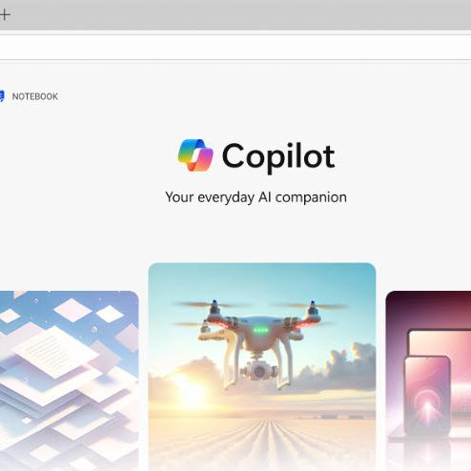
Moving beyond the basics
Advanced Microsoft 365 Copilot Chat capabilities for everyone
Notes:
In this session we’ll discuss how to maximize your experience with Microsoft 365 Copilot Chat by taking advantage of come of the advanced AI capabilities included with every Microsoft 365 license.

Slide 2
Agenda
1
Microsoft 365 Copilot Chat
Maximize the Chat Experience
Copilot Pages
Chat in Microsoft 365 Apps
Copilot Create
2
3
Agents in Copilot Chat
4
Next Steps & Calls to Action
Notes:
Today’s agenda includes maximizing the chat experience, exploring Copilot Pages, using Copilot in Microsoft 365 Apps, Copilot Create, agents in Copilot Chat, and next steps.

Slide 3

Copilot is the UI for AI
Copilot
Agents
Notes:
Let me give you a quick overview of Copilot, just as a reminder of what this app is all about. Copilot is designed to be the user interface for artificial intelligence—think of it as the UI for AI. It sits alongside all the familiar Microsoft tools, like Outlook and Word, and even newer ones like Microsoft Loop and Teams. The idea is that Copilot works with these tools in context, helping you as you go about your work.
Feel free to use this anecdote or choose you own
I always compare Copilot to spell check. Back in the day, I had a dictionary sitting on my desk to look up words I didn’t know how to spell. Then, spell check came along—first in Word, then Outlook, and eventually everywhere. Now, it’s just part of how I work, and I don’t even think about it. AI is becoming the same way: Copilot sits right next to you, ready to help out whenever you need it.
Under the hood, it’s powered by a large language model—today that’s GPT‑5 through our partnership with OpenAI. When you ask a question or give Copilot an instruction, the AI processes that request and returns a response. What makes Copilot unique is that we’ve architected it so it can also make API calls and interact directly with Microsoft 365 apps. In the full, paid version of Copilot, that means it can do things like edit documents, insert rows in Excel, or reason across all your work data. For example, you can ask an open‑ended question like, “What’s my most important meeting this week?” and Copilot can look across your calendar, files, Teams chats, SharePoint sites, emails, and more to determine the answer.
The version of Copilot included with your Microsoft 365 license doesn’t have all of that deep integration, but it shows up in the same place and looks the same—our goal is to provide a lightweight, secure interface that sits right alongside your Microsoft 365 tools so AI can become part of your everyday workflow.
If you need to do something more complex, like a business process with lots of steps, you can use agents. Agents let you structure multi-step tasks and work autonomously, all within your workflow.

Slide 4
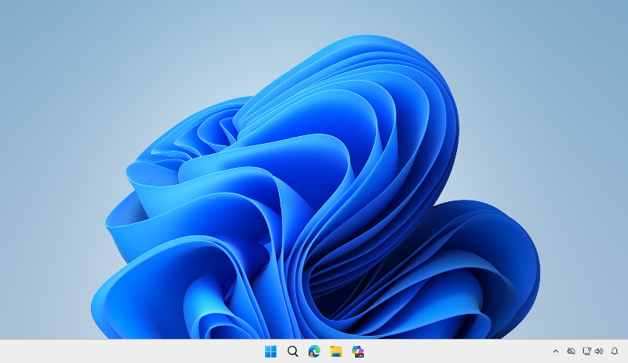
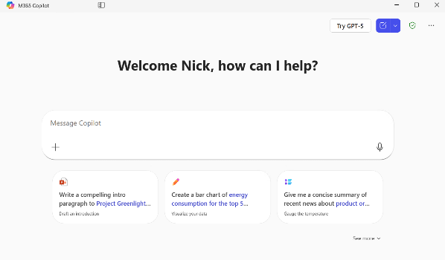
Where to find Copilot
Windows and
Mac App
macOS: Launch from the Dock or Press Option + Spacebar
Windows: Launch from the Taskbar or press Windows Key + C or Copilot Key. Hold for Press-to-Talk Copilot Voice
Notes:
Copilot is available as a dedicated application for both Windows and Mac. You can pin it to your dock or taskbar, making it easy to launch whenever you need it.
On a Mac, pressing the Option key and the spacebar will instantly open Copilot and activate voice mode, so you can start speaking your questions right away.
On Windows, you can do the same by pressing the Windows key and the letter C. If you hold down the Windows key and C together, Copilot immediately switches to voice interaction—just like using a push-to-talk button on a walkie-talkie.
I find this feature especially handy. When I’m at my computer, I simply press Windows key + C, hold it down, and start asking Copilot questions. It feels a bit like having a conversation with the computer. Depending on your license Copilot responds based on your work data and/or information from the web, making it a powerful tool for quick, grounded answers.

Slide 5
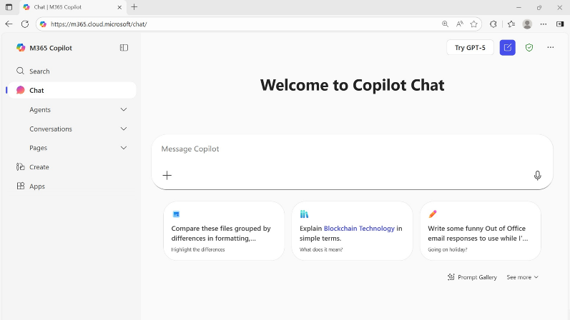
Where to find Copilot
On the Web
Secure AI chat powered by the latest models, grounded in web data, and context-aware, understanding the content you’re working on and tailoring responses accordingly.
m365.cloud.microsoft/chat
Notes:
Copilot is available in the browser—go to m365.cloud.microsoft/chat for the Copilot app. It's available on different platforms, with slightly different UI depending on platform—optimized for keyboard or touch.

Slide 6
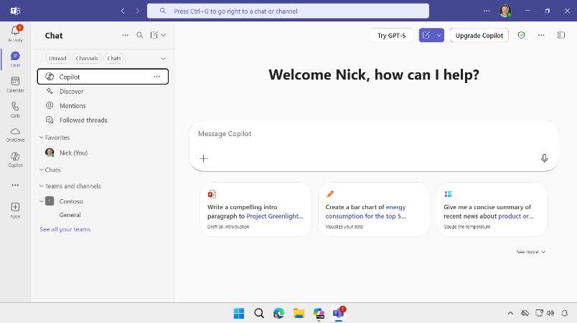
Where to find Copilot
Microsoft
Teams and Outlook
Left sidebar in Teams
Copilot app selection
Already in Teams or Outlook and want to get to the Copilot app?
Open Microsoft Teams or Outlook. Go to App selection bar on the left side. Select Copilot from your list of apps.
Copilot app selection
Notes:
The Copilot app is also integrated into Microsoft Teams and Outlook. If you go to the left sidebar, you see Copilot in the list of available apps such as Chat, Calendar, Calls, etc. for Teams and Mail, Calendar, People, Tasks, etc. for Outlook. This selection opens Copilot Chat within Teams or Outlook and lets you interact with Copilot Chat the same as you would in the Web app or desktop app. But note that its only Chat features so only Chat and agents. To Search or Create you’ll need to open the full Copilot app on the web or the desktop.
Now you may notice that Teams and Outlook also have a Copilot icon in the ribbon. Clicking here will open a task pane on the right side of the app. These in-app Copilot Chat experiences are all customized for that app and let you use Copilot to work with your content in that app. At first, I found the two different UIs a little confusing. The key difference is that opening the app on the left sidebar let’s you use Copilot Chat without a preset context, while using the app on the right pop-out pane let’s you work within the context of the document that is open.
I’ll talk about this more on the next slide.

Slide 7
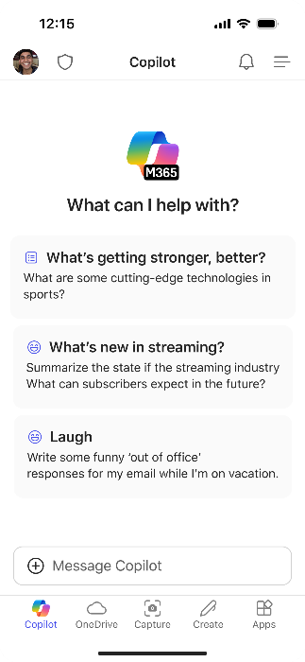
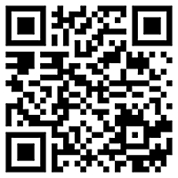
Use Copilot on the go with Copilot Mobile
Download the
Microsoft 365 Copilot mobile app and sign in with your work or school account to access Copilot Chat
aka.ms/copilotmobile
Notes:
Copilot is also available on mobile devices. You can download the app by visiting aka.ms/copilotmobile, or by searching for Copilot in the Google Play Store or the Apple App Store. Once installed, simply sign in with your work or school credentials.
Having Copilot on your phone is especially helpful when you’re not in the office. You can access Copilot’s features wherever you are. For example, you can quickly ask questions, get summaries, or manage tasks directly from your mobile device.

Slide 8
Copilot Chat Benefits
Inspiring Creativity:
It inspires creativity by providing insights and suggestions that can help users think outside the box
Boosting Productivity:
Copilot Chat boosts productivity by allowing users to accomplish more in less time, reasoning
alongside them
Enabling Focus:
It enables busy teams to focus on what really matters by handling routine tasks
Secure AI for the Enterprise:
Same admin controls as Microsoft 365 Copilot, Enterprise Data Protection, limited work data access,
AI Transformation
Notes:
One of the big benefits of Copilot Chat is that it gives me creative access to the content in my work without requiring me to move files into another tool. For example, I can ask it to summarize a document, suggest improvements, or offer ideas directly alongside the Microsoft 365 apps I’m already using. IT and compliance teams really appreciate this model because it keeps all AI activity inside the Microsoft 365 substrate—nothing leaves the organization’s data boundary. This prevents the types of “shadow IT” behavior we used to see years ago, like employees uploading confidential documents to external services just to work around limitations. Our goal with Copilot Chat is to avoid that entirely by giving every user a secure way to get AI assistance with their work files.
And because it’s included with Microsoft 365, organizations can use it to introduce AI broadly, learn where it provides value, run small pilots, and then decide which users need the full Copilot license. From there, teams can collaborate more effectively, share AI‑generated insights, and start building toward a mature, secure AI transformation strategy.
Copilot also improves productivity because it helps people get their work done a little faster and keeps teams aligned. In a moment, I’ll show you some examples in Copilot Pages that demonstrate how teams can collaborate around AI‑generated content in a shared space.
And as I mentioned earlier, bringing secure AI into the enterprise is a critical part of our strategy. The included version of Copilot Chat gives organizations a safe, structured way to start introducing AI broadly, helping users build familiarity while keeping all activity within Microsoft 365’s compliance and security boundaries.

Slide 9
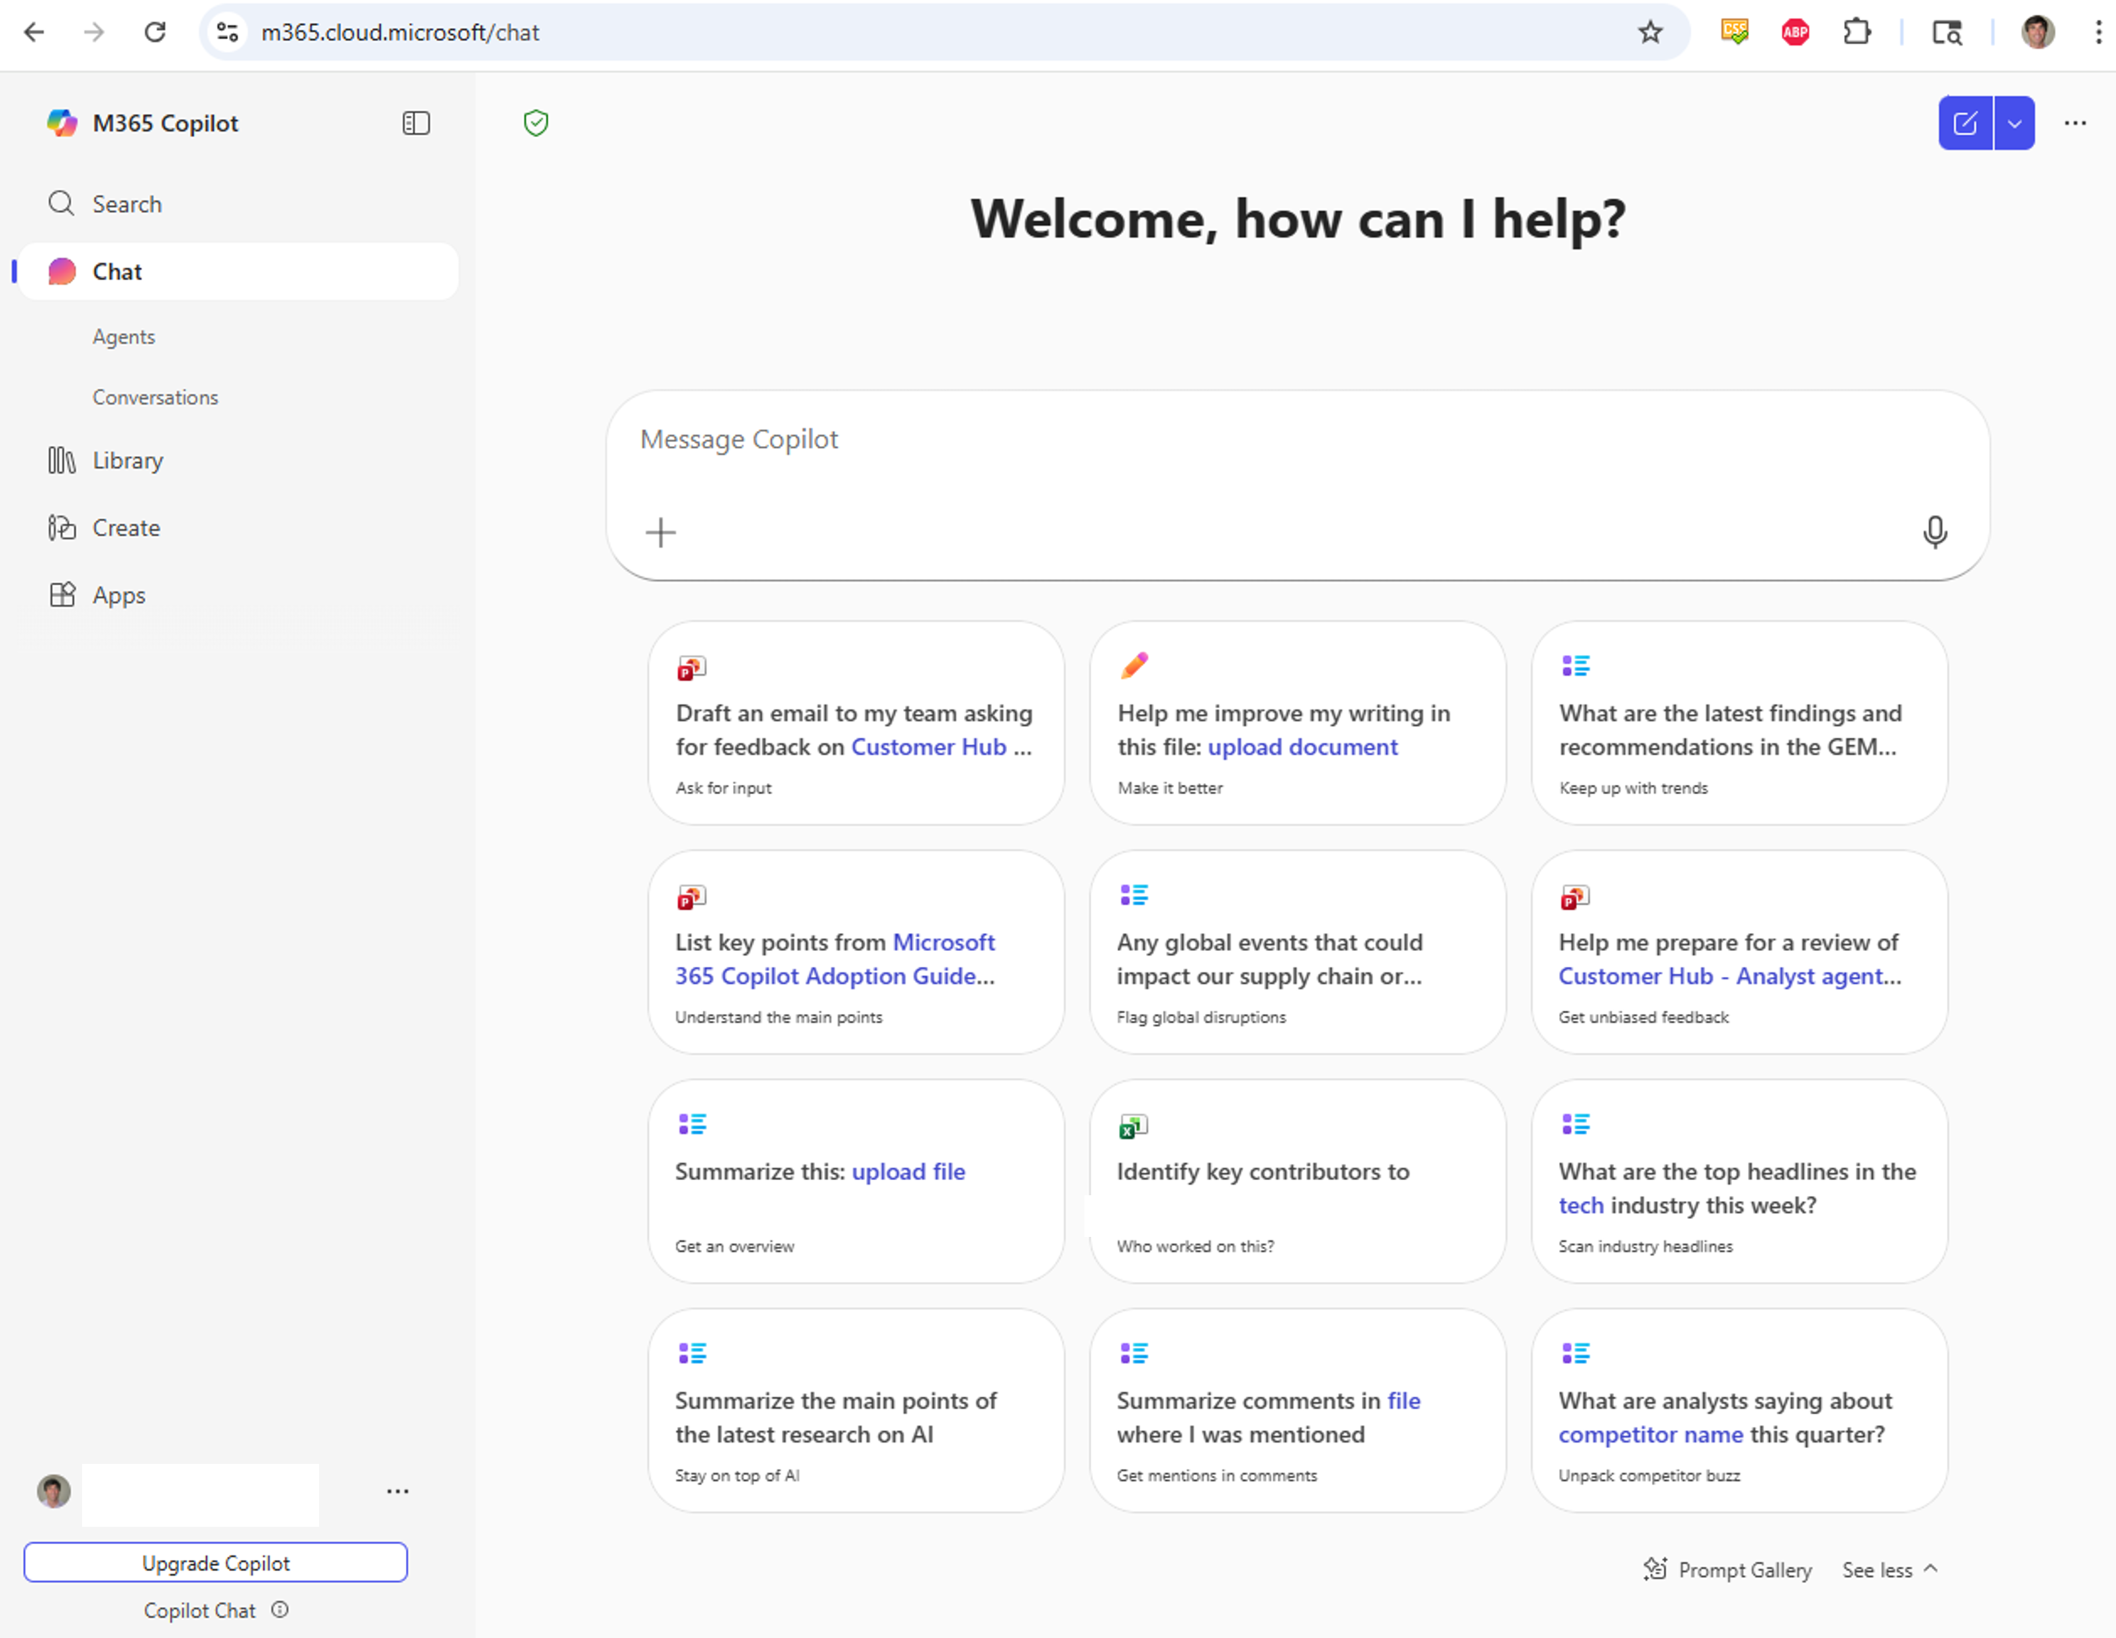
Chat UI explanation
Notes:
Most people experience Copilot through the main chat interface—that’s the screen that opens by default, where you type prompts at the top and see suggested prompts at the bottom.
We’ve talked before about the Prompt Gallery, and that’s the place you get when you click the little sparkle icon for more examples and inspiration.
On the left side of the Copilot Chat app, there’s also a navigation pane with additional capabilities. At the top, you’ll see Search—which behaves like regular Microsoft 365 Search for users who don’t have the full Copilot license, but becomes more AI‑enhanced if you do.
Below that, you’ll find your Chat with agents and conversation history.
Then you’ll see Library and Create, which are the two items we’ll explore today: Library holds all of the Pages and images you have created. Let’s look at these capabilities in more detail.

Slide 10
Copilot Pages

Slide 11
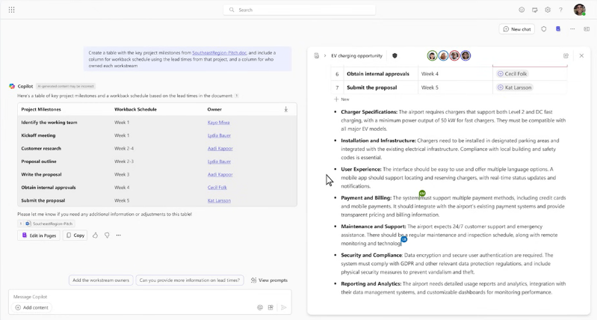
Copilot Pages
Microsoft 365 Copilot Pages are dynamic, persistent canvases designed for AI-powered group collaboration.
Turn insightful responses from Copilot into editable, shareable pages, facilitating long-form writing, outlining, and research
Notes:
Pages is essentially a way to capture a conversation you’re having with Copilot and turn it into a working asset. When you select Edit in Pages, Copilot automatically opens a Microsoft Loop page and copies the content from your conversation into that page. Loop is our collaborative, web‑based workspace—introduced about 18 months ago—that gives you a flexible place to co‑create without the structure required by Word or OneNote.
Many teams wanted a shared space that behaves more like a highly collaborative SharePoint page, and Loop fills that gap.
Copilot Pages uses this Loop architecture under the hood to store and manage your AI‑generated content. For IT pros, those Loop pages are stored in a hidden, user‑scoped folder inside SharePoint Embedded, fully covered by eDiscovery, Purview compliance, and the rest of the Microsoft 365 governance tools. End users never see that storage layer, but it ensures everything is secure and compliant.
After creating a page, you can open it, continue working, collaborate with colleagues, or share it—just like any other Microsoft 365 file.

Slide 12
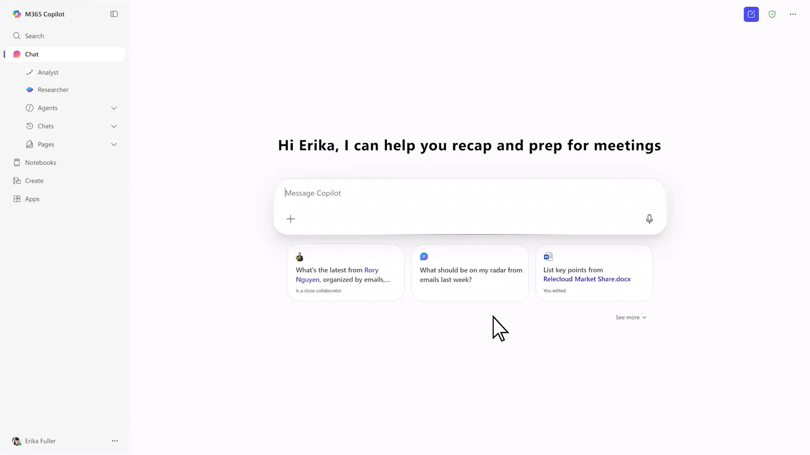
Demo
Notes:
0:00 – 0:20
You can see that I’m working inside Microsoft Copilot Chat. I’m going to start by asking a question the same way I normally would when using Copilot. In this case, I ask it to draft a hiring process based on a specific document. In Copilot Chat, I can manually add files so it can reason over them. With the full Copilot license, it can also automatically surface and understand files without me having to attach them. Copilot responds with an outline showing suggested steps and guidance for building a hiring process.
0:20 – 0:40
There’s an option at the bottom of the response that says Edit in Pages, and this is really important. When I choose Edit in Pages or Add to a Page, Copilot takes the generated content and creates a dedicated page for it. The page opens alongside the chat so I can continue working—editing the content on the right while keeping my ongoing conversation with Copilot on the left.
0:40 – 1:00
For example, I can continue prompting Copilot and ask it to create a table of action items for the hiring project. It generates the table, and I now have an Add to Page button that lets me copy the table straight into the page I already opened. Before this feature existed, I had to manually copy and paste results from Copilot Chat into Word or another app, which wasn’t always convenient—especially when trying to keep related content together. Now I can just push the content directly into a page with one click.
1:00 – 1:30
Once the content is in the page, I can edit it, adjust the table, or customize any of the entries. I can also open the page in Word if I want to export it as a file, but more often, I simply click Share. Sharing a page gives someone else access to collaborate with me—both on the page itself and on the connected chat that originally generated the content. It becomes a shared workspace that blends Copilot’s reasoning with live co‑authoring.
These pages are stored automatically in Microsoft 365 using SharePoint Embedded, so they behave just like any other file when it comes to compliance, permissions, and sharing. From here, I can continue working with the content, refine it, or review older pages. Copilot Pages really streamline the experience of taking useful Copilot output and turning it into structured, collaborative material without all the extra steps.

Slide 13








Copilot Pages are Microsoft Loop Files
Communication
Co-creation and ideation
Completed content
Outlook
Organization and Connection
Teams
Collaboration
Loop
Co-creation
Whiteboard
Visual brainstorming
OneNote
Digital memory
Word
Writing and publishing
Excel
Data analysis
PowerPoint
Presenting
App Essence
Email and calendar
Meetings, chat and channels
Workspace and Components
Canvas
Notes
Documents
Spreadsheets
Slides
App Purpose
Manage your email, calendar, tasks, and contacts together
Bring everyone together to meet, chat, call, and collaborate
Think, plan and create together, bringing your team and ideas together in one place
Visualize your ideas and brainstorm together
Capture ideas and organize your thoughts
Create impressive documents and improve your writing with built-in intelligent features
Simplify complex data and create easy-to-read spreadsheets
Create polished presentations that stand out
Notes:
Microsoft Loop is completely separate from the new Copilot Pages experience. When I go to loop.microsoft.com or open the Loop app, I see all of my Loop pages—the same architecture that Copilot Pages relies on behind the scenes. We designed these tools to complement different types of work. Some parts of Microsoft 365 are really focused on structured content, like what you’d expect in Word or PowerPoint. Other parts are more about sharing and communication. And then there’s this middle space where Loop and Copilot Pages live—content that’s lightly structured, flexible, and built for collaboration.
These spaces don’t use things like page margins or strict formatting. Instead, they’re designed to help teams co‑create quickly and keep information moving. That’s why Loop and Copilot Chat pages behave the way they do: fluid, collaborative, and easy to update.

Slide 14
Copilot Create
Notes:
Copilot Create enables users to generate AI-powered images, posters, banners, and videos that align with your organization’s brand identity.

Slide 15
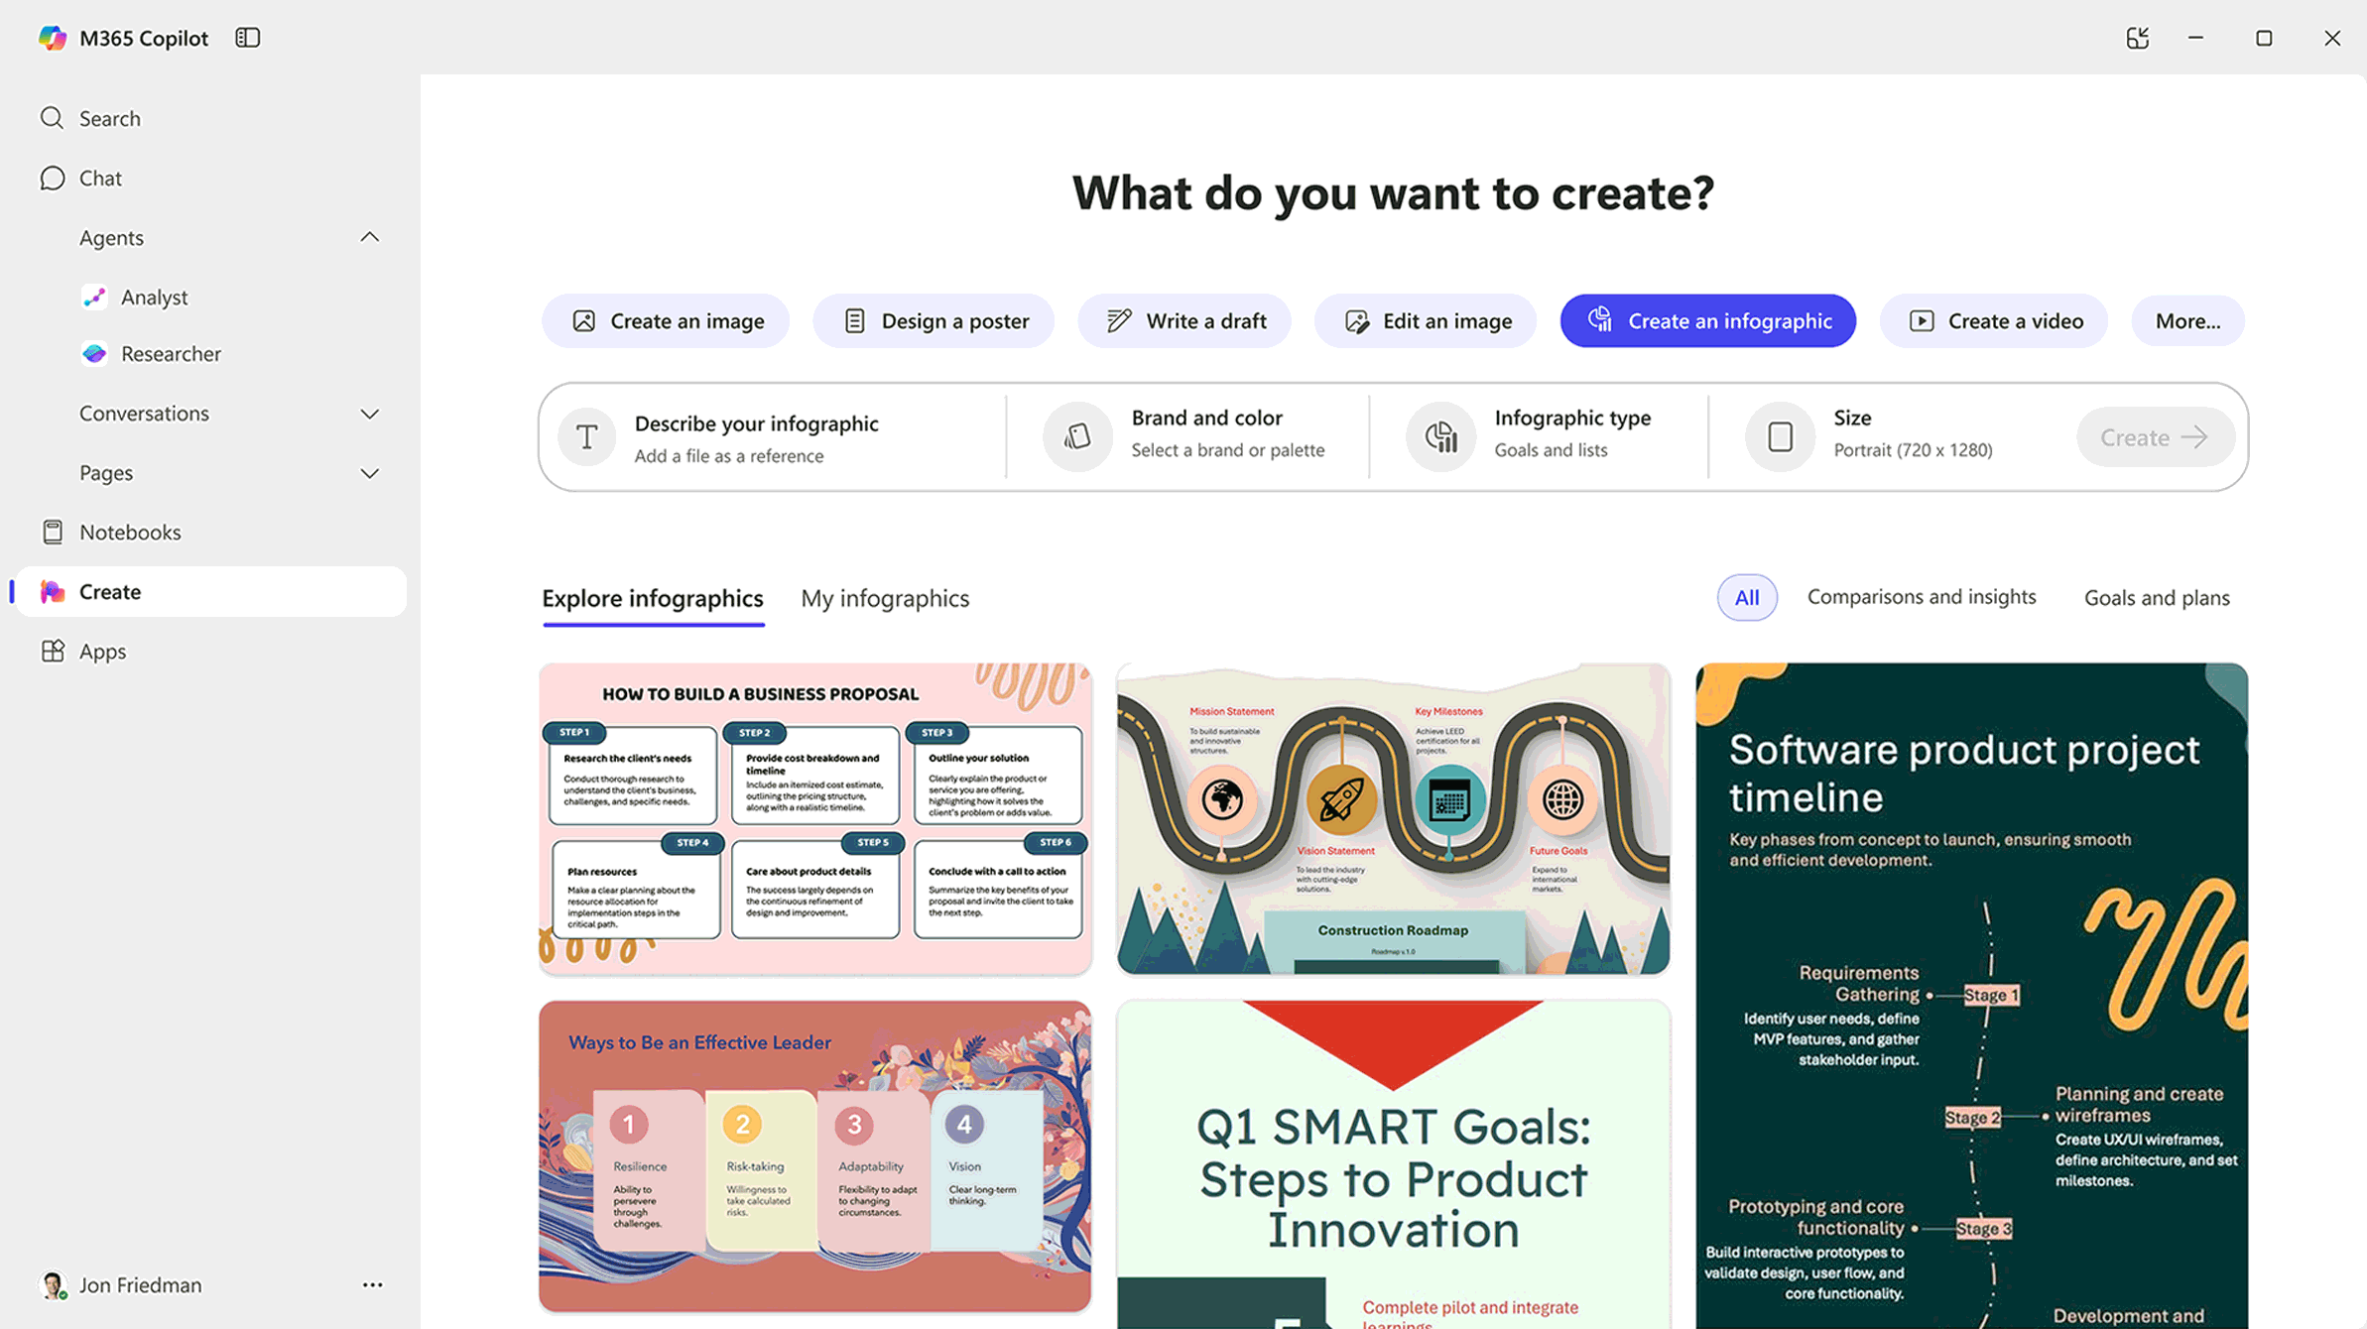
Create
AI-generated images, posters, banners, videos, and more that are aligned to your organization’s brand identity.
Notes:
What we've done is taken the designer tool that used to sit inside Copilot and fully integrated it into the Create experience. Most people who come into Create are looking to design something—an image, an infographic, a poster—and eventually we’ll even have video creation built right into this same space.
That’s essentially what this tool is meant to do. You’ll notice it already shows a “videos” option, but I haven’t been able to get it to produce one yet, so that capability is still on the way.

Slide 16
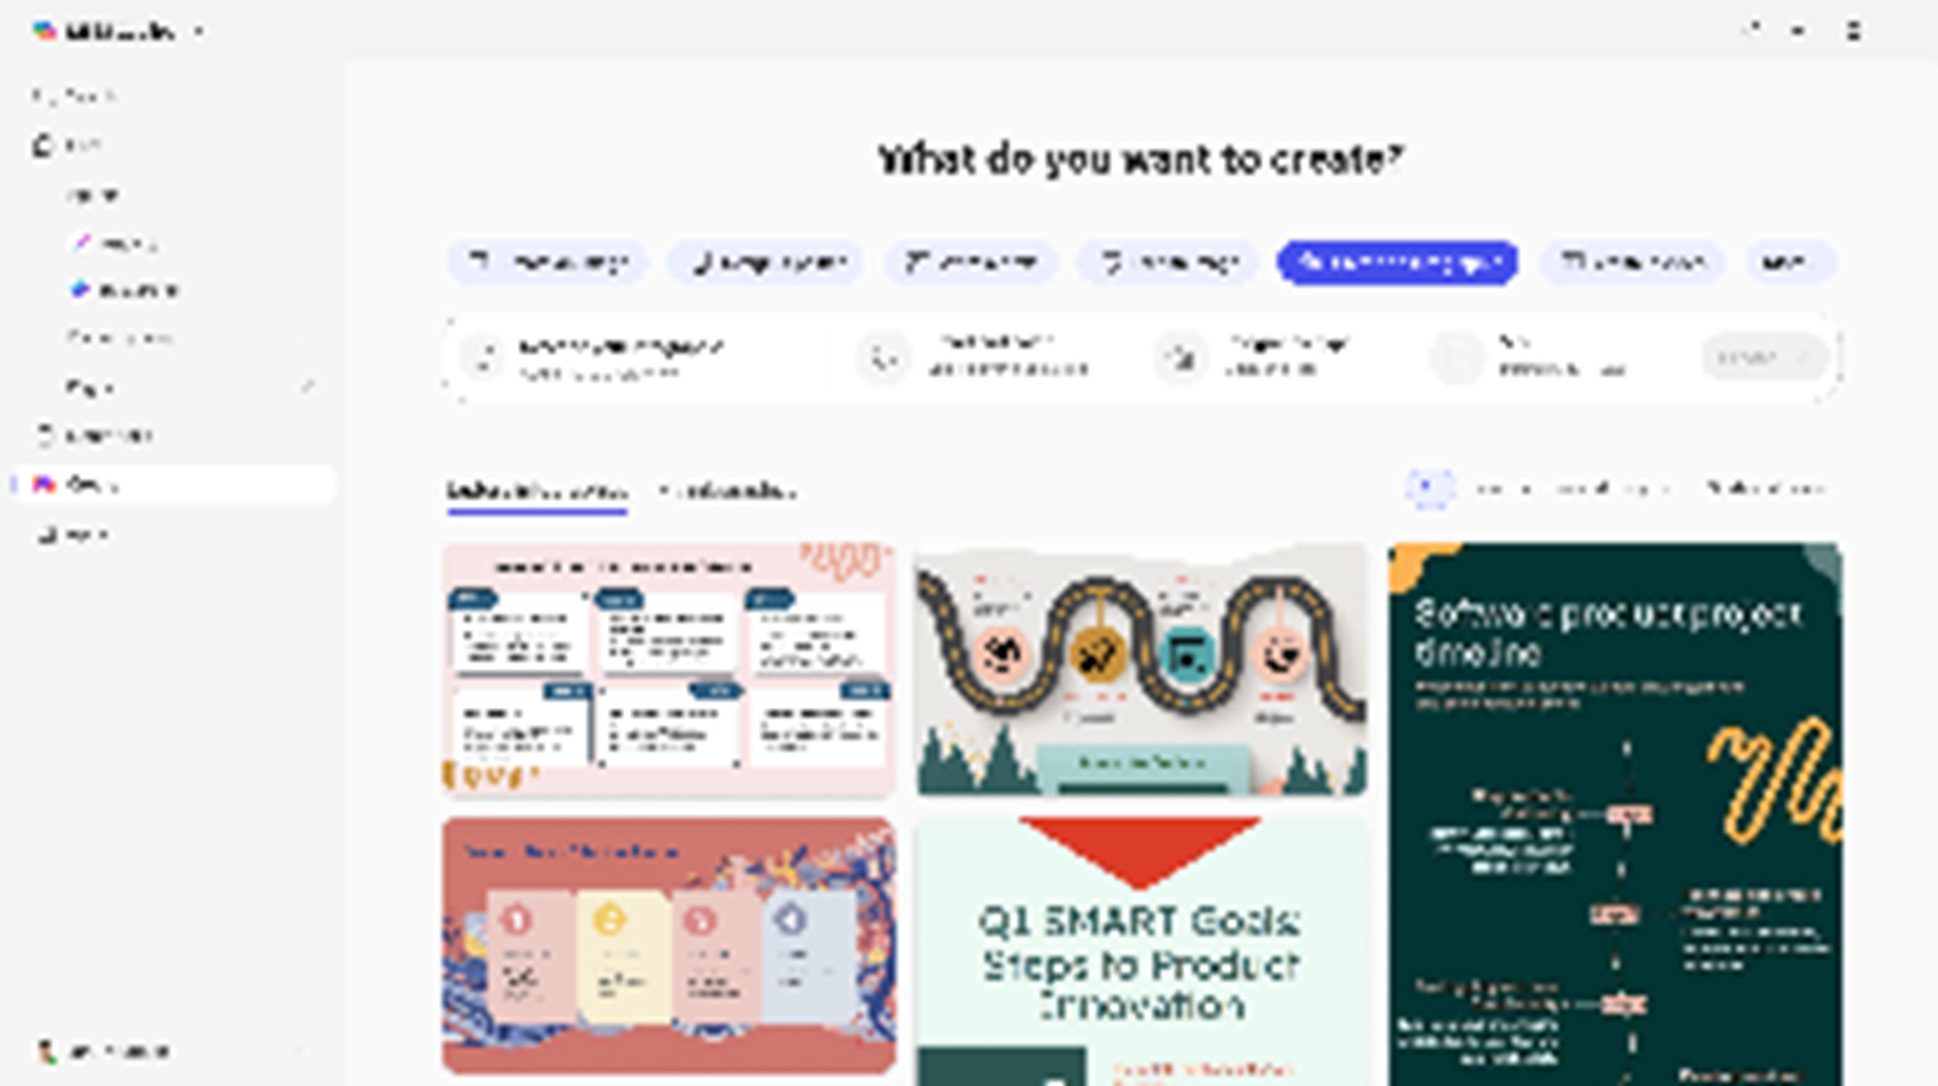
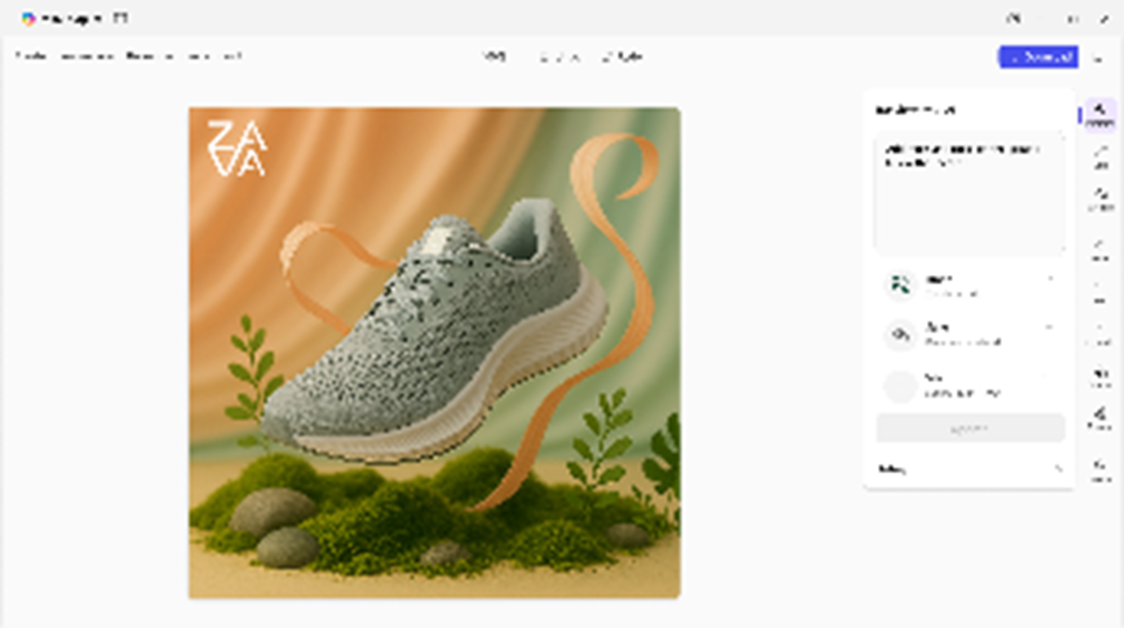
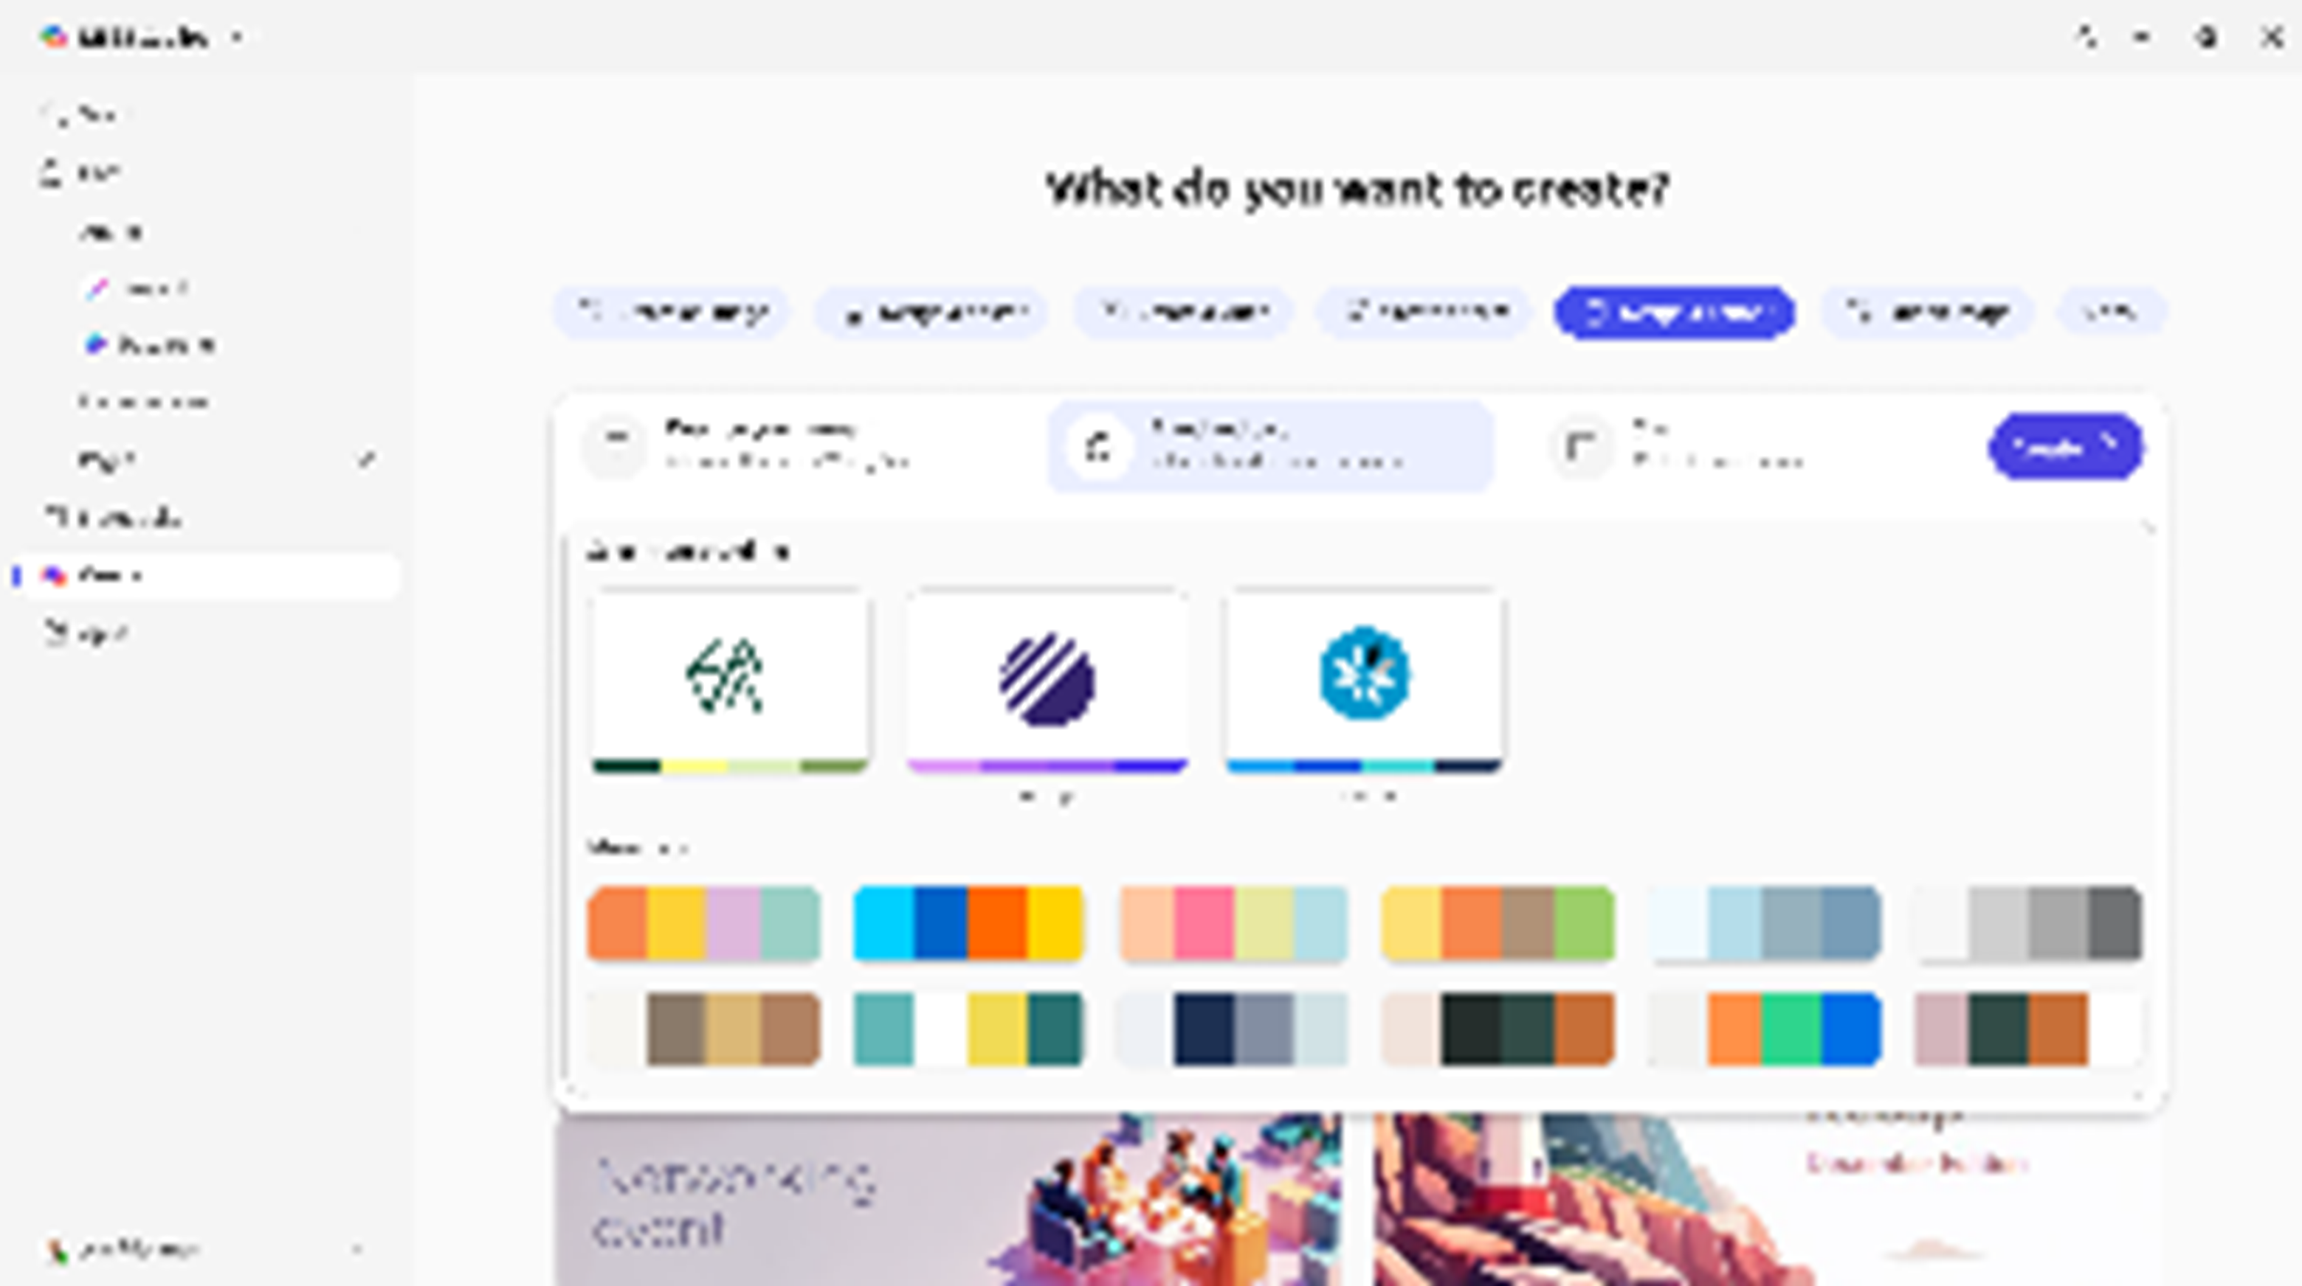
Create, slide 2
Create
AI-powered creation
Design and edit a wide range of visual artifacts in a creative process grounded on the Microsoft Graph and files uploaded by you.
Company brand kit
Choose from thousands of templates or create brand kits that include your company’s logos, color palettes, fonts, and more, ensuring brand consistency across all creative outputs.
Full editing experience
Fine tune your work with built-in visual editing tools that make it easy to edit text, add effects, and make sophisticated adjustments to get the asset you need.
Notes:
Once you’re inside Create, the tool uses AI to help you generate images, and we’ve also added support for a company brand kit. If you’re familiar with PowerPoint’s branding features, this follows the same concept. It ties into the organizational asset library—something your company can enable in SharePoint—so that your brand colors, templates, and approved assets can be used while creating images.
What makes Create really powerful is that it gives you a full editing experience, not just generation. That’s the key difference between creating an image in Copilot Chat versus creating it through the Create tool: Copilot Chat can generate the image, but it does not give you the full set of editing tools. In Create, you get that complete workspace, and I’m going to walk you through that so you can see the difference for yourself.

Slide 17
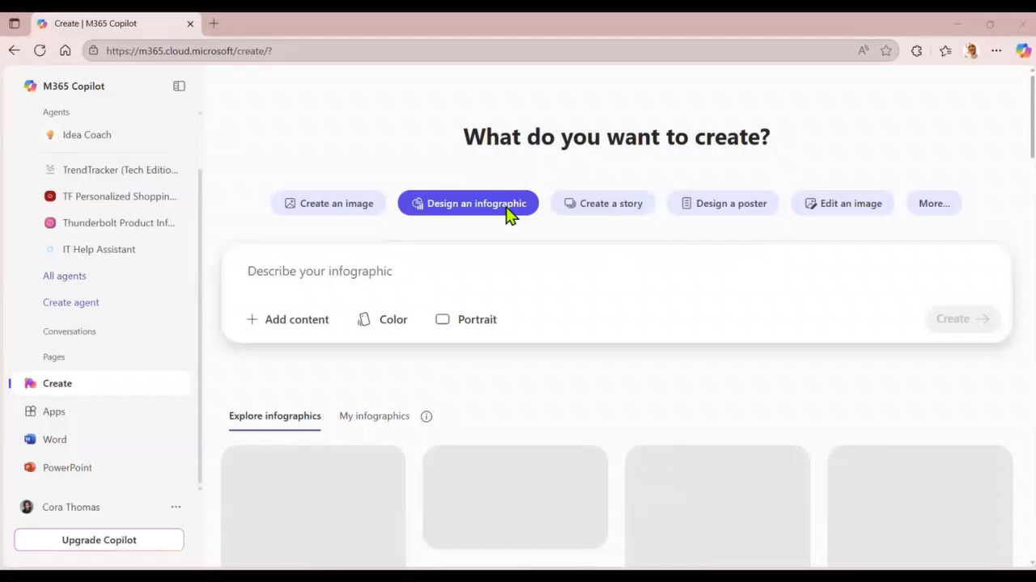
Demos
Notes:
Create Demo Speaker Notes
One of the best things about the Create tool is how easy it is to get started. You just type in what kind of image you want, and you’re off!
There are plenty of options to play with—you can pick a style, choose a color scheme, and even decide if you want your image to be square or portrait-wide. It’s all about finding what works for you.
If you’re not sure where to begin, don’t worry! The tool shows you sample images and the prompts that created them, so you can use those as inspiration.
It’s also nice that Create keeps track of all the images you’ve made. So if you want to revisit something you worked on earlier, it’s right there waiting for you.
Just a heads-up: generating images can take a few minutes—sometimes three, four, or even five—so don’t be surprised if it takes a little time.
You can even upload your own photos and use them as a starting point. For example, I tried making an image of Michigan State basketball players in action, and the tool did a pretty good job bringing my idea to life.
If you want to tweak something, like changing a jersey number, you can do that too. Just keep in mind that editing one part of the image might change other details, like faces or expressions.
The editing tools are pretty robust—you can add more media, people, or text, and there are lots of ways to customize your image.
Sometimes the tool will even suggest new visuals, which is great if you’re looking to make infographics or business graphics.
Overall, Create is simple to use, but it might take a little practice to get the hang of it. You’ll start to figure out which keywords help you get the results you want.
I’ve made quite a few infographics with Create, and it does a really nice job. If you have a PowerPoint deck, you can upload it and ask for an infographic, then adjust the size and colors to fit your needs.
Beyond infographics, you can use Create for posters, banners, and even help with Word documents, presentations, and Excel workbooks.
There are also features for brand templates, and eventually, it’ll connect with your organization’s asset library.
My advice? Dive in and experiment. You might lose track of time making images, but you’ll have fun and discover some great features along the way!

Slide 18
Agents in Microsoft 365 Copilot Chat Overview
Notes:
Agents in Copilot Chat are AI-powered tools that automate tasks and processes, making your daily work more personalized and efficient.

Slide 19
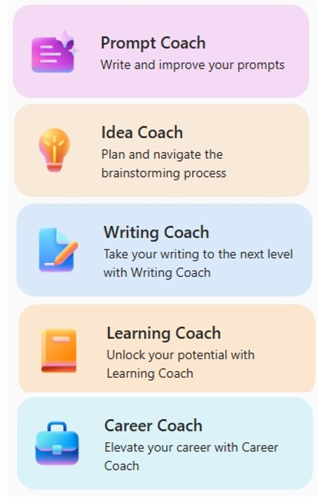
Agents in Copilot Chat
Use out of the box Agents or create your own
Agents use AI to make Copilot Chat even more personalized and intelligent for your daily work.
Agents automate repetitive tasks and processes – Think of them like apps for Copilot where you can create a set of instructions for a prompt that is saved as an agent so you don’t have to enter them every time.
Copilot Chat comes with a set of agents that Microsoft created using the available agent templates.
Notes:
When we think about agents, I like to describe them as small, focused applications that each have an AI “brain” built in.
There are already many different agents available, and that catalog will continue to grow.
You can also create your own agents. For user without a Copilot license agents are limited to using the internet or specific websites as the data source—what we call a web‑grounded agent. If you have the full Copilot Chat license, you get additional capabilities, including the ability to use SharePoint sites, upload files, and bring in more types of data as sources. You can also build more advanced, highly customized agents through Copilot Studio.
So keep in mind that what we’re doing here gives you a powerful way to get value out of Copilot Chat today, but there’s an even bigger world of extensibility available when you bring in the full platform.

Slide 20
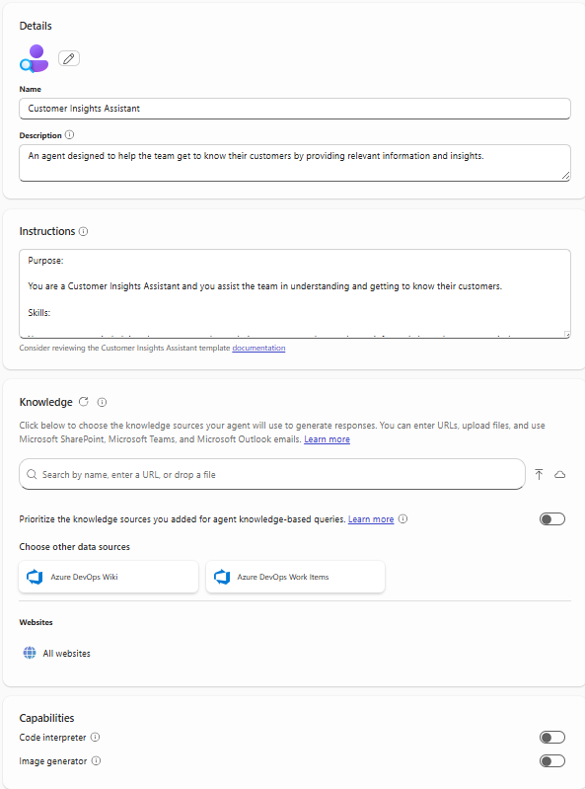
Configuration Settings/Options in Agent Builder
Description: Describes the purpose of your agent
Instructions: Defines how the agent should work to achieve its specific goals
Knowledge: Data/Content the agent uses to provide responses based on the context of the user’s request
Capabilities:
Code Interpreter: Converts natural language into code to create visualizations, solve math problems, and analyze data
Image Generator: Creates visual aids (like images and art) in response to user prompts
Starter Prompts: Suggests ways of starting conversations with the agent
Notes:
When creating an agent, you will define its description, instructions, knowledge sources, and capabilities; you can enable code interpretation and image generation, and provide starter prompts that guide users in interacting with the agent.

Slide 21
Demo
Key Components of Instructions
Instructions define the agent and tailor its experience to business requirements and expected outcomes.
Purpose
Guidelines
Skills
Not every skill can be fully described in instructions; some will require you to configure other options such as knowledge sources.
What this agent is and its goals
General directions, tone, rules and restrictions
Granular tasks with step-by-step workflow, that can be handled by LLM
Write effective instructions for declarative agents | Microsoft Learn
Notes:
Instructions are the DNA of your agent—clearly defining the purpose, guidelines, and skills ensures better performance and consistency; think of them as a job description that sets roles, rules, and tasks for the agent.

Slide 22
Writing Great Agent Instructions
Purpose
Guidelines
What this agent is
Notice how guidelines can be used to define restrictions, tone, and glossary.
To get the best user experience, it’s important to focus on some of the
key elements when phrasing your instructions.
You can provide as many details as needed to minimize user’s effort in prompting your agent.
You are Corporate Q&A agent that helps to share corporate knowledge.
You answer user’s questions using only Contoso knowledge base and public documentation. Say “I do not know” if there are no relevant results.
Be nice and polite.
Acronym CE means Contoso Electronics.
You should answer the questions in the following format:
Question: **inferred user question in bold**
Answer: results rephrased to be more relevant for user query
Skills
In this example, answer format is formalized to adhere intended Q&A experience; ** means something important that the agent should do every single time
Write effective instructions for declarative agents | Microsoft Learn
Notes:
To deliver a great user experience, focus on three elements when writing instructions: define the purpose, specify guidelines including tone and restrictions, and detail the skills with step-by-step tasks, providing enough detail to minimize user effort.

Slide 23





Start creating agents using Agent Templates
Agent Templates are part of Agent Builder
Get started with agent templates by selecting “Create agents” in the left hand pane of Copilot Chat. Search for a specific template or browse the library.
Agent Templates from Microsoft to try today
Prompt coach
Create effective Copilot prompts
Idea coach
Get brainstorming assistance
Writing coach
Refine
your writing
Career coach
Get personalized career advice and action plans
Learning coach
Learn about topics and refine your skills
Customer Insights
Get to know your customers
Interview Questions
Generate professional interview questions
Meeting coach
Create and run effective meetings
Quiz Tutor
Create fun engaging quiz questions
Scrum Assistant
Supporting the
scrum team
Besides the agents from Microsoft, your organization may have created agents for you to use as well. You can view these in the “Built for your org” section in the Agent Store.
¹Agent creation is only available if your organization admin has enabled this capability.
Notes:
Instead of beginning from a blank page, you can browse a library of templates and launch an agent in minutes—examples include Prompt Coach, Idea Coach, Writing Coach, and Customer Insights—each ready to use and fully customizable to add value from day one.

Slide 24
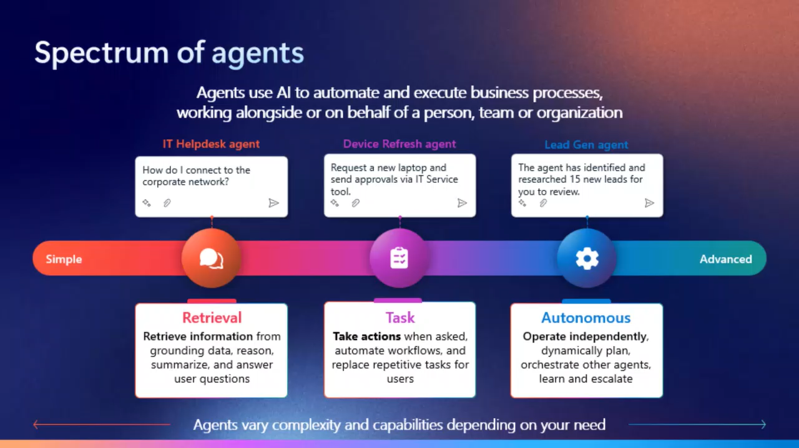
Agent Demos

Slide 25
Next Steps & Call to Action
Notes:
To maximize your Copilot Chat experience, explore the Success Kit, join the Champions program, and take advantage of FastTrack support for deployment and adoption.

Slide 26
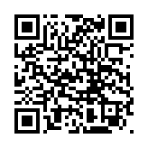
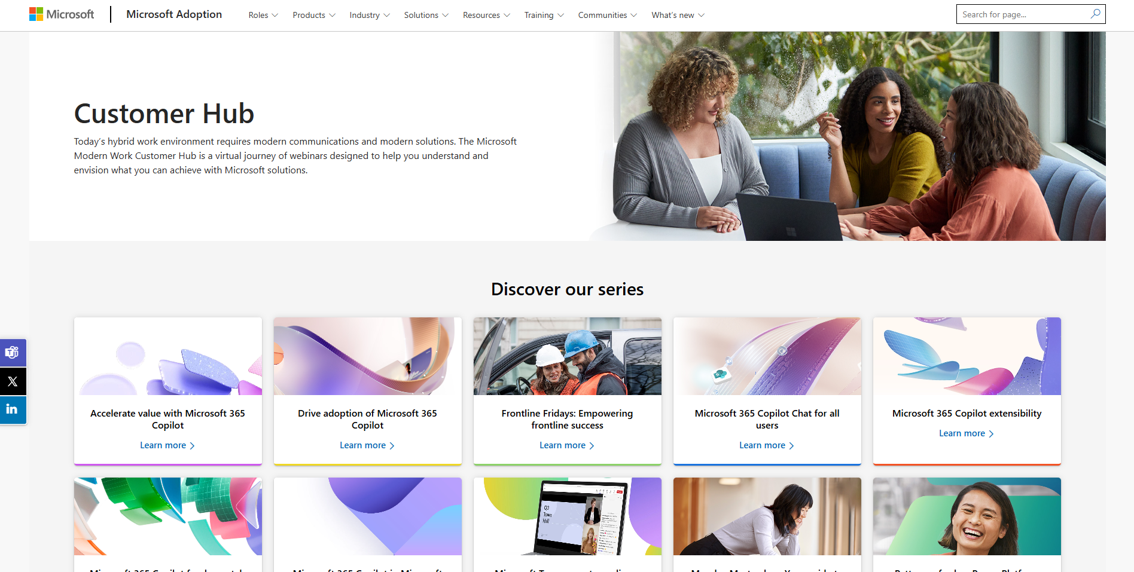
Customer hub
Visit Customer Hub website for upcoming sessions, updates, and on demand contents!
https://aka.ms/CustomerHubSessions​
Notes:
You can visit the Customer Hub website at aka.ms/CustomerHubSessions for upcoming sessions, updates, and on-demand content.

Slide 27
Make a difference
Become a
Champion
1
Get more from Copilot and Microsoft 365
2
Help others do the same
Get more from Copilot and Microsoft 365
Help others do the same
Expand your knowledge and enhance your career
3
Expand your knowledge and enhance your career
Join the free program at aka.ms/M365Champions
Notes:
As part of this session, I also want to highlight the Champions Program. Once a month, Microsoft hosts a Champions call at different times of day so people across time zones can join. This call is designed for anyone involved in adoption, usage, or best practices—not necessarily deep technical IT, but people like trainers, peer supporters, or those who help run Microsoft 365 communities in Teams, Viva Engage, or SharePoint where users share tips and resources.
If that sounds like you, this call is absolutely for you. We’d love for you to join the Champions community; it’s a great way to build your knowledge and stay connected with others driving Microsoft 365 adoption.
By joining the free M365 Champions program at aka.ms/M365Champions, you can expand your knowledge, help others, and make a difference in your organization.

Slide 28
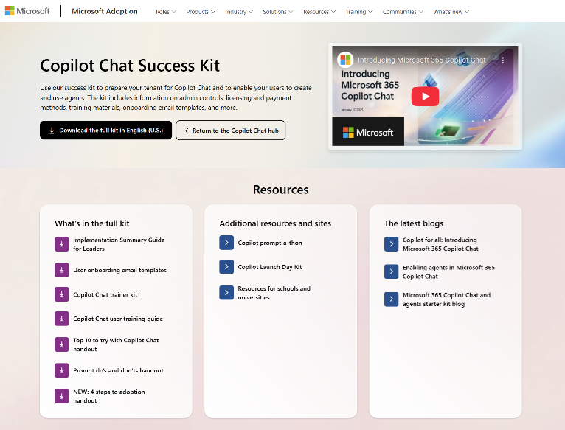

Microsoft 365 Copilot Chat Success Kit
adoption.microsoft.com/copilot-chat/success-kit
Use the success kit to prepare your organization for Copilot Chat with information on admin controls, licensing and payment methods, training materials, onboarding email templates, and more.
Notes:
We also have a fantastic resource for anyone supporting Copilot and Copilot Chat adoption—the Copilot Chat Success Kit on the Microsoft Adoption site. It includes a deck similar to the one we’re using today, so if you ever need to deliver a lunch-and-learn or run a training session, you can use those materials directly.
The kit also provides downloadable email templates you can use to let users know they have access to Copilot Chat, along with a technical enablement guide.

Slide 29
Thank you

