Slide 1
Researcher Deep Dive
Customer Hub -AI Agents Series
Overview
Use Cases & Scenarios
Prompt Guidance

Slide 2

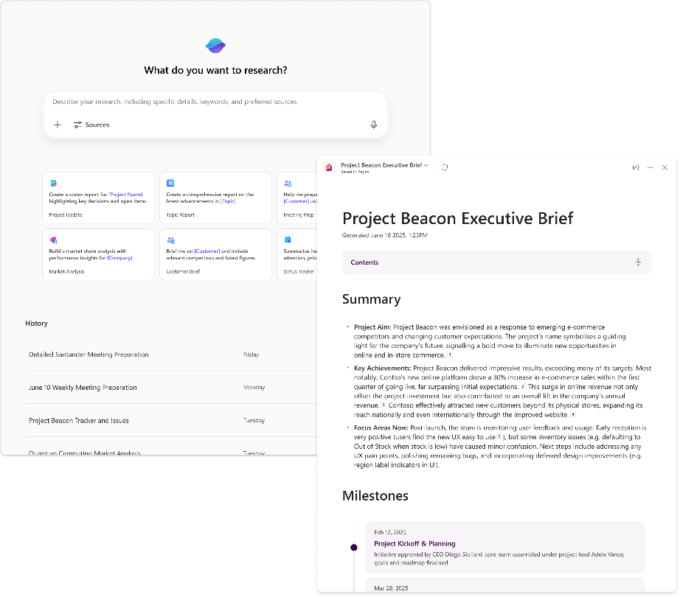
Meet Researcher: Your very own research assistant
Unlike traditional Copilot responses, Researcher spends 10–30 minutes, performing deep reasoning across your enterprise data and trusted web sources, before curating a detailed, contextual, and actionable report tailored to your toughest questions.
Whether you’re preparing for that big meeting, evaluating a new market, or aligning on strategy, Researcher acts like a team of subject experts, working securely and compliantly within your Microsoft 365 environment.
Delegate complexity. Gain clarity. Stay ahead.
Notes:
Introducing Researcher Agent
Today, I want to introduce you to Researcher, one of Microsoft’s first-party deep reasoning agents.
Unlike Copilot, which is designed to give you quick answers for simple questions, Researcher is built to handle complex, challenging problems that require detailed thinking and analysis.
Think of Researcher as an agent that takes its time to understand the task at hand. It doesn’t just respond instantly—it reflects, plans, and then delivers a thorough, well-considered answer.
To help you understand the difference, let’s use the concept from Daniel Kahneman’s book, Thinking, Fast and Slow. Our brains have two modes: fast, reflexive thinking and slow, deliberate thinking. Copilot is like fast thinking—quick and reactive. Researcher is like slow thinking—careful, methodical, and deep.
When you ask Researcher a question, expect it to spend 10 to 30 minutes working through the problem. It will start by listing out the tasks it needs to complete, then systematically work through each one to arrive at a comprehensive answer.
In my experience, Researcher acts like an enthusiastic new intern in your organization. You can delegate your toughest problems to it, and it will do all the necessary research and due diligence before coming back to you with a detailed response.
Let me highlight what makes Researcher unique:
It’s designed for reflection, not just reflex. It’s for your hardest problems—those that need careful, detailed thought.
When you give Researcher a prompt, it doesn’t jump into action immediately. Instead, it pauses and may ask you clarifying questions to get more context and understand exactly what you’re looking for.
This approach ensures that the answers you get are not just quick, but truly insightful and tailored to your needs.

Slide 3
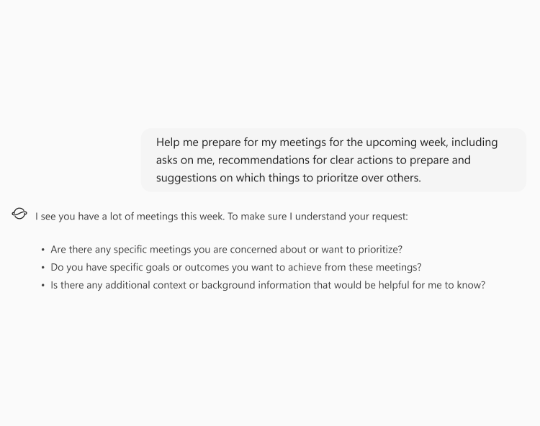
Reflect, not reflex
How it works
Clarify
Backtracking, error handling
Unchartered or uncertain areas
Cross-checking
Notes:
Researcher’s Reflective Approach
Let’s talk about what makes Researcher different from other agents, especially Copilot.
Researcher is designed to reflect, not just react. It’s not about giving you a fast, reflexive answer—it’s built for your hardest problems, the ones that need careful, detailed thinking.
For example, if you need to do a competitive analysis in a product space, or plan a detailed deployment strategy as an IT admin, Researcher is the right tool for the job. It’s meant for situations where you need to think deeply and thoroughly.
When you give Researcher a prompt, it doesn’t jump into action right away. Instead, it pauses and may ask you clarifying questions—just like a thoughtful intern would. This helps it gather more context and understand exactly what you’re looking for.
You might be asked about the kind of answers you expect, or for more details about your problem. Taking the time to answer these questions helps Researcher deliver a much more valuable and tailored response.
The key takeaway: Researcher is for your most complex challenges. It’s not about speed—it’s about depth, accuracy, and relevance. By reflecting and asking for more context, Researcher ensures you get answers that truly address your needs.

Slide 4
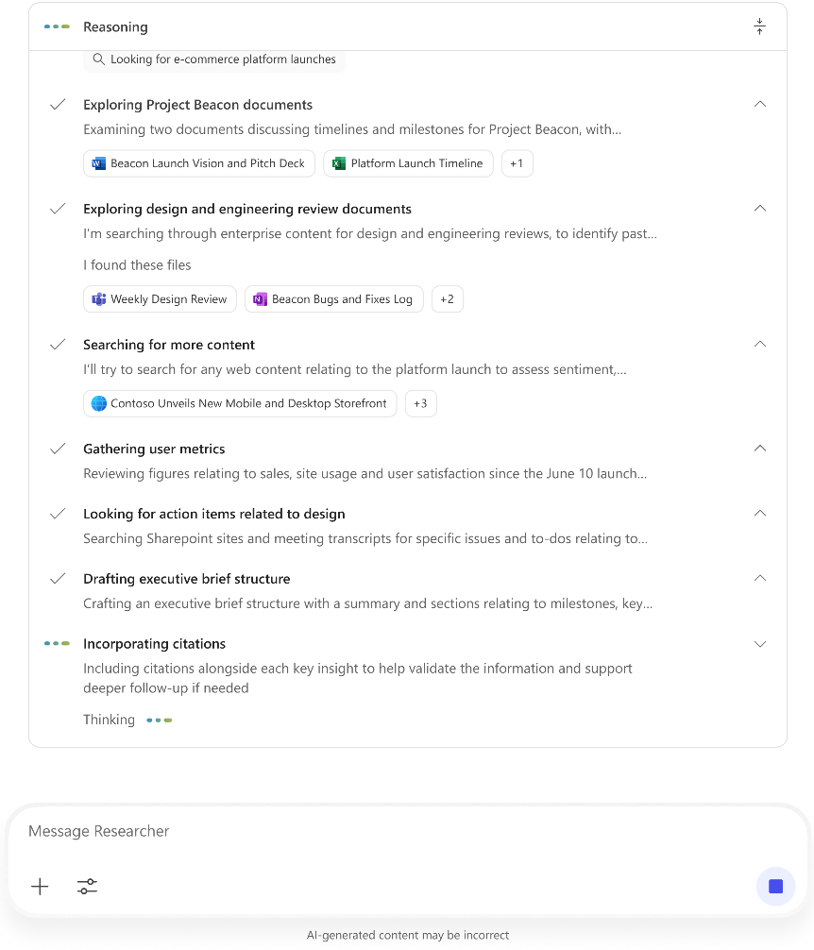
Continuous reasoning
How it works
Model carries forward its chain-of thought
Notes:
Continuous Reasoning in Researcher
Another key feature of Researcher is its ability to perform continuous reasoning, which is often called “chain of thought” in the world of AI agents.
When you give Researcher a prompt, it doesn’t just answer right away. Instead, it writes down a list of tasks it needs to complete to solve your problem.
For example, if you ask Researcher to do a market competitive analysis for a product or feature, it will:
Identify the top market players in your space.
Decide how to compare these players—maybe by pricing, features, or market share.
Gather and analyze all the relevant facts, even if you didn’t specify every detail.
You don’t have to spell out every step—Researcher is designed to think ahead and break down your request into actionable tasks.
This approach gives you much more thorough and detailed answers, because Researcher is actively reasoning through the problem, step by step, rather than just responding to a single question.
The result is a deeper, more insightful response that covers all the important aspects of your challenge.

Slide 5
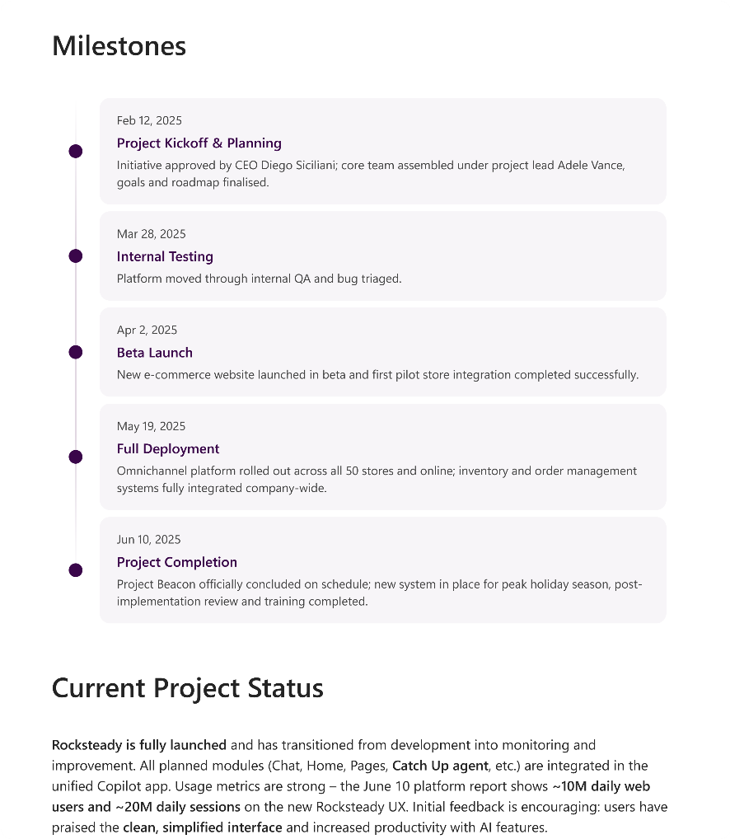
Deeper inferencing
How it works
Draws connections to provide tighter narratives and inferred conclusions over factual summarization
Notes:
Deep Inferencing with Researcher
Now, let’s look at another important capability of Researcher: its ability to perform deep inferencing.
In an enterprise setting, you’re often dealing with a huge volume of information—documents, emails, chats, and even web data. With so many sources, it’s common to encounter conflicting information.
Researcher is designed to handle this complexity. It can connect different, sometimes conflicting, pieces of information and reason through them to determine which source is most reliable and accurate.
This is a major advantage over standard Copilot, which may not go as deep when evaluating multiple sources. Because Researcher is built for deep thinking, it can sift through all the data and provide you with thorough, factual insights—even when the information isn’t straightforward.
The result is that you get answers that are not only comprehensive, but also grounded in the best available evidence from across your organization and the web.
In summary, Researcher’s deep inferencing helps you make sense of complex, sometimes contradictory information, so you can make better decisions based on solid insights.

Slide 6
Across Roles
C-Suite Executives
Executives need comprehensive data to make strategic decisions
The Researcher Agent provides detailed reports integrating data from various sources,
helping executives make
informed decisions and stay ahead of
industry trends.
Marketing Professionals
Marketers need to create targeted campaigns based on diverse data
The Researcher Agent compiles data from customer demographics, market analysis, and social media trends, enabling marketers to craft effective and personalized campaigns
LHR Professionals
HR Professionals need to manage employee data and stay updated with
HR trends
The Researcher Agent consolidates data from employee records, industry reports, and HR best practices, providing insights that help HR Professionals improve employee engagement
and retention
Product Managers
Product Managers need to understand market needs and competitor strategies
The Researcher Agent analyzes market trends, customer feedback, and competitor data, providing insights that help Product Managers develop successful products
Sales Managers
Sales Managers need to track sales performance and identify
new opportunities
The Researcher Agent aggregates data from sales reports, customer feedback, and market trends, providing insights that help Sales Managers optimize strategies and boost sales.
IT Admins
IT Admins need to stay ahead of rapidly evolving technology trends and
security threats
The Researcher Agent gathers data from tech blogs and security reports, providing detailed insights to help IT admins make informed decisions and stay ahead of threats.
Notes:
Researcher’s Value for All Roles
Now, let’s talk about how Researcher can support you, no matter your role or function in the organization.
Whether you’re a C-level executive, a manager, or an individual contributor, Researcher can help you gain deeper knowledge and insights on any topic or technology you’re interested in.
For executives, Researcher can be your learning buddy—helping you understand complex subjects in greater depth, beyond just quick answers.
If you’re in sales, Researcher can analyze your product landscape and customer needs, then help you draft tailored pitches that resonate with your target audience.
The key point is that Researcher adapts to your specific needs and context, providing valuable support whether you’re learning, strategizing, or preparing to engage with customers.
No matter your industry or role, there are many scenarios where Researcher can help you work smarter and more efficiently.

Slide 7
Get started with Researcher
1
You are <Role>: Specify the role
2
ASK: The specific task that you want Researcher to accomplish
3
Guiding principles: Share some guiding principles on how you want Researcher to approach the problem
4
Select sources
  Sources: Select many sources for more breadth of data and select appropriate sources to avoid noise.
  Leverage the Web
5
Specify the output format
  Length of the format
  Sections, subsections and more
  Formats (Coming soon)
Notes:
Getting the Most Value from Researcher
Let’s talk about how to get the best results from Researcher and similar AI agents.
Remember, these agents are powerful, but they’re not a substitute for human creativity, context, and critical thinking. The more context you provide, the better the output you’ll receive.
Think of delegating a hard project to an intern. You wouldn’t just say, “Do a market analysis.” Instead, you’d explain why you need it, what you’re hoping to achieve, and any important details or constraints.
When creating prompts for Researcher, give as much background and context as possible. Some customers even create multi-page prompts to guide the agent’s work.
Consider building a prompt library—a collection of well-crafted prompts that you and your team can reuse and share to get consistent, high-quality results.
Here’s a tip: Assign a role to Researcher in your prompt, like “You are a research analyst” or “You are a financial analyst.” This helps the agent understand the perspective and approach you want it to take.
You can also specify which sources to prioritize or avoid, and guide the agent on how to structure the output—such as requesting specific sections or formats.
By providing clear instructions and context, you’ll have much tighter control over the results and ensure that Researcher delivers exactly what you need.

Slide 8
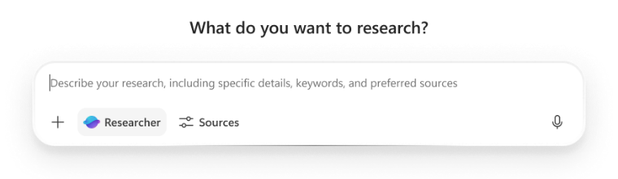
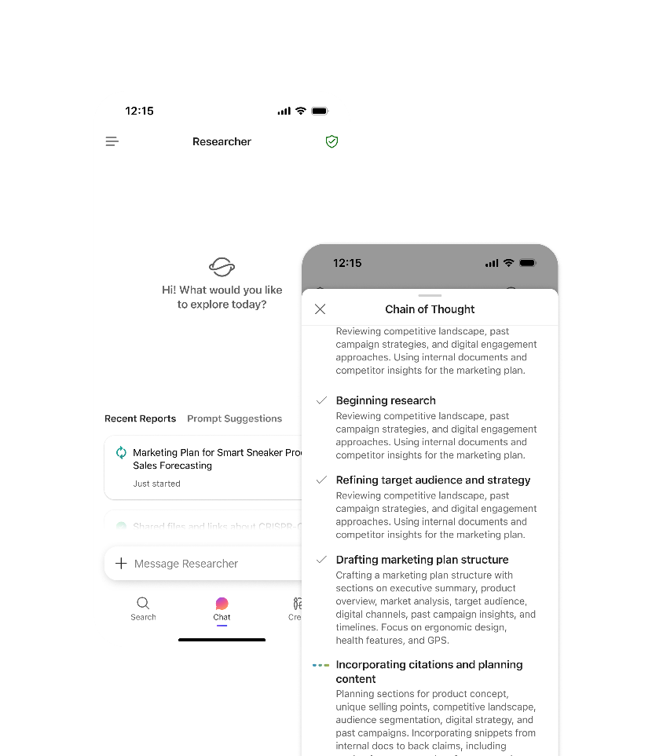
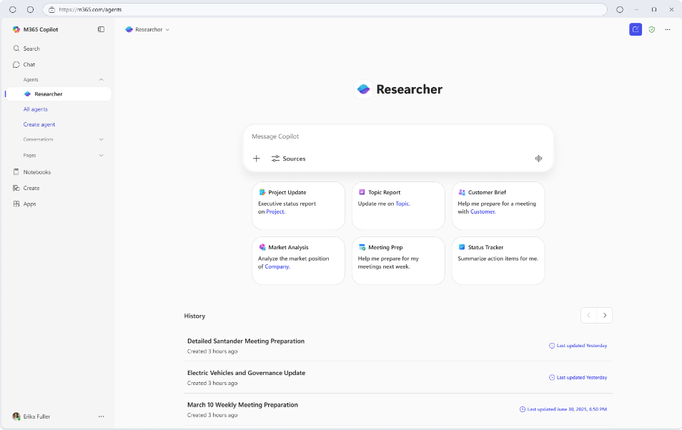
Access Everywhere
Notes:
Expanding Access to Researcher
Let’s talk about how access to Researcher is expanding to make it even easier for users to leverage its capabilities.
Researcher is now available on mobile endpoints, so you can use its deep reasoning features from your phone or tablet, not just your desktop.
We’re also bringing Researcher directly into the Copilot prompt box. This means you’ll be able to access Researcher’s advanced analysis and reasoning simply by clicking a button in the Copilot interface, making it much more convenient to start a conversation with the agent wherever you’re working.
The goal is to make Researcher available across as many endpoints as possible, so you can get help with complex tasks no matter where you are or what device you’re using.
These improvements are designed to help you integrate Researcher into your daily workflow, making advanced reasoning and analysis accessible anytime you need it.

Slide 9
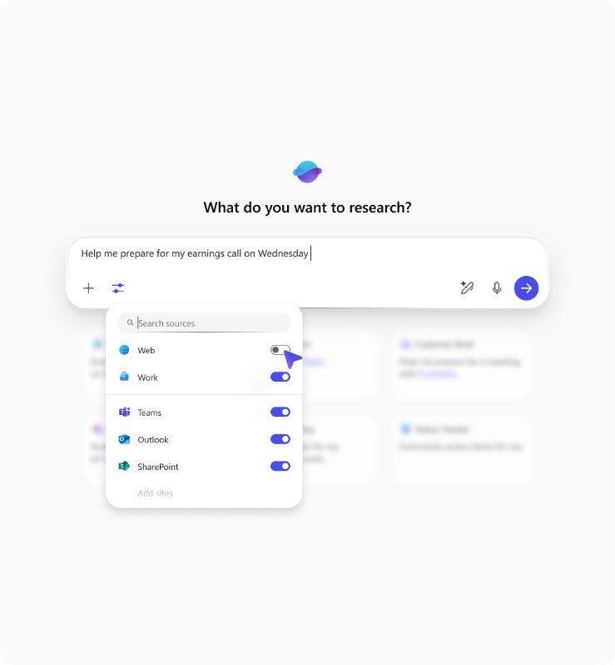
Users in Control
Sources control
Notes:
Upcoming Features for Researcher Agents
Before we move into the demo, I want to share some exciting features that are coming soon to Researcher agents.
Source Controls
Currently, Researcher can ground its reasoning in both work and web data, but soon, users will have more control over which sources Researcher uses.
You’ll be able to manually select whether you want Researcher to use only work data, only web data, or a combination. This gives you more flexibility and ensures that the agent’s analysis is tailored to your needs and privacy requirements.
If you want Researcher to look at just a particular document or specific SharePoint sites—without getting distracted by emails or Teams chats—you can set those preferences. This helps you get the right balance between signal and noise, so your results are high quality and relevant.
Report Length Controls
We know some users love deep, detailed reports, while others want quick summaries.
That’s why we’re working hard to let you control the length of Researcher reports.
If you’re making an executive report, you might want a short summary instead of a long, dense document. Soon, you’ll be able to adjust the report length to fit your needs.
Microsoft Native Formats
We’re also making it easier to export your Researcher results into Microsoft formats like Word and PowerPoint.
This means you can quickly move your findings into documents or presentations and keep working without any hassle.
Key Takeaway:
Researcher is becoming more flexible, letting you choose your sources and report length, and making it easier to use your results in familiar Microsoft tools. This is all about helping you get the information you need, in the format you want, with less noise and more control.

Slide 10
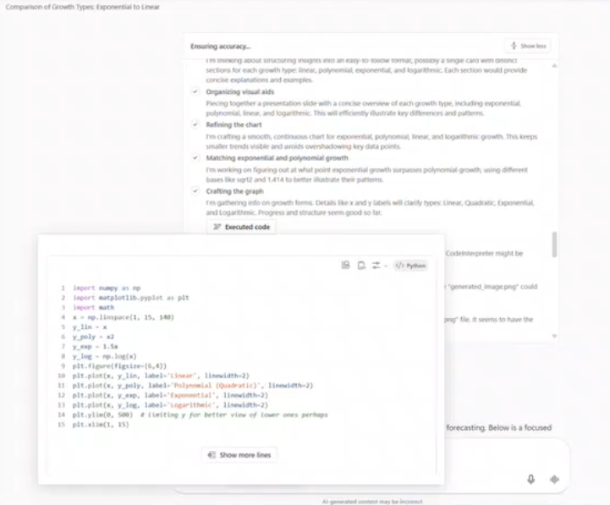
Code Interpreter
Notes:
Code Interpreter in Researcher
Introduction
Let’s talk about a powerful new feature in Researcher: the code interpreter.
What’s New?
Researcher can now actually write and run Python code for you.
This means you can use Researcher to create static charts and visualizations from your data—no coding experience needed.
Why Is This Useful?
Imagine you have some basic data you want to analyze. Instead of just looking at tables of numbers, Researcher can turn that data into a chart automatically.
For example, if you’re doing a simple market share analysis as part of a bigger project, Researcher can take your data, run the Python code, and instantly show you a chart.
How Does It Help?
You don’t have to ask for a chart or enable anything special—Researcher just does it for you, on the fly.
This makes your findings much easier to understand and share, especially when you’re presenting to others.
Key Takeaway:
Researcher’s new code interpreter lets you go from raw data to clear, visual insights—quickly and easily. It’s all about making data analysis more intuitive and accessible for everyone.

Slide 11
Copilot Chat with GPT-5 vs. Researcher
Copilot Chat with GPT-5 chooses which to use
 | GPT-5 Chat | GPT-5 Reasoning | Researcher
Type of task | Quick and straightforward: Simple Q&A, summaries, or creative brainstorming | Logical analysis and problem-solving: Complex questions that benefit from deliberate thought, reasoning through scenarios | Thorough investigations or reports: Comprehensive tasks requiring gathering and synthesizing information from lots of sources
Depth of reasoning | Direct and rapid answers | Multi-step logical reasoning for “think this through” – type prompts | Recursive, “exhaustive” reasoning for deep inferences and synthesis
Output format | Brief, concise responses | Structured, well-organized responses | Comprehensive, detailed reports
Ideal use case | Everyday queries | Analytical and structured reasoning | In-depth research, cross-source synthesis, deep dives
Example use cases | What does this acronym mean? Draft a 2-sentence reply thanking the team Summarize this document | Plan a 5-step project timeline from kickoff to launch List the decisions made yesterday on Project X and identify open questions Let’s walk through this problem together | Compile a competitive analysis on… Summarize the new research on x and compare it to our internal strategy Create a detailed brief before a large meeting
Sample prompts | “Write a short announcement for [product x].” | “Look back at last week’s activity on [product x], and write a detailed newsletter to share with all stakeholders identifying current status, key decisions, and open items.” | “Build a full go-to-market strategy for [product x]. Include competitive positioning, internal readiness, lessons learned from past launches, and external trends.”
Notes:
GPT-5 Reasoning vs. Researcher Agent
Now, let’s discuss the difference between GPT-5 reasoning and the Researcher agent.
With Copilot, you get quick, reflexive answers—great for simple questions and fast tasks. GPT-5 reasoning takes this a step further, offering more structured thinking and deeper analysis for moderately complex problems. It typically takes 30 seconds to a few minutes to deliver a well-organized answer.
Researcher, on the other hand, is designed for your most challenging problems—those that might take days or weeks to solve manually. It uses deep reasoning and thorough analysis, often spending 10 to 30 minutes to produce a comprehensive report or solution.
For example, if you need a five-step framework or a process overview, GPT-5 reasoning is a good choice. But if you want to push AI to its limits and get the most detailed, thoughtful output—like a market strategy or an in-depth financial analysis—Researcher is the agent to use.
Researcher can analyze both internal documents and web data, providing insights that are grounded in real facts and supported by citations. It’s ideal for complex scenarios where you need to save significant time and get expert-level analysis.
In summary, use Copilot and GPT-5 reasoning for quick and moderately complex tasks, and turn to Researcher for deep, strategic thinking and the most demanding challenges.

Slide 12

Researcher demo video
Notes:
Show the demo with audio

Slide 13





Try it! Researcher Agent
Sample Query
Sample Output
“Give me a detailed history and current status update on Project Alpine and identify all key decisions and open questions. Focus on [meetings/files/etc.]”
Researcher will gather emails, meeting notes, documents, and any SharePoint pages about that project and summarize the timeline and current state.
Project
Status
“Prepare a report for my upcoming meeting with Fabrikam Co. My goals for this meeting are…”
Researcher will pull the last interactions with Fabrikam, recent news about them, and relevant product info
Client
Prep
“What are the latest trends in cybersecurity and how might they impact our business? Focus on [product/project/etc.]”
It will consult internal reports in your organization’s knowledge base as well as external articles
to produce a trend report.
Industry
Research
“Brief me on Company X’s recent announcements
and our internal insights on them.”
Combining web/news data about Company X with any internal analysis or emails that discuss Company X
Competition
Analysis
““Help me prepare for my week. I want to…”
A report that outlines your upcoming meetings, deadlines, and pulls in any materials you should review for each, essentially a personalized weekly game plan.
Personal
Productivity
Notes:
Here are some suggestions for prompts to try with Researcher. Use them to come up with a prompt that make sense for your audience and try it out.

Slide 14
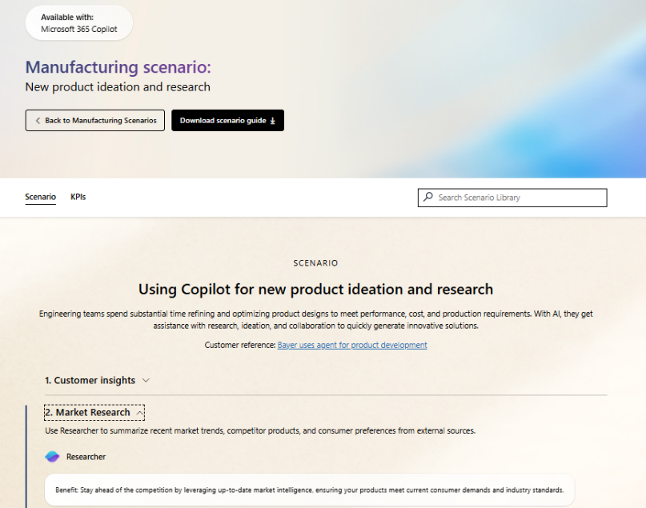
Scenario Library
Get ideas on how to integrate Researcher into your business processes.
New product ideation and research – Use Researcher to create a report on market trends, competitor products, and consumer sentiment. Then combine market research, project information, and meeting notes into a report on new product ideas.
Streamline market research and strategy – Use Researcher to create a market research report from internal and external sources.
Data strategy and insights – Use Researcher to propose a strategy for how to monetize data streams.
Create an unsolicited proposal – Use Researcher to better understand a customer’s business challenges and strategies before proposing new services. Then use Researcher to create a strategy for using your solution to improve the customer’s business.
Draft a product strategy document – Use Researcher to create a proposal for a new IT solution.
Notes:
Researcher in the Scenario Library
As we wrap up, I want to highlight some valuable resources to help you get the most out of the Researcher agent and other Copilot features.
Microsoft provides a scenario library at adoption.microsoft.com, which walks through specific use cases for different functions and industries. You’ll find examples tailored to finance, HR, sales, operations, and more.
These resources include KPIs you might be tracking and show where Researcher and Copilot can help you solve real business problems and drive adoption in your organization.

Slide 15
Resources
Read the announcement blog and view the demos: Blog: Researcher and Analyst are now generally available
Video: Explore Researcher and Analyst agents and the Agent Store
Check out the Agents in Microsoft 365
adoption page
Learn more from our engineering team:
Researcher agent in Microsoft 365 Copilot | Microsoft Community Hub
Analyst agent in Microsoft 365 Copilot | Microsoft Community Hub
Notes:
Finally, we have some great resources available to help you learn more, get started and start to realize how Analyst can play a meaningful role in data analysis across your business. We encourage you to check these resources out and know that we’re continuing to innovate, as you try out these agents, we welcome your feedback and look forward to hearing how you’re leveraging them across your organization.

Slide 16
Next Steps and Call to Action

Slide 17


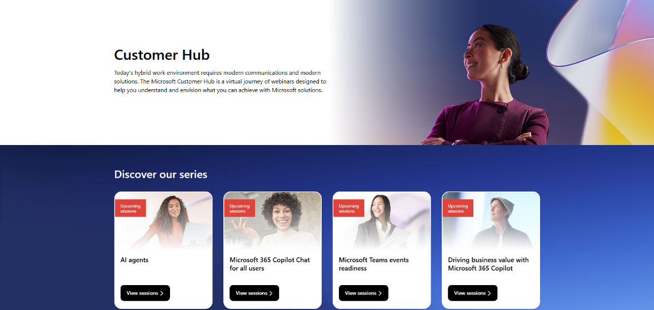
Customer Hub
Visit Customer Hub website for upcoming sessions, updates, and on demand contents!
https://aka.ms/CustomerHubSessions​
Notes:
Customer Hub
Introduction
“As we wrap up, I want to highlight some resources that can help you and your organization get even more value from Copilot Chat.”
Key Points to Cover
Customer Hub
“Get the latest information from Microsoft experts with extensive demos.”
“If you want to deliver the full version of the course you can access is on Customer Hub”
“Next, we’ll look at where to get the content you need for adoption.”

Slide 18
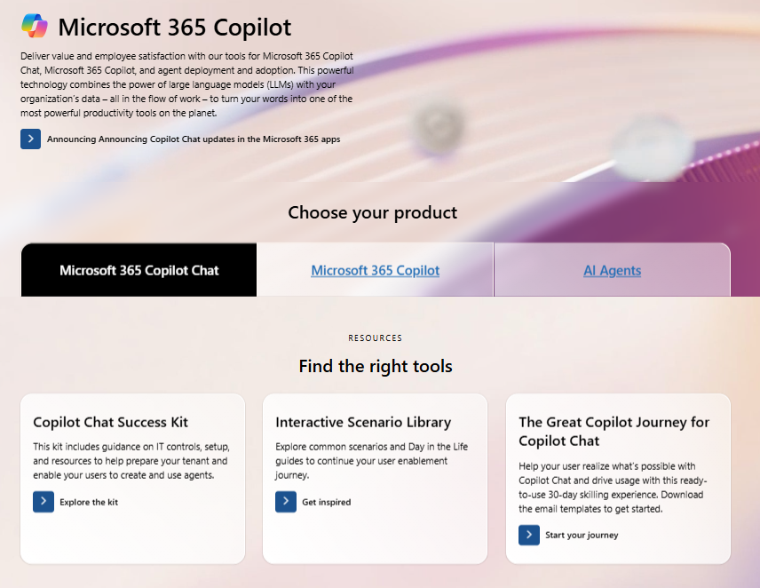

Copilot Chat Adoption Hub
adoption.microsoft.com/copilot-chat/
Notes:
Copilot Chat Success Kit & Support Resources
Introduction
“The Adoption Hub has content organized by role and adoption stage to make it easy to find what you need.”
Key Points to Cover
Copilot Chat Success Kit:
“There’s a Copilot Chat Success Kit available, which is a great resource for organizations looking to deploy Copilot Chat. It includes helpful materials like IT controls guides, user onboarding email templates, a trainer kit, user training guides, handouts, and links to other useful resources.”
“We also have great programs like the Great Copilot Journey to help your users make Copilot a habit and the Scenario Library to learn how to improve your key business processes with Copilot.”
“Next, we’ll look at how to access Copilot Chat on your mobile device and wrap up with final tips.”

Slide 19
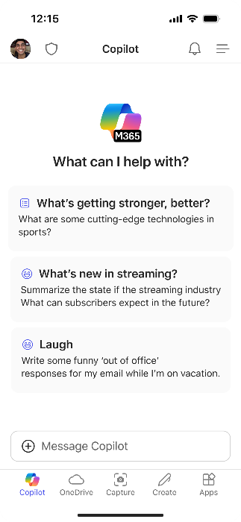

Use Copilot Chat on the go
Download the Microsoft 365 Copilot mobile app and sign in with your work or school account to access Copilot Chat
Notes:
Speaker Notes: Copilot Chat on Mobile Devices
Introduction
“Before we finish, let’s talk about how you can use Copilot Chat on your mobile device.”
Key Points to Cover
Mobile Access:
“Copilot Chat isn’t just for your desktop or laptop—it’s also available on mobile devices.”
“You can download the Copilot Chat app using the QR code provided on this slide.”
“Having Copilot Chat on your phone means you can get quick answers, summaries, and support wherever you are—even outside the office.”
Practical Benefits:
“This is great for staying productive on the go, resolving questions in meetings, or even settling debates at a restaurant!”
“You’ll have the same secure, enterprise-grade experience as on your desktop, with all your data protected.”
Encourage Experimentation:
“If you haven’t tried Copilot Chat on mobile yet, I encourage you to download it and explore its features.”
“It’s a handy way to keep Copilot close at hand for work and personal use.”
Wrap-Up
“That brings us to the end of our session. Thank you for participating and exploring Copilot Chat with me today.”

Slide 20
Thankyou !

